Slide 2
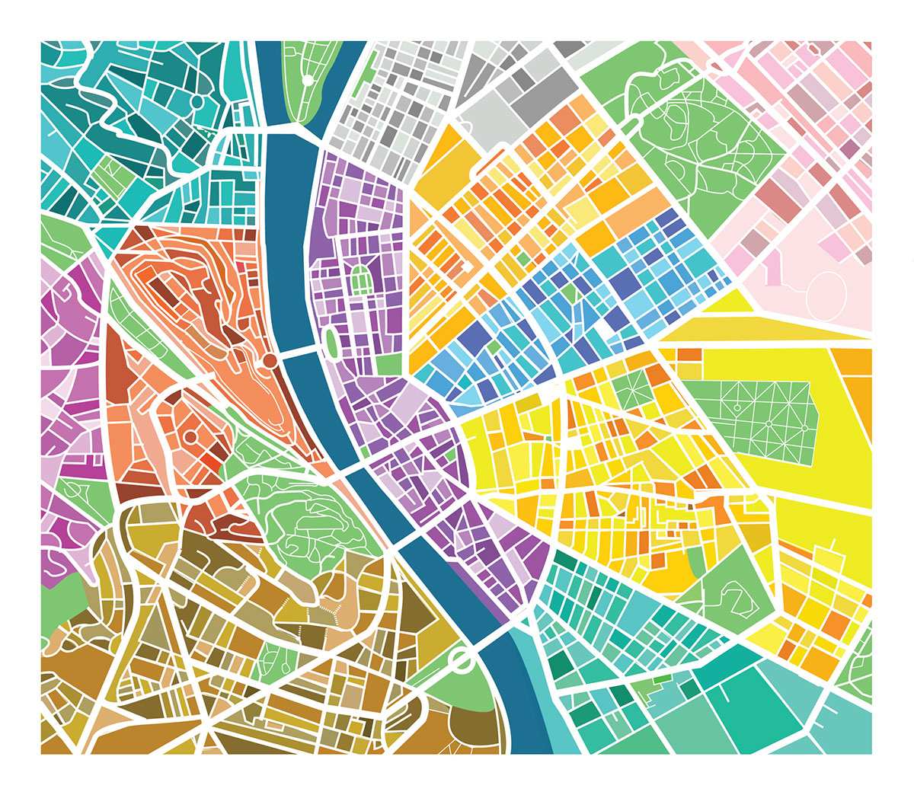
WEEKEND OF OPEN HOUSES - BUDAPEST A COMMUNITY FESTIVAL CELEBRATING THE CITY’S HERITAGE AND VALUES
A COMMUNITY FESTIVAL CELEBRATING THE CITY’S HERITAGE AND VALUES

Slide 3
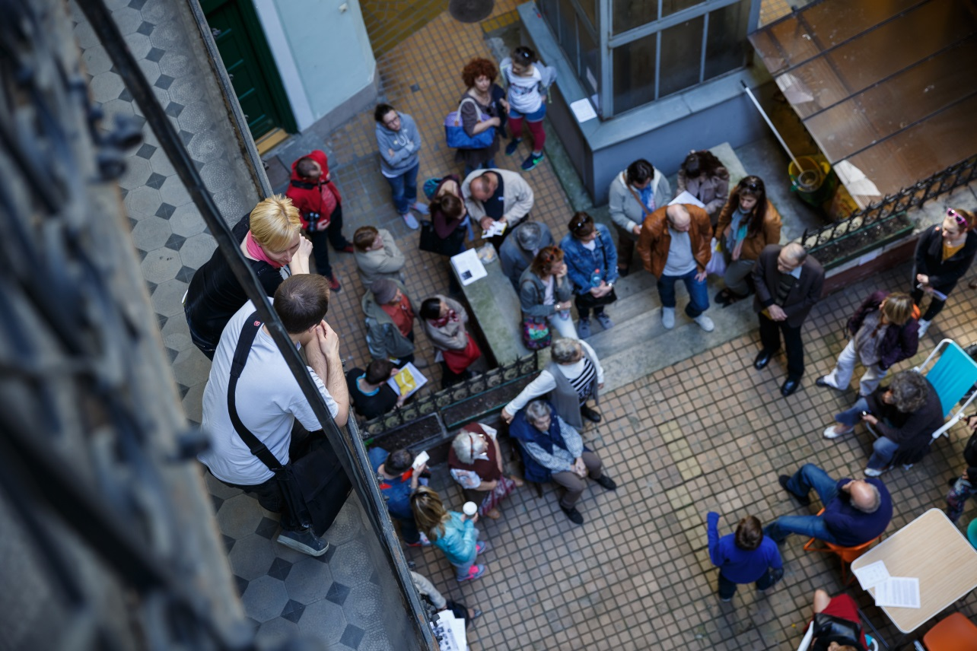
The festival is a 2 days long program for celebrating Budapest buildings by the cooperation of volunteers, locals and residents.
reform the urban community co-existence
change the relationship between the city and its residents
help the crowds to become more responsible citizens
encourage the bottom-up and civic activism

Slide 4
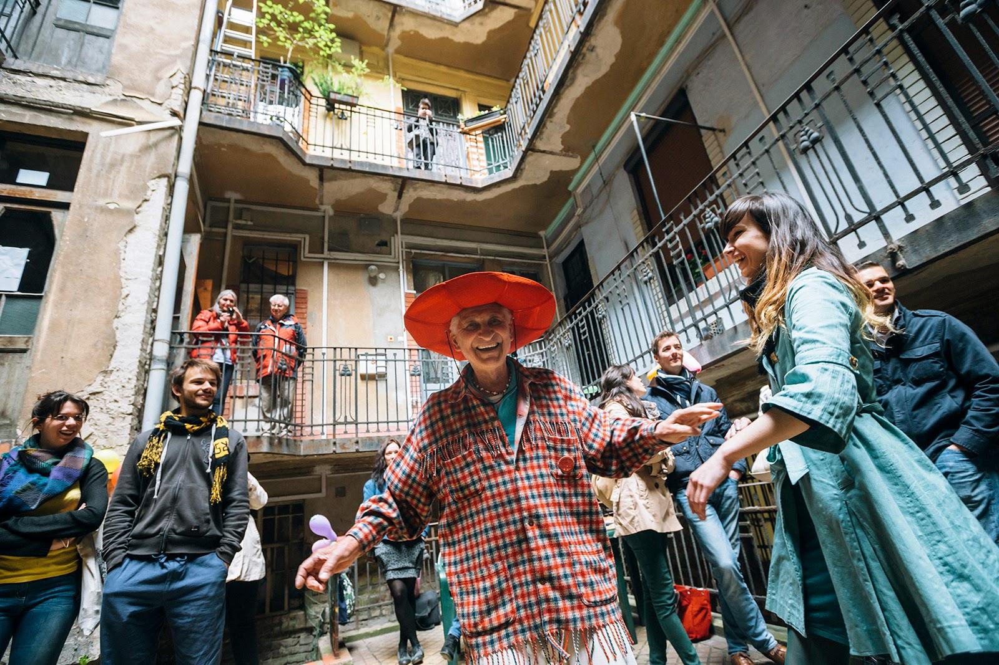
PROCESS Gather likeminded volunteers Use built environment as a tool Address the residents Research Open the doors Facilitate and coordinate
Achievements
Growing number of visitors
Awareness
Government interest
Brand

Slide 5
ISSUES / LESSON LEARNED Ignorance Financial and social sustainability Professional content implementation Passive mindsets Lack of institutional support Community building

