Slide 1
UIA and Housing for all

Slide 2
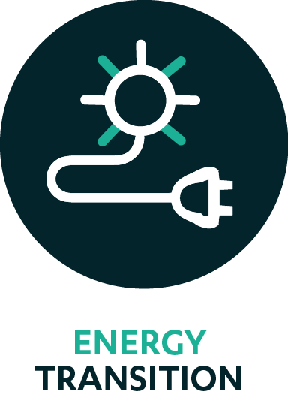
City of Viladecans: VILAWATT
ERDF budget: € 4 269 862.80
7 partners: including energy agencies, SMEs and a non-for-profit association
The VILAWATT project seeks to secure a stable energy transition process through deep energy renovation of residential buildings. The project will create an innovative Public-Private-Citizen governance Partnership structured around three main pillars.
First, a Local Energy Operator will be established to act as a local energy supplier and renewable energy producer. An Energy Savings Company, offering renovation and energy saving services to its members (the municipality, businesses and citizens) will be created. Finally, a financial mechanism to capitalise energy savings will be used by the new entity to further invest in deep energy renovations in the municipality. A new energy currency linked to the savings will work as an incentive for energy efficiency and as a mechanism to increase the economic capacity of vulnerable groups.

Slide 3
City of Antwerp: CURANT
ERDF budget: € 4 894 303.32
6 partners: including healthcare association, NGOs and a higher education and research institute
The CURANT project seeks to provide integrated services for unaccompanied young refugees once they reach adulthood and are no longer entitled to benefit from social protection as an unaccompanied minor. It will combine co-housing and social integration schemes with volunteer buddies (young local residents aged 20-30 years old) for 1-1 integration and circular integrated individual trajectories.
75 affordable co-housing units for both unaccompanied young adults and buddies will be made available in the city. The trajectories of the young refugees involved will be treated in all their complexity instead of focusing separately on different components. A guaranteed, safe, affordable and quality place to live will pivot around a circular set of social services including language courses, training and health care.

Slide 4
City of Athens: Curing the Limbo (shortlisted)
ERDF budget: € 4,999,748
5 partners: including a metropolitan agency, NGOs and a higher education and research institutes
The Curing the Limbo project targets newly arrived refugees and vulnerable locals that are unemployed and without a role in society as well as tackling the issues surrounding the large number of buildings that have become vacant since the economic crisis.
The project will capitalise on the strong civil society in Athens to help them overcome the state of inertia they find themselves. The city will pilot different and tailored pathways to access affordable housing. A financial scheme for renovation and refurbishment of vacant buildings will be combined with activation schemes for refugees (housing in exchange for limited hours of community service, plus language learning, psychological support as well as knowledge on their rights and duties).

Slide 5
Housing in the 3rd UIA Call for Proposals
3rd Call topics: Housing, Air Quality, Climate Change, Jobs and Skills
Budget: approx. 100 ml €
Timeline:
Launch: December 2017
Applicant Seminars: January/February 2018 (Bucarest, Zagreb, Malmo, Bruxelles)
Deadline: April 2018
Final selection: October 2018
Focus on Housing:
increase housing affordability
increase energy efficiency, reduce CO2 emissions
promote efficient and sustainable use of building land and prevent urban sprawl
innovative financing schemes through public-private partnership
efficient use of resources
brownfield re-development
housing refurbishment
better access to affordable, quality housing and social housing
housing solutions for different phases of life
new needs of new types of families; collaborative housing; specific needs of vulnerable groups.

Slide 6
Main features of UIA projects
Requirements:
Be related to sustainable urban development
Be of relevance at Union level
Support the thematic objectives and investment priorities for ERDF
Characteristics:
Innovative: To what extent the project proposal is a new solution that has the clear potential to add value?
Built and delivered in partnership:To what extent is the involvement of key stakeholders relevant for the implementation of the project?
With measurable results: To what extent will the project deliver measurable results?
Transferable: To what extent will the project be transferable to other urban areas across Europe?
Of good quality:To what extent is the work plan realistic, consistent and coherent? To what extent is the budget coherent and proportionate?
.6
Notes:
Main messages
Innovation
Stress innovation can be process, product and/or service – but should be the solution to address the challange identified
Stress « solution never been tested before in Europe »
Stress absolute (at EU level) versus relative (local level) concept of innovation
Stress responsibility for benchmark
Stress projects are normally complex set of actions. Importance that most innovative elements are central
Partnership:
Stress local dimension of partnership
Stress importance of involving « unusual suspects »
Stress co-design and co-implementation
Stress flexibility offered by UIA
Measurability:
Stress importance in the framework of experimention
Stress potential innovation in measurability
6

