Slide 2
Call for
Transfer networks
URBACT CITY FESTIVAL 2017

Slide 3

Following the successful Call for Good Practices URBACT launches the
Call for up to 25 Transfer Networks

Slide 4
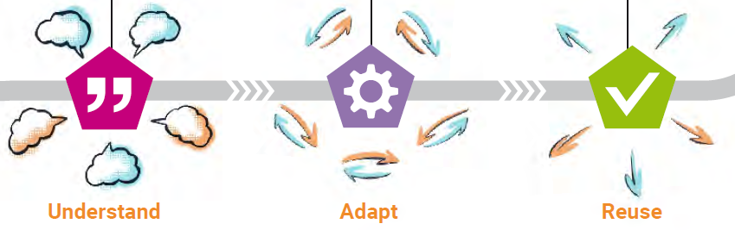
Why?
Good Practice - a successful experience which has been tested and validated deserves to be shared so that a greater number of cities can adopt it…
Specific objective:
To improve the implementation of sustainable urban strategies and action plans in cities
You can learn more about the good practice transfer experience from URBACT articles about URBACT Transfer Pilots available via: urbact.eu
Notes:
Across Europe and increasingly on a global scale, cities face comparable problems. For more than a decade URBACT has invested in city networks designed to tackle shared challenges using the URBACT method. Now URBACT Programme is launching its first call for a new type of network, based on the transfer of good practice. These new networks acknowledge the huge potential for cities to collaborate and share effective solutions across Europe and beyond. This principle is important. It makes it clear that URBACT’s end goal is not the gathering of good practices, but their effective transfer across Europe’s cities.

Slide 5
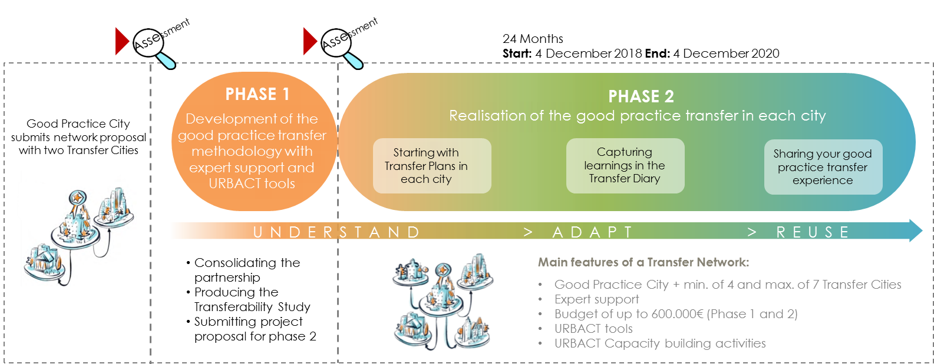
The 2-Phase Journey
6 Months
Start: 4 April
End: 4 Oct
Providing a clear description of the Good Practice
Assessing the transfer potential in each Transfer City
Notes:
Emphasize Phase 1 – development – assessing transfer potential
The Guide For Partnership enlargement and the Transferability Study will be available for approved Transfer Networks in Phase 1
Phase 2 expected results at local level
The Guide For The Transfer Plans and Transfer Guide will be available during phase 1 for approved Transfer Networks
How many Transfer Networks are expected to be financed in phase 1, and how many of these are expected to be financed in phase 2?
Up to 25 Transfer Network will be approved for Phase 1. Hopefully all Transfer Networks approved for Phase 1 shall continue to Phase 2 (depending on the quality of Phase 2 application).

Slide 6
Transfer Network
is for cities
1. Interested in transferring one of the 97 labelled URBACT Good Practices:
To tackle a specific policy challenge with an integrated and sustainable solution
To adapt and re-use a tested and effective practice in their own city context
as Transfer Cities
2. Awarded the URBACT Good Practice label:
To lead and mentor the process of understanding, adapting and reusing their good practice.
To refine and improve their own methodology through peer reviews and with the support of URBACT experts.
as Good Practice Cities
All of the 97 URBACT labelled Good Practices can be discovered on the following website: http://urbactgoodpractices.eu/
Notes:
Good Practice Cities will be also Lead Partners of Transfer Networks

Slide 7
Working with the URBACT method
Learning from peers across Europe & experimenting with tried and tested solutions
Enhancing capacities for policy-making and delivery
Transfer Cities: adapt and re-use in their own city context
Good Practice Cities: refine and improve their own methodology
Support from URBACT Programme
Validated URBACT experts, Programme Experts, URBACT Joint Secretariat, NUPs
Accessing financial resources for exchange and learning
Notes:
For Good practice city the opportunity to share the experience within the framework of a Transfer Network means the following:
An opportunity to lead and mentor the process of understanding, adapting and reusing the good practice.
Refining and improving its own methodology through peer reviews and with the support of an URBACT expert.
The learning captured with other partners could lead to a wider recognition of the potential for reuse of the good practice across Europe and beyond, therefore increasing the visibility of the city in the arena of urban practitioners and among URBACT partners (European Commission, Urban Innovative Action, European Investment Bank, UN Habitat, etc.).
Please refer to the GUIDE Section 1 for more information

Slide 8

Who is eligible?
Proposals for the Transfer Network can be submitted only by 97 URBACT Good Practice Cities as future Lead Partners of Transfer Networks.
Cities interested in transferring the Good Practice to their local context as Transfer Cities should first check if any of 97 Good Practices correspond to their needs and get in contact with them
Potential Transfer Cities shall be:
From one of the member or partner EU states
Cities, municipalities, towns
Infra-municipal tiers of government
Metropolitan Authorities and organized agglomerations
“Non-City”: Local agencies defined as public or semi-public organisations set up by a city
“Non-city“ partners cannot be proposed for the initial partnership – Phase 1 application.
But can join during Phase 1. More info available in the terms of reference of the call

Slide 9
Partnership
Partnership proposed for Phase 1 should comprise a Good Practice City and two Transfer Cities
Each Transfer Network in Phase 2 will comprise a Good Practice City and up to 7 Transfer Cities:
minimum 5 and maximum 8 partners including the Good Practice City as Lead Partner;
Include no more than 2 non-city partners (local agencies);
be composed of partners all coming from different Member/partner States;
Including:
a minimum of 2 partners from Less Developed regions where the total number of partner is 5;
a minimum of 3 partners from Less Developed regions where the total number of partner is 6 to 7 partners.
a minimum of 4 partners from Less Developed regions where the total number of partner is 8 partners.
Good Practice City can take part in another Transfer Network as Transfer City
Notes:
In how many proposals can a city apply in the call for Transfer Networks as partner?
One can indeed be involved in only 1 approved Transfer Network as Transfer City (transferring the good practice). Good Practice City (sharing the good practice) can be involved in another Transfer Network as a Transfer City.
In how many Transfer Network proposals can one be proposed?
One can be proposed in the initial partnership as a Transfer City in more than one Network proposals for Phase 1, however, we strongly discourage the commitment in several Network proposals due to high risk and eligibility problems multiple commitments could cause after the approval (High number of Transfer Networks approved (up to 25), small initial partnership with only 2 Transfer Cities).
Good Practice Cities are advised to check the commitment of possible Transfer Cities in other Network proposals and it is up to the Good Practice City to assess the risk by proposing the initial partnership with candidate Transfer Cities committed in several Network proposals.
Transfer Cities are suggested to minimalise the commitments in several network proposals and rather commit to join the complete partnership for Phase 2 (All approved Networks for Phase 1 will need to enlarge their partnership with at least 2 Transfer Cities to be proposed for Phase 2).

Slide 10
Good Practice Cities choosing right Transfer Cities
Does the good practice address an issue faced by the potential Transfer City?
Does the Transfer City have an evident commitment to tackling the challenge?
Does the Transfer City have a commitment to the adaptation and transfer of the Good Practice?
Does each partner have a commitment to resourcing their network activities as required, as well as the transfer costs?
Is the proposed partnership eligible in the framework of the present Call for Proposals?
Notes:
How will the Good Practice Cities select the Transfer Cities to proposed in partnership for Phase 1?
The selection of Transfer City candidates to be proposed in the initial partnership for Phase 1 will be based on the judgement of Good Practice Cities. The Guide to Transfer Networks provides the recommendations for setting up the partnership for Phase 1.
It is also suggested that Good Practice Cities already make the shortlist of suitable Transfer City candidates that can join the Network during Phase 1 when network will be enlarging their partnerships from 3 to up to 8 partners including the Good Practice City).

Slide 11
Financial resources
The maximum budget of a Transfer Network will be up to EUR 600 000 (Phases 1 and 2)
The total eligible cost for the Phase 1 of a Transfer Network is set at a maximum of EUR 80000.
The European Regional Development Fund (ERDF) co-finances network costs, with the following co-financing rates:
70% for cities located in more developed regions
85% for cities located in less developed and transition regions
Partners from Switzerland will be co-financed at up to 50% by Swiss national funds
Partners from Norway may participate in Transfer Networks at their own cost for this call
The map of regions for co-financing rates of Structural funds is available via:
http://ec.europa.eu/regional_policy/sources/graph/poster2014/eu28.pdf
Notes:
Does the budget for Transfer Network covers also costs of good practice adaptation in Transfer Cities?
The budget for Transfer Networks covers exchange and learning activities in relation to the transfer of good practice as well as the expertise support for the effective adaptation or improvement of the good practice.

Slide 12
Expertise envelope
Each approved Transfer Network will have an additional allocation of EUR 109500 (146 days) to cover the costs of expertise over the lifetime of the network (Phase 1 and Phase 2).
For Phase 1, the expertise allocation available for each Network will be limited to EUR 19500 (26 days of expertise)
All experts must be chosen from the URBACT III pool of validated experts: http://urbact.eu/experts-list
All partners have the possibility of using additional expertise support through the Network Budget (Budget line - external expertise). Not necessarily validated URBACT experts.
Notes:
The call for URBACT III pool of validated experts is open on a constant basis.

Slide 13
Expertise support
Phase 1 – Network Experts:
Lead Partners must propose 3 Experts
Both Lead and Ad hoc validated URBACT experts can be proposed as Experts in phase 1*
All Lead Experts and Ad hoc Experts currently appointed in ongoing URBACT networks can be proposed for expertise services in Phase 1 of Transfer Networks
Assessment panel will make recommendations for contracting the “right” expert for phase 1
*Check the Guide for tips on choosing the right expert profile
Phase 2 – Network Lead Experts and Ad hoc Experts:
Network Expert in phase 1 can be proposed as Lead Expert in phase 2 if the performance was positive
All networks in Phase 2 can have Ad hoc Experts in addition to the Lead Expert

Slide 14
Submission procedure
Candidates interested in transferring the Good Practice as a Transfer City, should contact the URBACT Good Practice City to express their interest in transferring the practice to their local context*. All contacts are available on the URBACT Good Practices website.
Good Practice Cities ready to submit the proposal for Transfer Network should send the request via email: TN@urbact.eu The URBACT Joint Secretariat will take care of opening the online application form in SYNERGIE-CTE for them.
The deadline for the online submission of the Phase 1 Applications is 10 January 2018, 15.00 CET.
*Previous experience shows that the creation of partnerships takes place in the very beginning of the calls therefore candidate cities should get in contact with Good Practice Cities as soon as possible.
URBACT Secretariat will indicate (on the online Good Practice Profiles) when the Good Practice City will stop accepting interests from Transfer City candidates.
Notes:
We are a Good Practice City and we do not want to share our good practice in the framework of Transfer Network call. What should we do?
Please contact the URBACT Secretariat (TN@urbact.eu) which will upon your request make an indication on your online Good Practice Profile that you are not accepting any expressions of interest by potential Transfer Cities in relation to the call for Transfer Networks.
We are a Good Practice City ready to submit the Transfer Network proposal for Phase 1 but we are still receiving expressions of interest from cities wanting to transfer our good practice. What should we do?
Please contact the URBACT Secretariat (TN@urbact.eu) which will upon your request make an indication at your online Good Practice Profile that you are not looking for potential Transfer Cities anymore.
We are interested in transferring one of the 97 URBACT good practices. How do we know which URBACT Good Practice City is committed to transfer their good practice in the framework of Transfer Network?
All 97 URBACT Good Practices are eligible good practices for the Transfer Network call. Each Good Practice profile has an indication whether the Good Practice City is interested or not in potential Transfer Cities.

Slide 15
Assessment process
Assessments* of Transfer Network proposals will be carried out by the External Assessment panel
*Layout of the application form and the criteria available in the terms of references of the call
Approval by the Monitoring Committee 4 April 2018
Formal starting date of Phase 1

Slide 16
Useful resources
Reference documents:
The Terms of References
The Guide to Transfer Networks – Phase 1
The Programme Manual Factesheet 2C – Transfer Networks
All links available on the dedicated webpage: http://urbact.eu/open-calls-networks
URBACT Secretariat
  For all questions concerning the Good Practice Call, applicants are invited to contact the URBACT Secretariat on the following email address - TN@urbact.eu
URBACT articles on our website & blog
If you want to learn more about good practice transfer experiences, please visit our website and blog which offers a great variety of articles organised by topics:
http://urbact.eu/
http://www.blog.urbact.eu/
Articles:
http://urbact.eu/good-practice-call-difference
http://urbact.eu/it-time-cities-share-their-good-practices-now-more-ever
http://urbact.eu/cities-and-good-practice-lessons-urbact-transfer-pilots
http://urbact.eu/two-cities-united-love-good-food
Notes:
All candidates should read the Terms of References and the Guide together. Only by reading both one can understand the whole picture.

Slide 17
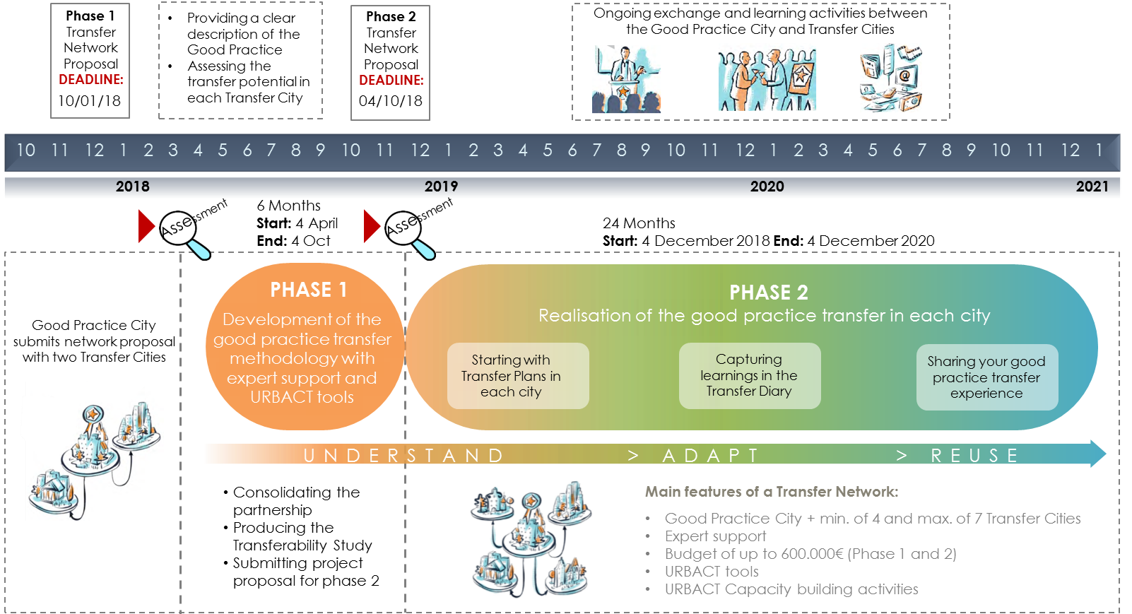
The 2-Phase Journey
Notes:
Emphasize Phase 1 – development – assessing transfer potential
The Guide For Partnership enlargement and the Transferability Study will be available for approved Transfer Networks in Phase 1
Phase 2 expected results at local level
The Guide For The Transfer Plans and Transfer Guide will be available during phase 1 for approved Transfer Networks
How many Transfer Networks are expected to be financed in phase 1, and how many of these are expected to be financed in phase 2?
Up to 25 Transfer Network will be approved for Phase 1. Hopefully all Transfer Networks approved for Phase 1 shall continue to Phase 2 (depending on the quality of Phase 2 application).

Slide 18
www.urbact.eu
We are looking forward to
driving change for better cities with you!

