Slide 2
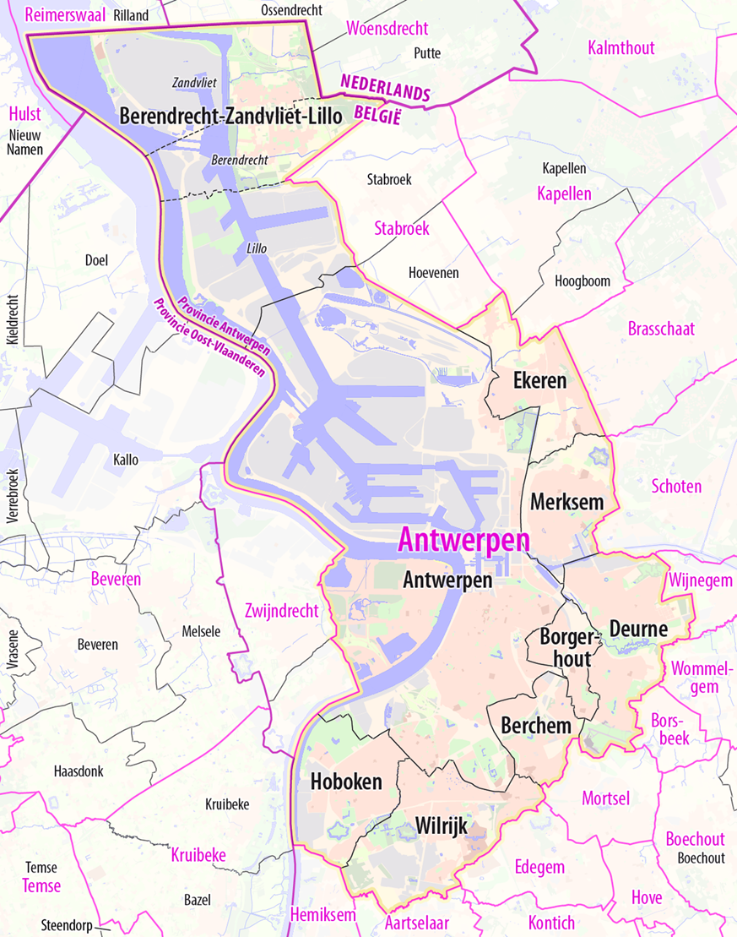
Pop up to Date Antwerp-Berchem

Slide 3
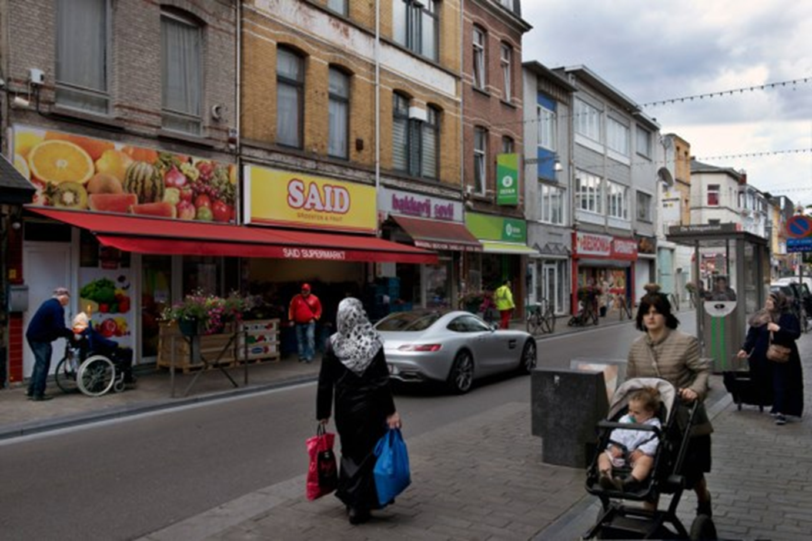

Slide 4
Pop up to Date: from vacant to vibrant
Biennal since 2012
Converting 6-10 empty shops to creative hubs
Supporting creative start-ups
Boosting the neighbourhood - tackling deprivation

Slide 5
^{Project results}
70% of the empty shops get new allocation shortly after the project
60% of the creative start-ups open a permanent shop,
20 % proceeds it’s activities free-lance
Boosting the image of the neighbourhood and local economy
Everybody wins
.

Slide 6
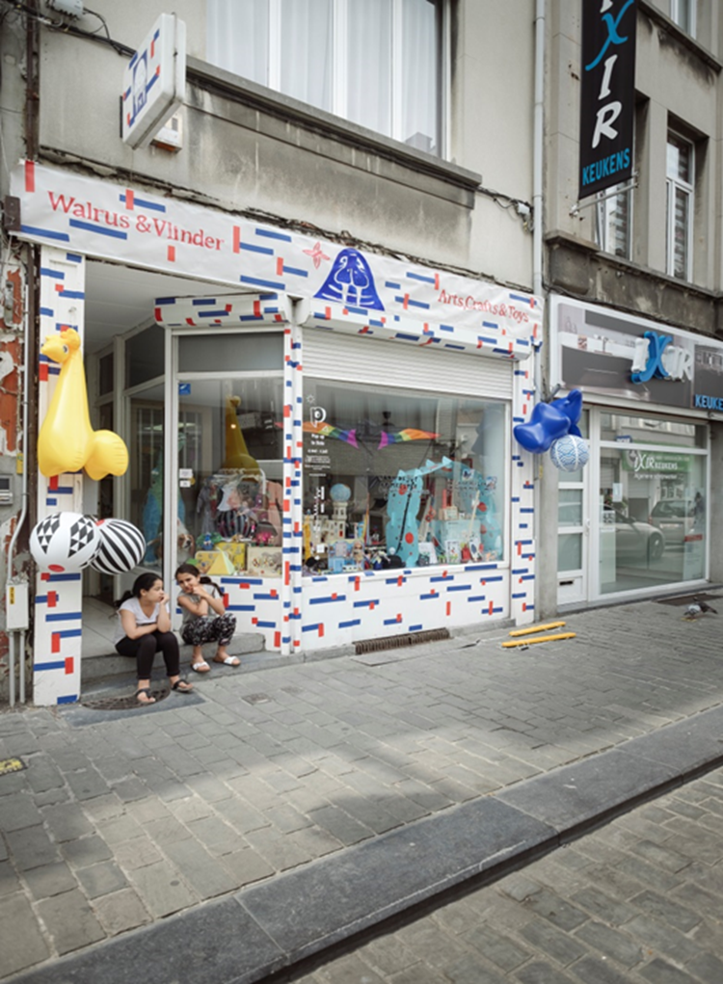
Before After

Slide 7
^{Challenges}
Tracing shop-owners and persuading them
Short term preparations
Vague legislation
Preserve positive dynamic after two months of
BUT IT’S WORTH IT!
.

