Slide 2
^{ENTREPRENEURSHIP PANEL}
MODERATOR: JIM SIMS
QUESTION FACILITATOR: ALISA ALITI VLASIC
How to identify your city's business assets? Can culture be a good business? What kind of business support for social economy?

Slide 3
^{PANEL Q&A}
MODERATOR: JIM SIMS
AUDIENCE FACILITATOR: ALISA ALITI VLASIC

Slide 4
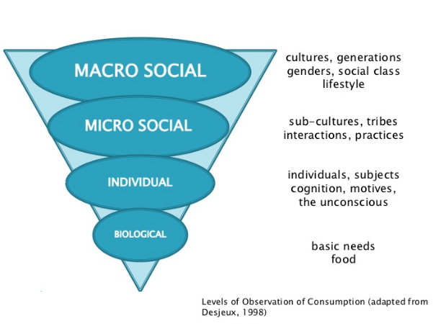
To change mass behaviour we need to influence the social system

Slide 5
Selecting your mix of entrepreneurship interventions and getting the system to work together
Social Policy Interventions
Residents
Consumer Markets
Business Markets
Inward Investors
(Overseas Businesses)
High Value Firm Creation
International Visitors
Creative Residents
Out of School Activities
PATHWAYS TO ENTREPRENEURSHIP
Indigenous Business Community
Technical School
SKILLS PIPELINE
Vocational School
Grammar School
Apprenticeships
Start Up Support
Tourism Promotion
Inward Investment
Business Support
Universal ‘for all’ services
Vocational College
Skills University
Suppliers of Business Services
(Finance, Accountant, Premises etc)
Sector Group 1
Sector Group 2
Research University
Sector based initiatives
THE ATTRIBUTES OF THE CITY
© The Service Design Company

Slide 7
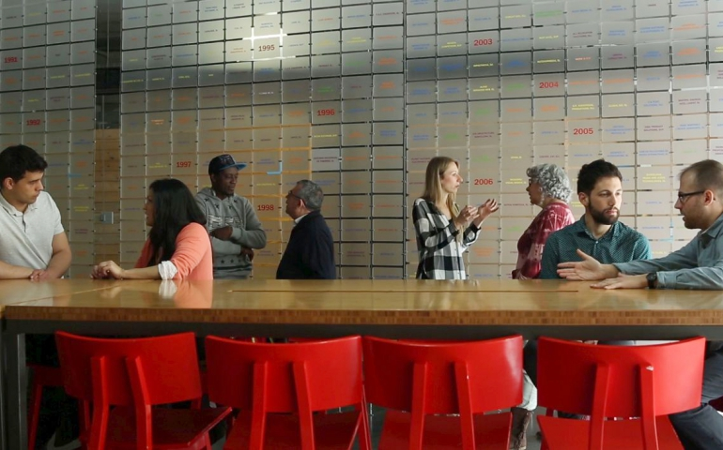
INCLUSIVE ENTREPRENEURSHIP MODEL
BARCELONA / SPAIN
Lowering barriers to make entrepreneurship an option for everyone
Link

