Slide 2
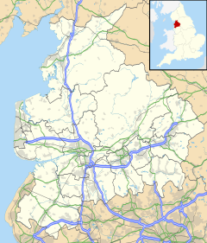
Progressing procurement practice through spend analysis
Preston and Lancashire anchor institutions using spend analysis to improve procurement practice and benefit the local economy
Preston, UK

Slide 3
Progressing procurement practice through spend analysis
What?
Co-ordinated collection of spend data between 6 major anchor institutions within the Preston Functional Area
Collective spend is substantial
Appropriate management and direction of the spend will yield socio-economic benefits
Manage regional leakage

Slide 4
Progressing procurement practice through spend analysis
^{How?}
Locally, this is facilitated by regular anchor institution meetings, ad hoc communication, and coordination of spend analysis by a single third party
^{Generally,} this has achieved a standard approach, and a consistency of analysis and progress reporting over the 5 years of the project
Specifically, this has measured an increase in
local spend from 5% (2012) to 18% 2016) and
regional spend from 39% (2012) to 79% (2016)

Slide 5
Progressing procurement practice through spend analysis
Problems?
Appropriate stakeholders
Strategic drivers
Multi organisation / multi sector
Manage regional leakage

Slide 6
Lessons learned
Spend data is collected in various areas within different organisations
Spend data will therefore take different forms
Spend analysis takes time
Different organisations will be able to apply a range of proactive economic measures

