Slide 1
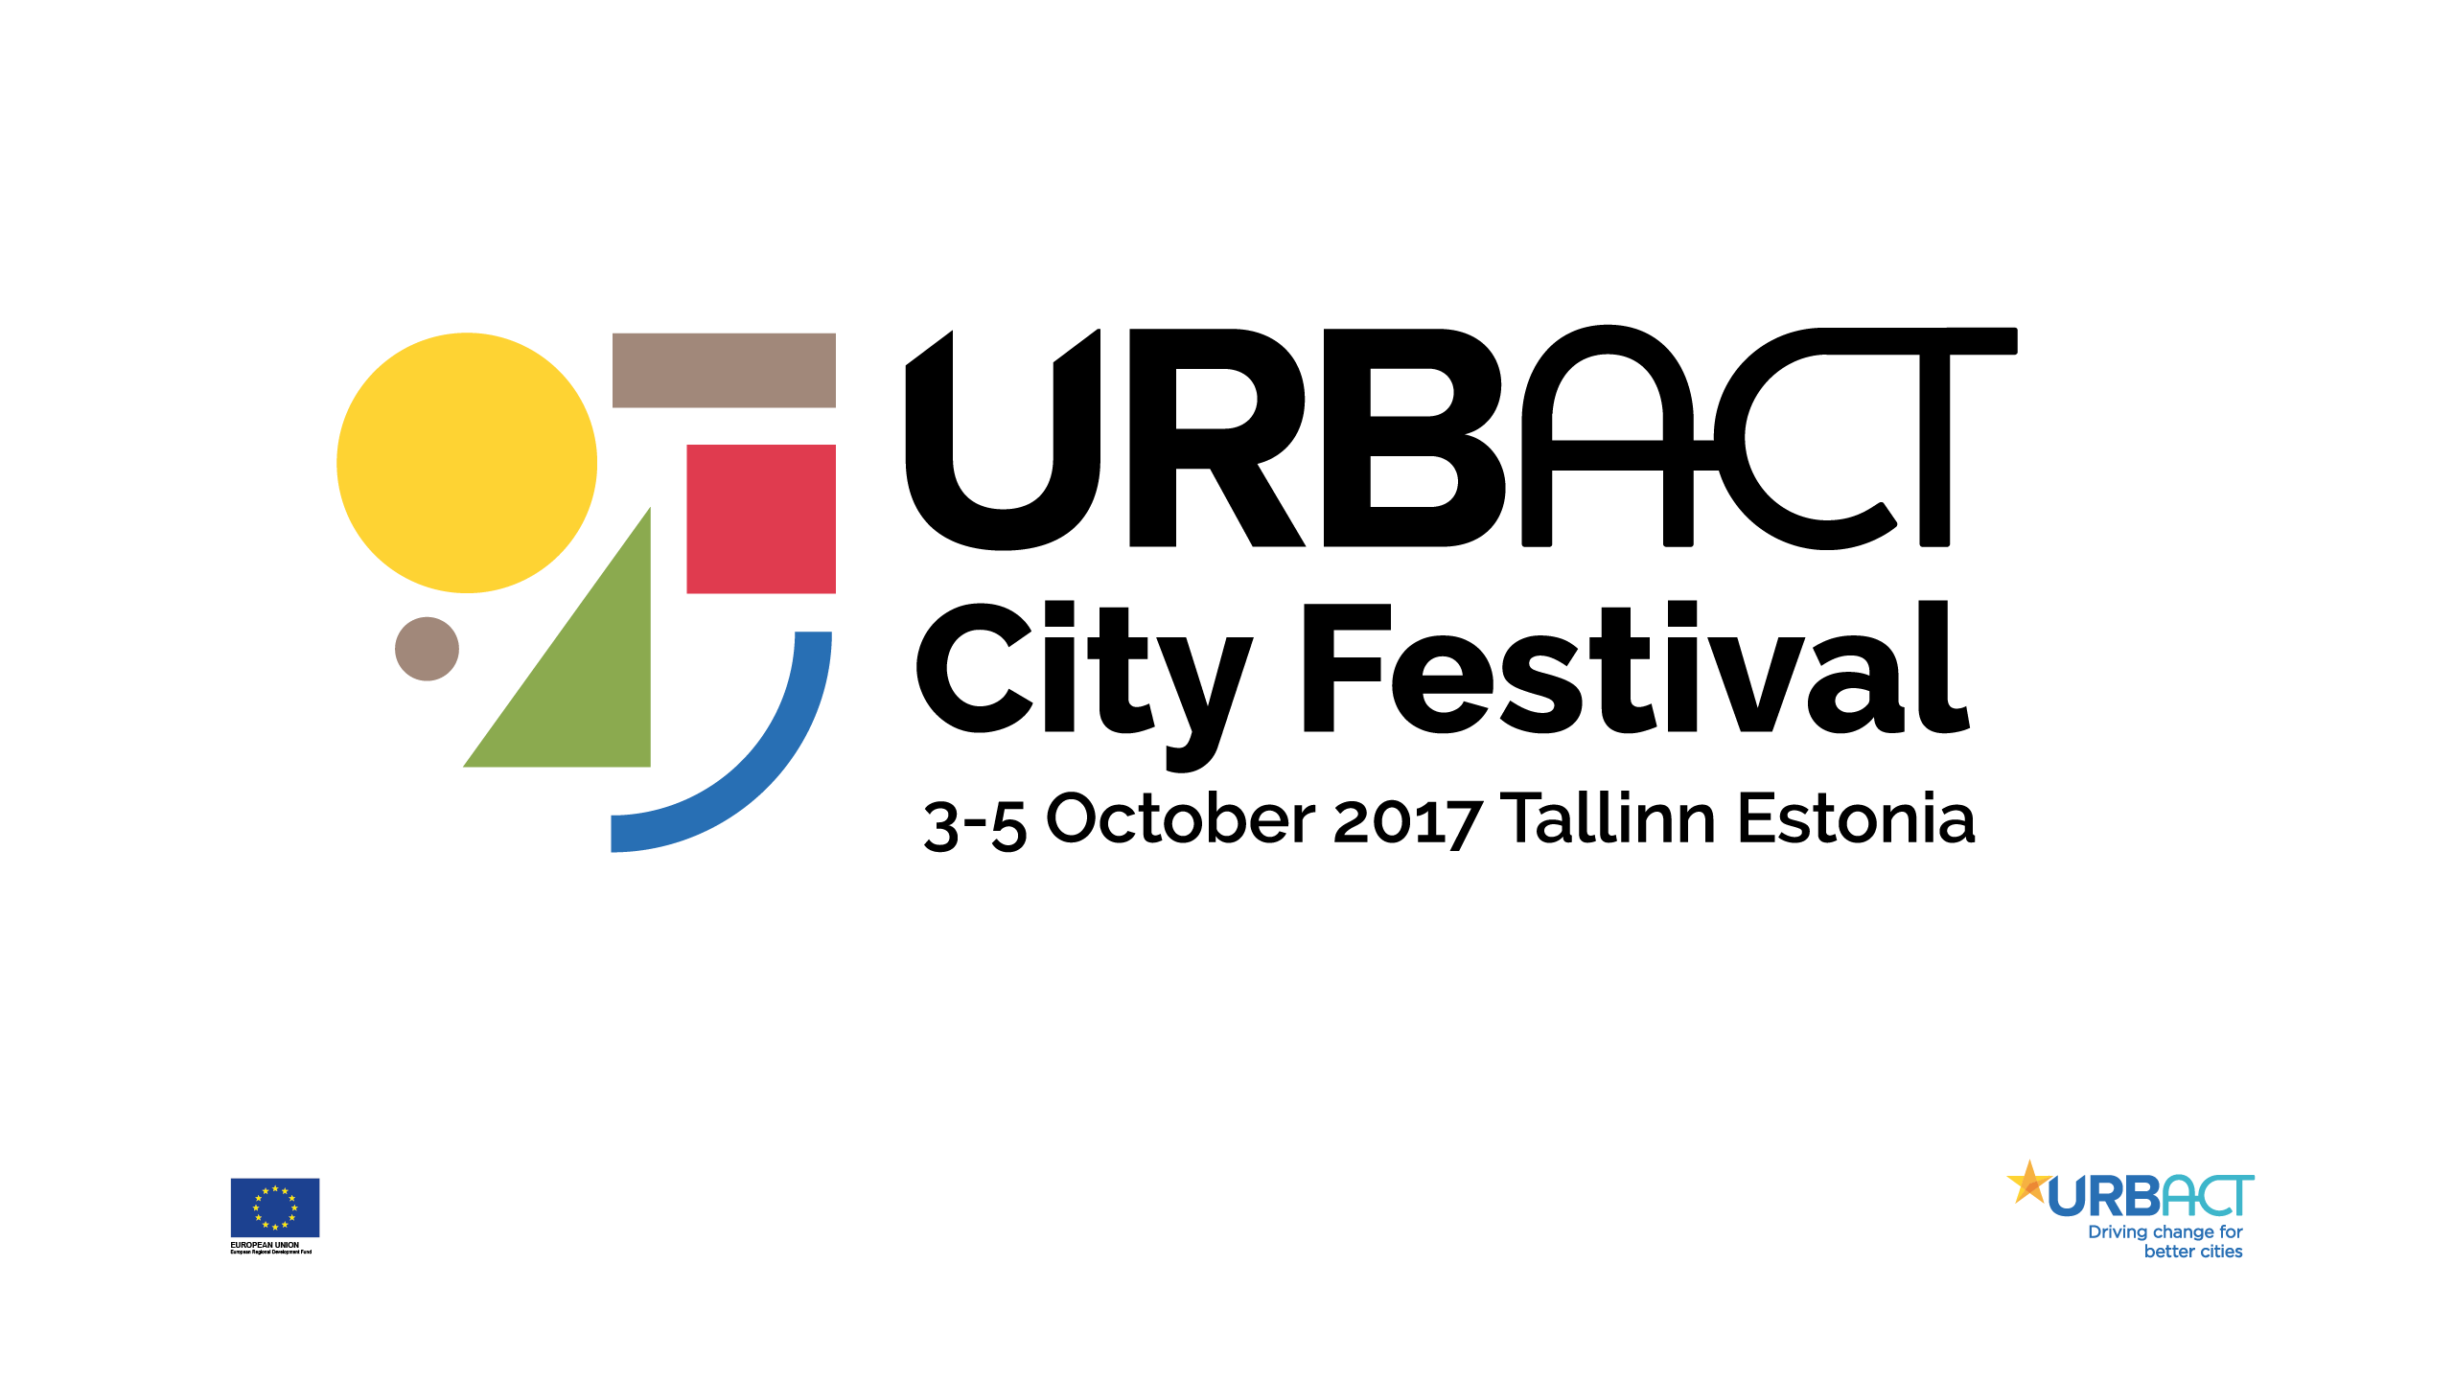

Slide 2
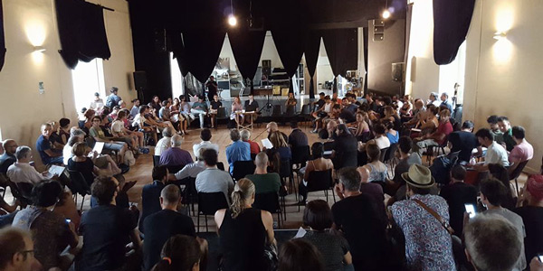
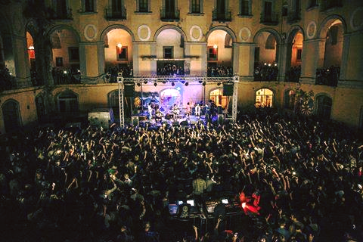
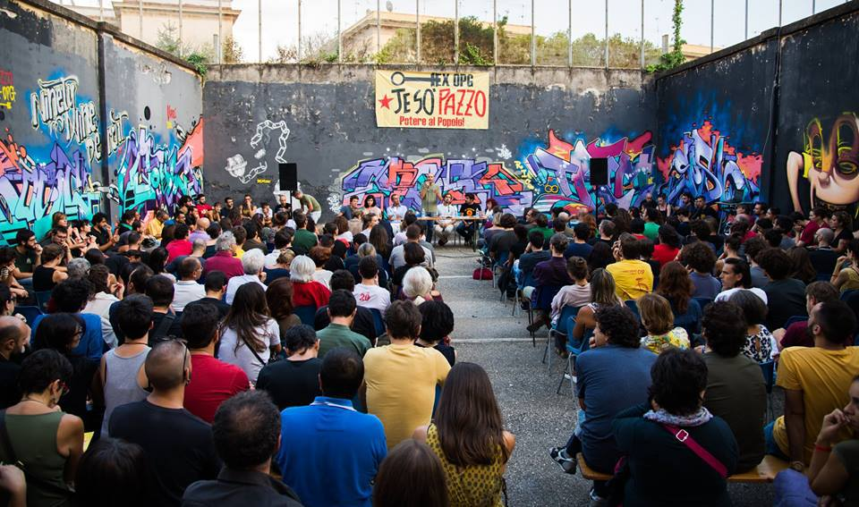
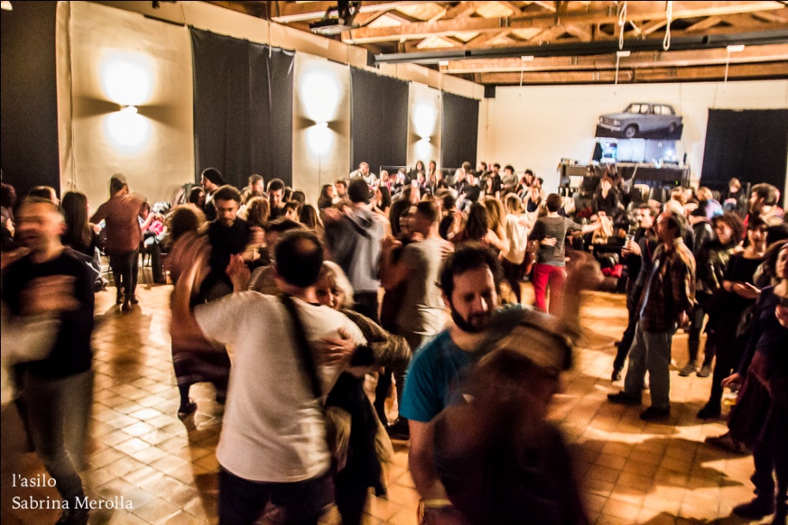
^{Lost & found} Civic uses and new policy tools for the community

Slide 3
^{The problem addressed}
^{Lost & found} Civic uses and new policy tools for the community
By revisiting the outmoded institution of civic use, the good practice proposed by the Naples city council aims at guaranteeing the collective enjoyment of common goods - such as cultural and natural heritage, essential public services, public spaces, water, etc. - through an administrative process that strengths participation and allows fair use of these resources.
In particular, the good practice aims at making spontaneous bottom-up initiatives recognizable and institutionalized, ensuring the autonomy of both parties involved: the proactive citizens and the institutions.
The first good to be recognized as a common was the Ex-Asilo Filangeri, a complex that in 2012 had been occupied by a group of art and culture professionals protesting against the restoration and new abandonment of the premises: acknowledging its civic use, the City Council of Naples ratified the resolution n.400/2012 and identified this building as a “place with a complex use in the cultural field, and whose spaces are used to experiment in participative democracy”.

Slide 4
^{How it works}
^{Lost & found} Civic uses and new policy tools for the community
The urban civic use regulation recognizes the autonomy of the management system adopted by the users. The public administration waives completely the role of top-down manager and, with a horizontal subsidiarity mechanism, acts like a guarantor and takes its own burdens and responsibilities related to the operation.
Re-use produces high social and cultural value created and positive economic externalities.
Uses must involve not only the users of the space but the whole neighborhood and city,
In return the administration contributes to the operating expenses to ensure an adequate accessibility of the property and general safety conditions: maintenance, cleaning, electricity consumption and surveillance.
An ah-hoc unit -technical level- and a political coordinator are in charge of promoting and fostering an integrated approach (particularly, between municipal departments involved or other institutions).

Slide 5
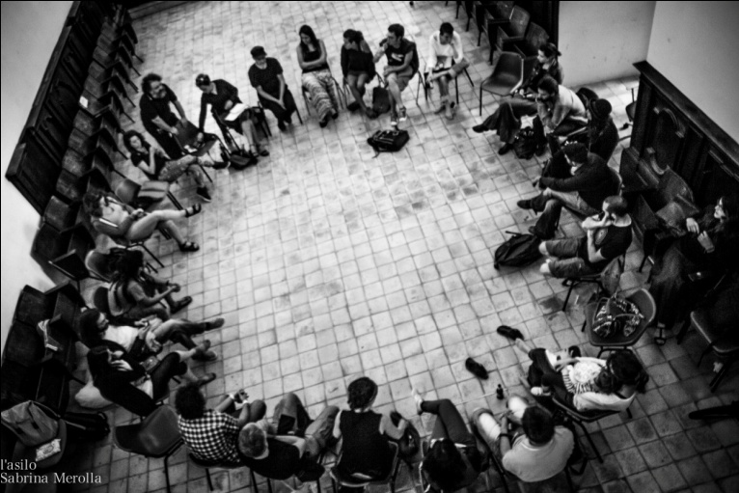
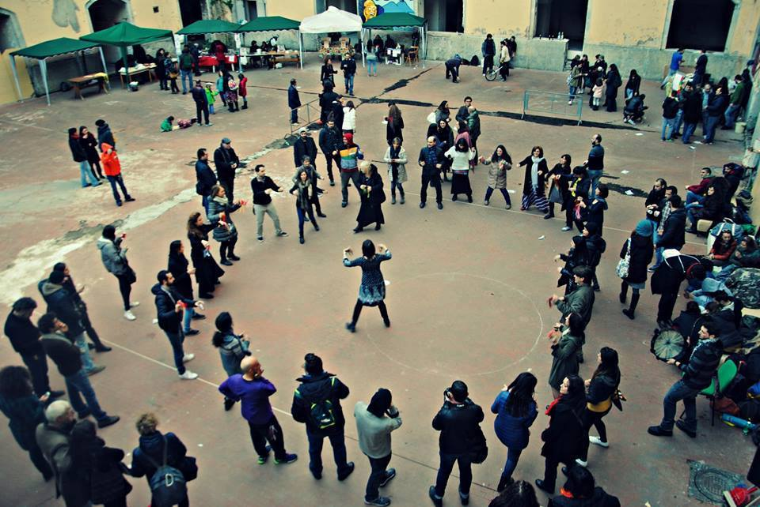
^{Civic development environments}
^{Lost & found} Civic uses and new policy tools for the community
Aim is to make use of a place identified as a common good
It has to be free and guaranteed to all,
The management model must be based on a strong participatory process.
Example Ex Asilo Filangieri, is managed by three main open organisms, the "Management assembly", the "Steering assembly“ and the “Board of Trustees”:
There have been 200+ weekly open meetings,since 2012, and several working groups for the implementation 900+ events and activities with 18,000 attendances.
Transparency - strong bond between the citizens, and has narrowed the gap between artists, academics and citizens.
Donations, voluntary contributions, self-financement or other forms of social pricing are permitted for the initiatives

Slide 6
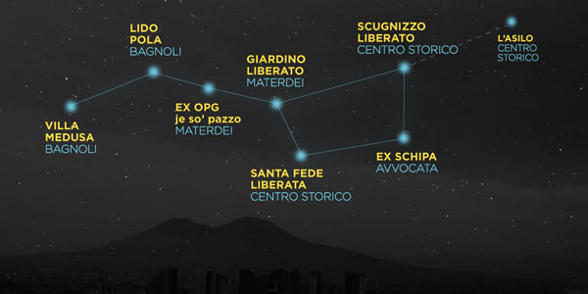
^{Main results achieved}
^{Lost & found} Civic uses and new policy tools for the community
The resolution, n.446/2016, recognized seven more public properties as “relevant civic spaces” to be ascribed to the category of common goods”. Their open and inclusive management model is plain by the data registered since 2012:
• 5,800 activities (1,500 days of theatre,
^{dance and music rehearsals);}
^{• 300+ exhibitions;}
• 250+ art projects, 300+ concerts;
• 200,000 users took part in the activities;
• 300+ debates, seminars, public meetings;
• 300+ musical groups and individual
musicians in rehearsals and concerts;
• free trainings for un-employed;
• free neighbourhood nursery service;
^{• free health services;}
^{• free school for migrants.}

Slide 7
Lesson learnt and future improvements
^{Lost & found} Civic uses and new policy tools for the community
Alternative democratic uses of public assets, that take in account local communities’ self organizational models, produced an increase of mutual trust and a valuable social/cultural income for the neighborhoods. Hundreds of projects came to life, breaking down the production costs by using free and shared spaces, resources, knowledge and skills, with several services provided at practically no cost.
The process could be easily adopted and upgraded in other cities with similar needs and contexts: the existence of a great number of underused public spaces and buildings, a strong community of citizens that needs/claims common space to improve their quality of life. Morover, it is based on largely shared ethical, legal and social values, already widespread in other countries.
On the other hand, a profitable exchange with other European cities could help to improve the policy framework, explore circular economy models for long-term sustainability, to enhance the system of shared responsibility in monitoring/evaluating activities and in managing the security of the sites.

