Slide 2
^{ENTREPRENEURSHIP PANEL}
MODERATOR: JIM SIMS
QUESTION FACILITATOR: ALISA ALITI VLASIC
How to identify your city's business assets? Can culture be a good business? What kind of business support for social economy?

Slide 3
Anastasia (Natassa) Kannavou
‎European Structural and Investment Funds Manager
^{MUNICIPALITY OF PIRAEUS}
^{kannavou@gmail.com}
www.pireasnet.gr / www.bluegrowth.gr

Slide 4
Link

Slide 5
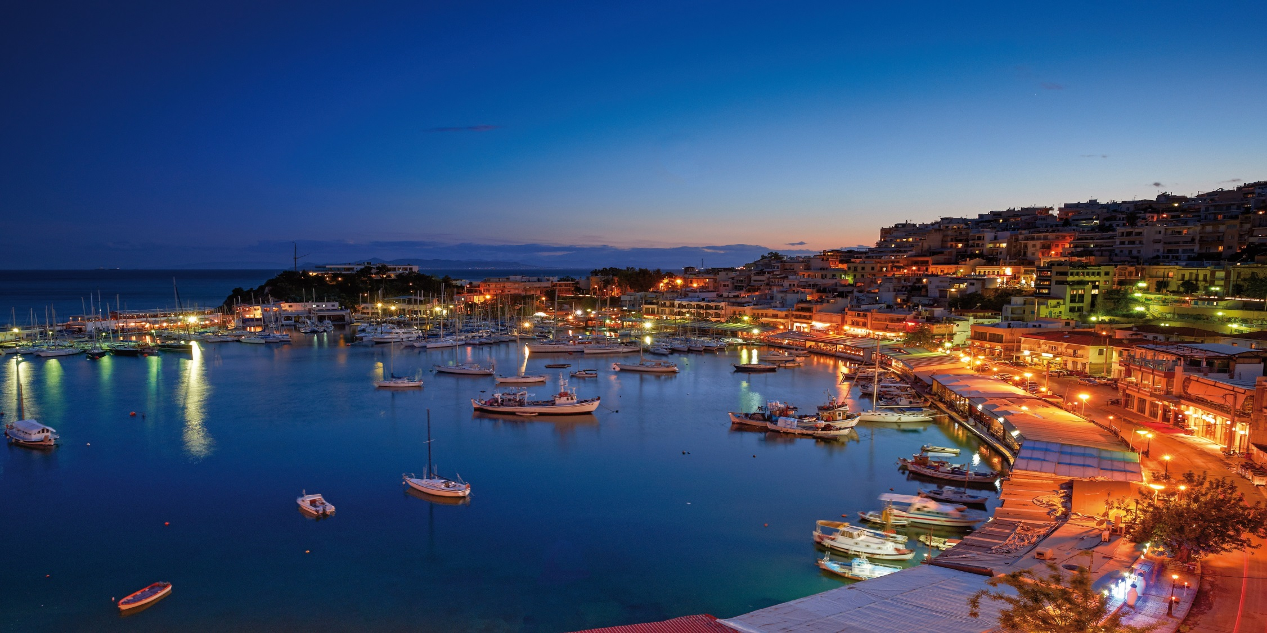
^{PIRAEUS} ^{GREECE}

Slide 6
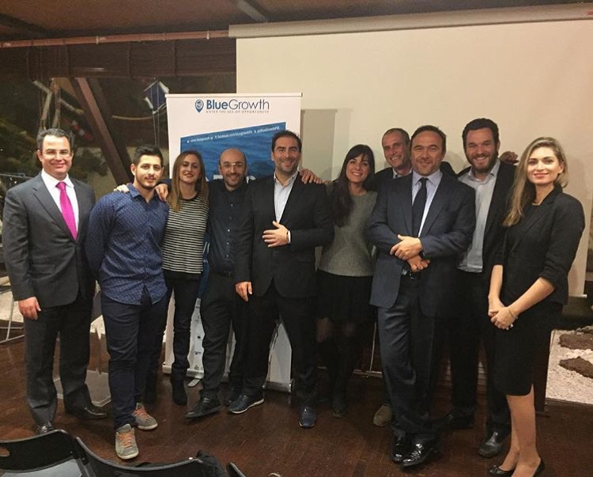
Promoting entrepreneurship and innovation in the maritime economy
"BlueGrowth" (BG) is an initiative to support start-ups and sustainable entrepreneurship in the maritime economy.
BG is the first-established at EU level (2014) innovation competition for maritime economy (Blue Economy).
BG’s vision is to strengthen the traditional economic activities related to the maritime economy with innovative business ideas.
BG is aiming to inspire and help young entrepreneurs realize the innovative concepts relating to marine and freshwater resources.
BG creates new jobs and promotes a new innovative ecosystem, posing the sea in the forefront of economic development.

Slide 7
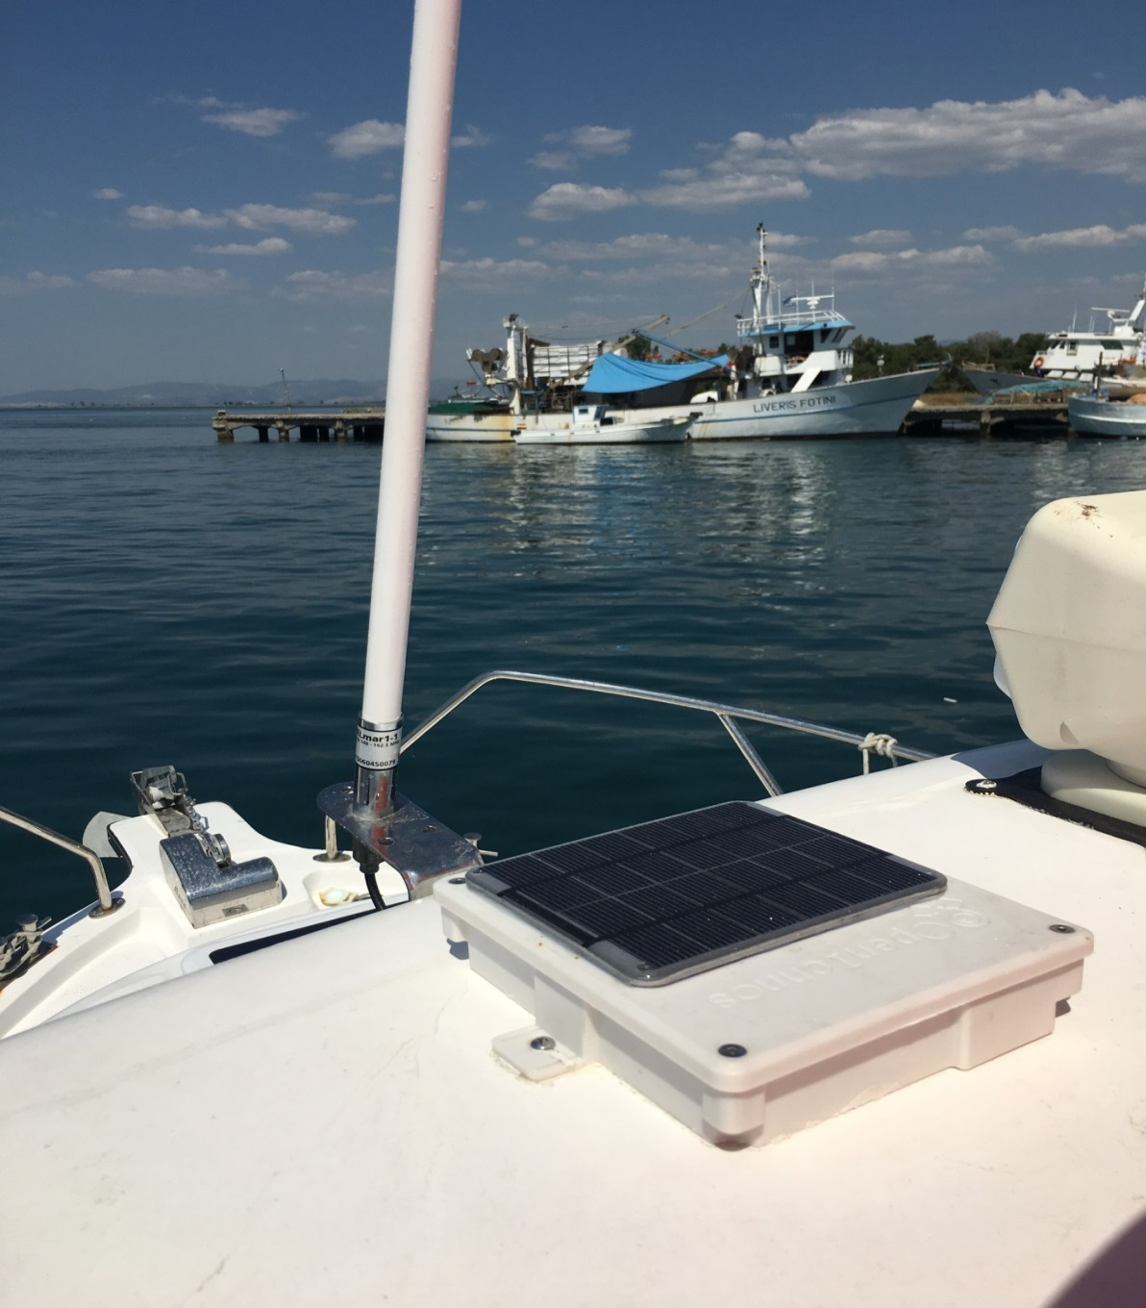
^{The problem and the solutions}
Problems
^{Unemployment}
^{Education}
^{Urban poverty}
^{Social exclusion}
^{Environmental issues}
Innovation is a cross-cutting theme in Piraeus development agenda
^{Proposed solutions by BG:}
Innovation & business strategies applied regarding Blue Economy
Acceleration of knowledge transfer to companies
Access to new production and technological processes
Strengthening of cooperation in the fields of research/education/ practice
Continuous innovation mechanism in blue and green economy
Creation of channels for exchanging knowledge
Improvement of skills and knowledge in Blue Economy
^{Creation of jobs}

Slide 8
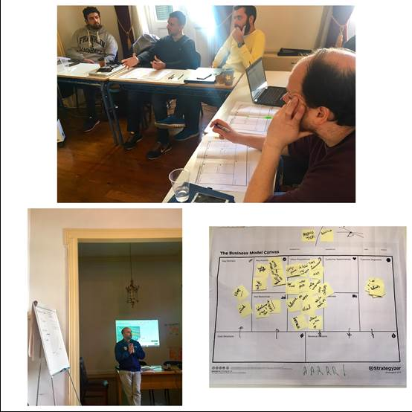
^{Participatory approach}
^{“The Marinescape”}
Partnership of public (Municipality of Piraeus) and private sector (Aephoria.net) – planning and implementation.
BG is implemented under the auspices of the Ministry of Marine and Aegean.
Marinescape: An extensive network of stakeholders (businesses, universities, chambers, etc) that:
Promotes a constant dialogue on Blue Economy issues
Aims at the expansion of the network
Provides mentors in the incubation stage

Slide 9
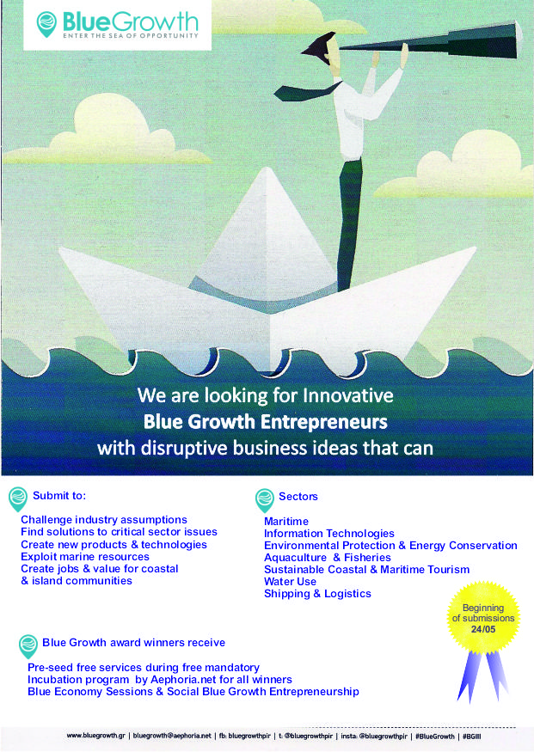
^{Stages of BG Initiative}
Proposals submission
June-October
Proposals
evaluation
October-November
Award
ceremony
December
Incubation programme
January-May

Slide 10
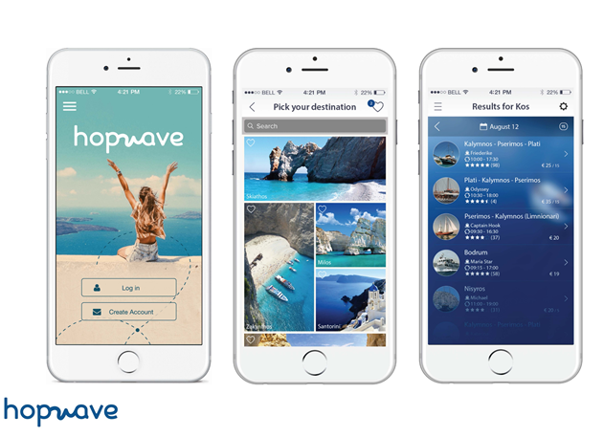
^{What difference has it made?}
IMPACT
Encouragement of entrepreneurship
Creation of new jobs and businesses
Improvement of entrepreneurial mentality
Promotion of innovative business concepts
Promotion of sustainable entrepreneurship’s values
KEY FACTS
^{10 startups launched}
^{55 jobs created}
^{25 community networking events}
1 startup funded by HORIZON 2020
^{2 startups went to PortXL}

