Slide 1
Low-Carbon Housing Solutions
Ilari Rautanen, Project Manager, City of Tampere and EcoFellows Ltd.

Slide 2
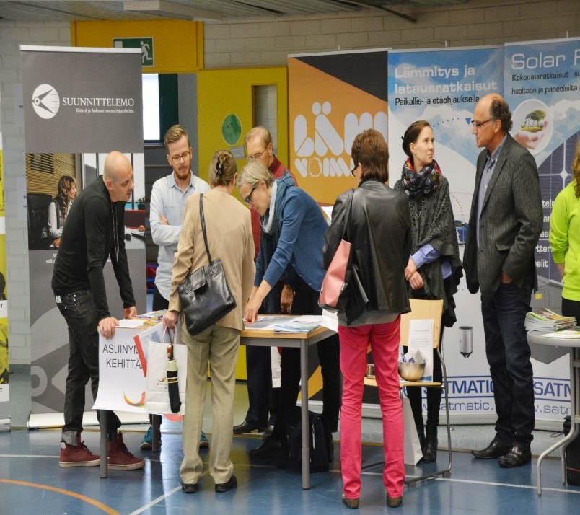
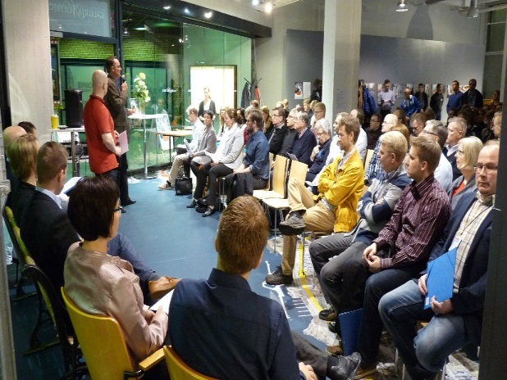
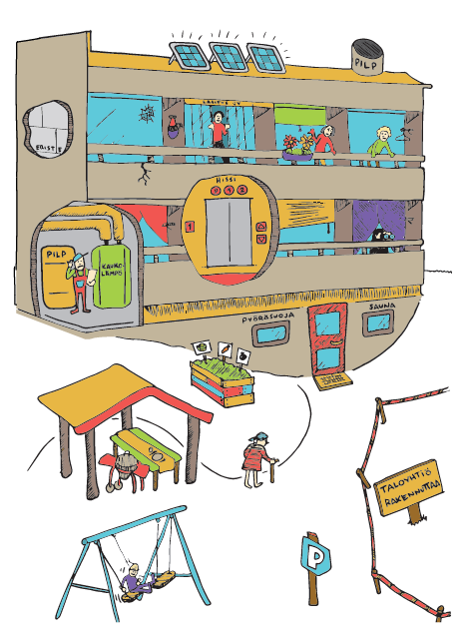
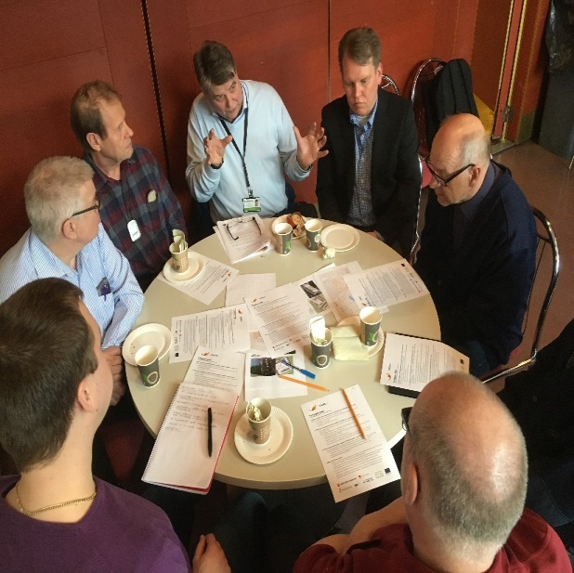
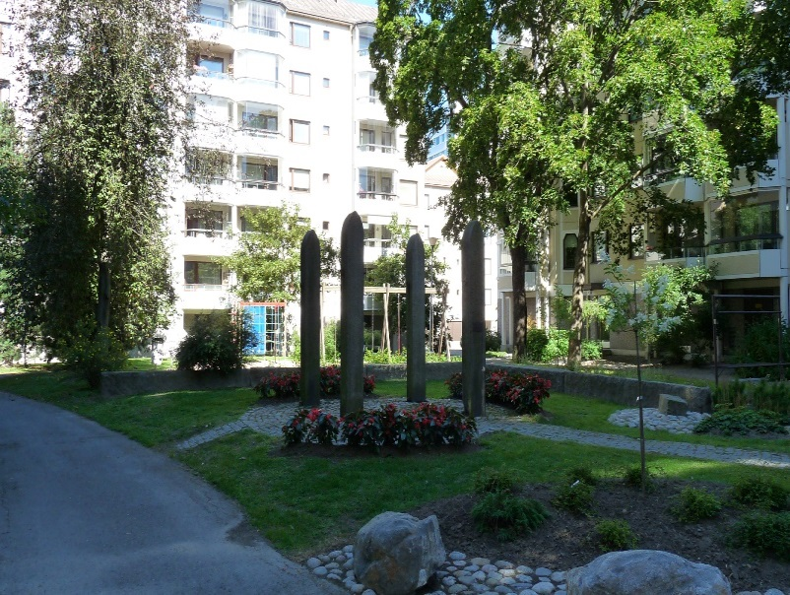
NETWORK

Slide 3
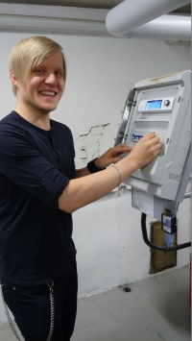
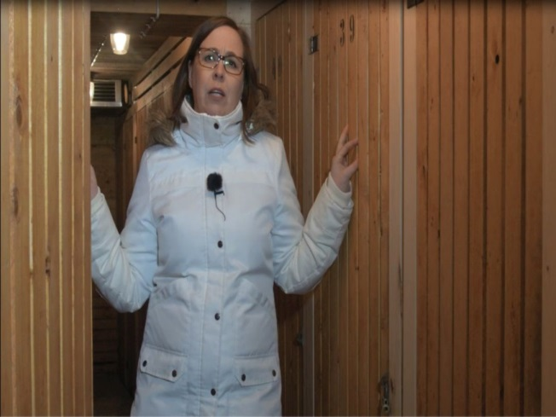
ENERGY EXPERTS
A free-willing resident
Attends to 5 evening long course
Basic principles how a housing company can decrease energy consumption and make the living better for all residents.

Slide 4
HOUSING
City owned rental housing companies (social housing)
Privately owned rental companies (strict laws how to run business)
Private individual flat owners renting their flats

Slide 5
HOUSING COMPANY
In Finland we have Limited liability housing companies (and rental housing companies)
Privately owned by the residents through shares/stocks, flats individually + together common and shared spaces
Board of the housing company, annual meetings (2 weeks notice before)
Manager of the housing company, takes care of the finance and guides

Slide 6
SOCIAL ASPECTS
Energy = money! In Finland even 70% of the monthly living costs can go to energy (mainly heating)
When an energy renovation is done the energy consumption can decrease even 60%.
Right scheduled renovation is more economic than doing it a bit too late
All the renovations are being decided together

Slide 7
RENOVATIONS
5 year plans for renovations (Finnish Law)
Promotion towards long term strategies for 15...20 years
Workshops and instructions how to make those

Slide 8
HOMELESSNESS
Feantsa, the European Federation of National Organisations Working with the Homeless –report
“The report says homelessness is rising in all European countries, except Finland”
Constitution of Finland: Everyone who cannot get lifeworthy life by themselves has a right to be taken care of by the community / government

Slide 9
RESULTS

