Slide 2
BEE PATH
City of Ljubljana, Slovenia
Maruška MARKOVČIČ
City of Ljubljana
Higher adviser for rural development

Slide 3
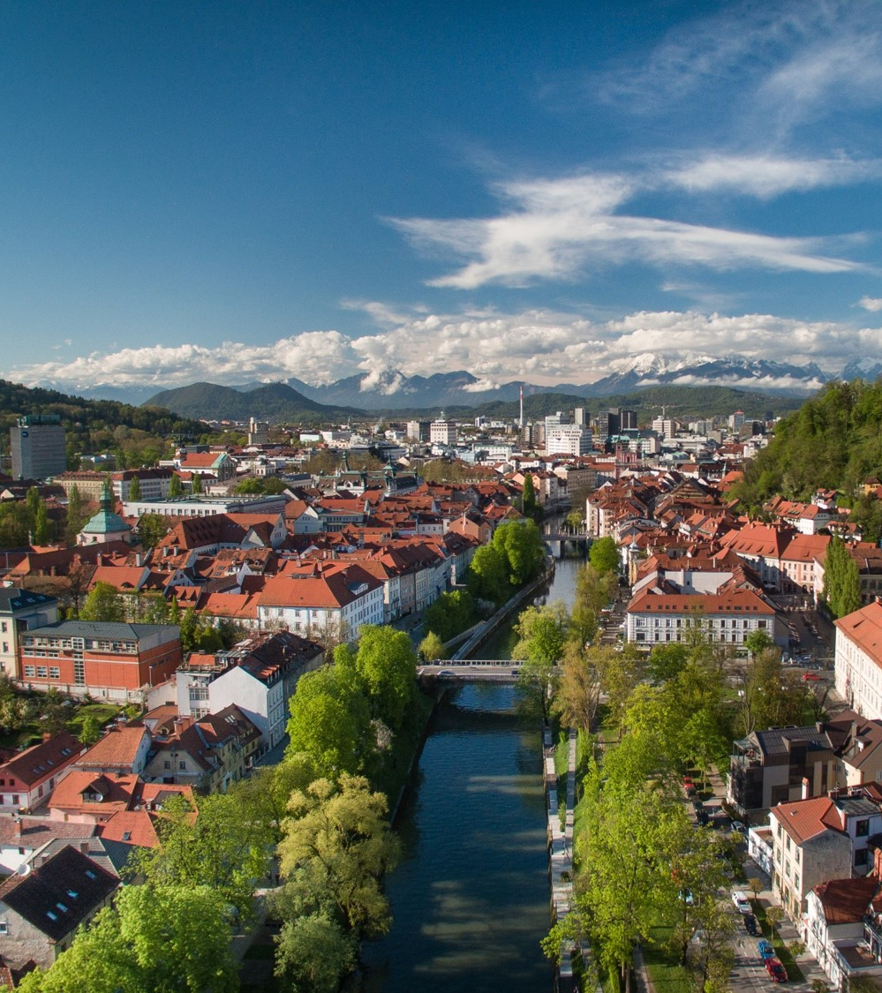
Ljubljana – Green capital of Europe 2016
2/3 rural areas
46% forest
melliferous plants on public areas
3% of all Slovene bee keepers
healthy honey without pesticides and insecticides

Slide 4
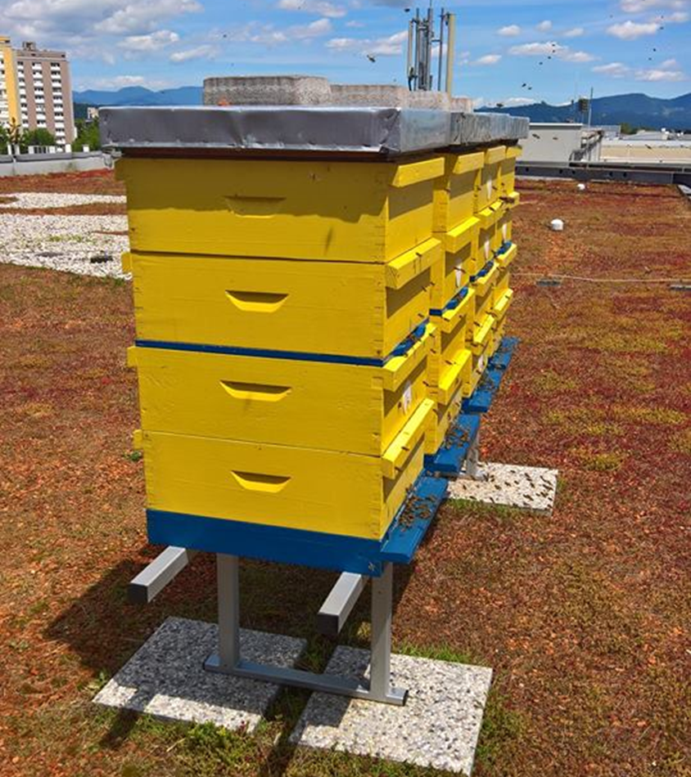
Urban beekeeping
bees indicate good environment
Bee path – 32 stakeholders
new forms of beehives
rules and guidelines

Slide 5
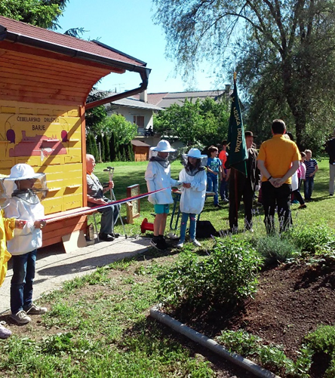
Synergy effects
pedagogical programs (primary schools)
promotion of beekeeping (events)
„Everybody by themselves and all together for one goal“
long-term / holistic

