Slide 2
NEIGHBOURHOOD REGENERATION
How to initiate a ’rethinking’ process about physical environments, local network and cohesion, as well as storytelling and identity? How to include the residents into the regeneration of their deprived neighbourhood? How can municipalities and investors work together for regeneration?
Good Practices of Lisbon, Chemnitz, Aalborg and Kranj
Moderator: Ivan Tosics, URBACT PE
Critical friend: Pedro Campos Ponce, NL

Slide 3



FRANCO Rui
Deputy City Councilor – Housing and Local Development
rui.franco@cm-lisboa.pt
Lisbon City Council

Slide 4
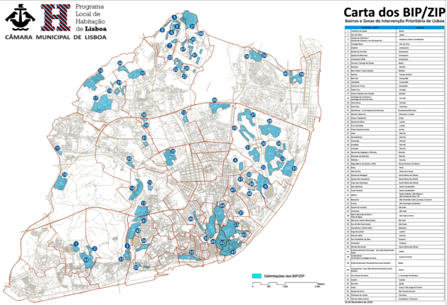
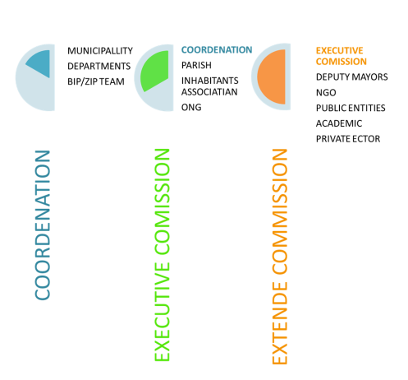
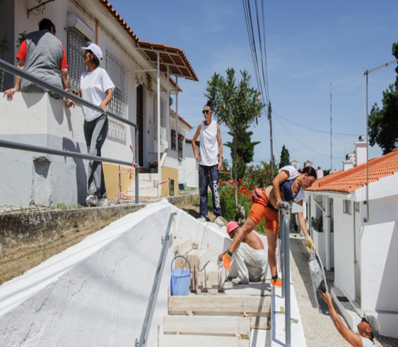
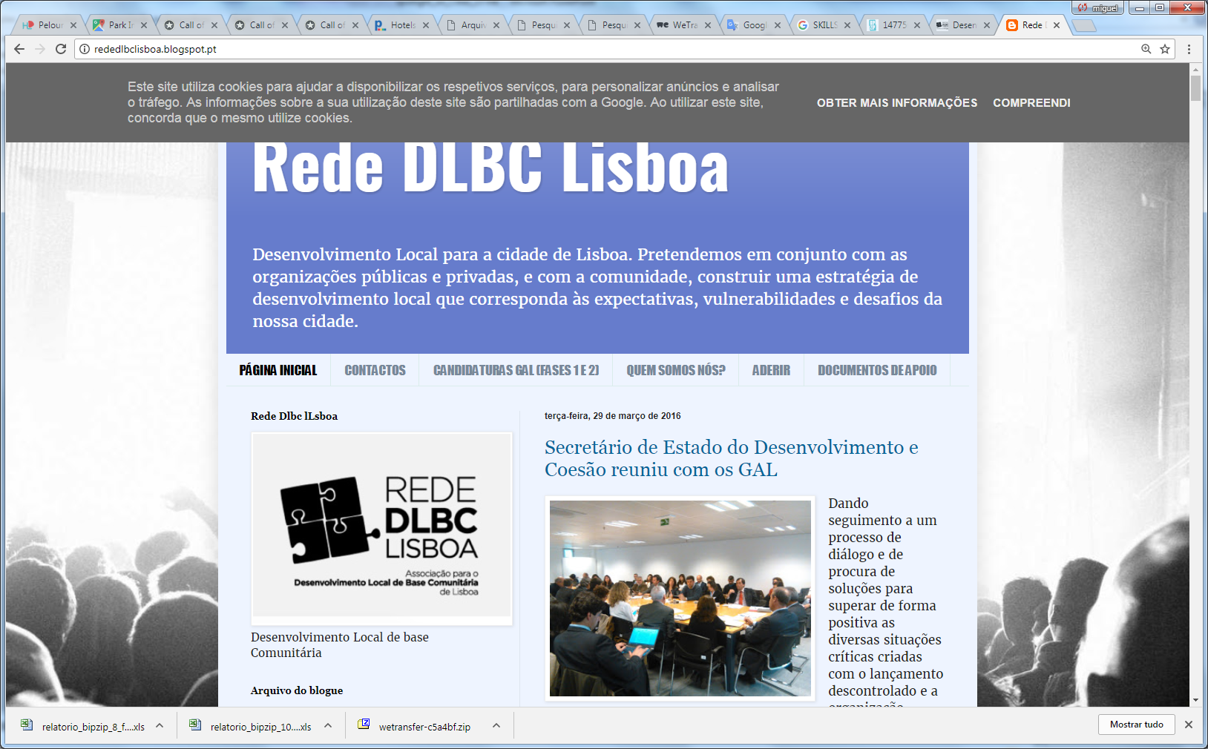


#1| Mapping BIP/ZIP
#2| Funding BIP/ZIP Projects
#3| Co-Governing BIP/ZIP
#4| Scalling-Up BIP/ZIP (CLLD)
#Example| Boavista BIP/ZIP

Slide 5

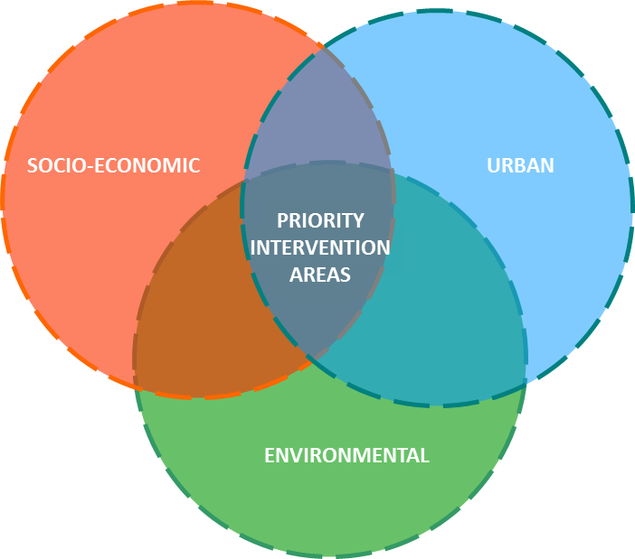
#1 Mapping BIP/ZIP

Slide 6
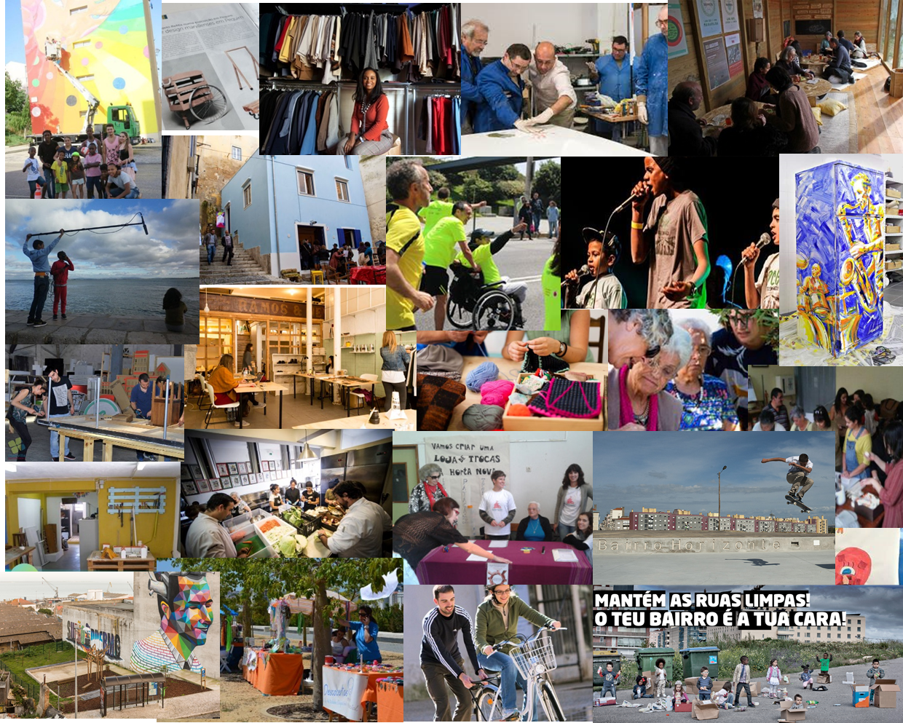
#2
270 Projects
funded since 2011
BIP/ZIP PROGRAM

Slide 7
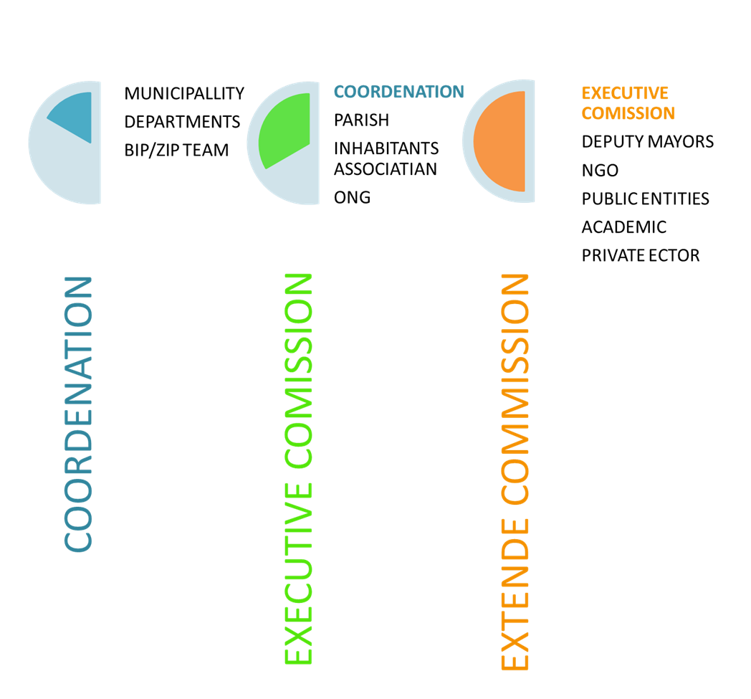
#3
Co-Governance
GABIP Local Structure
BIP/ZIP - A PLACE FOR PARTICIPATION

Slide 8
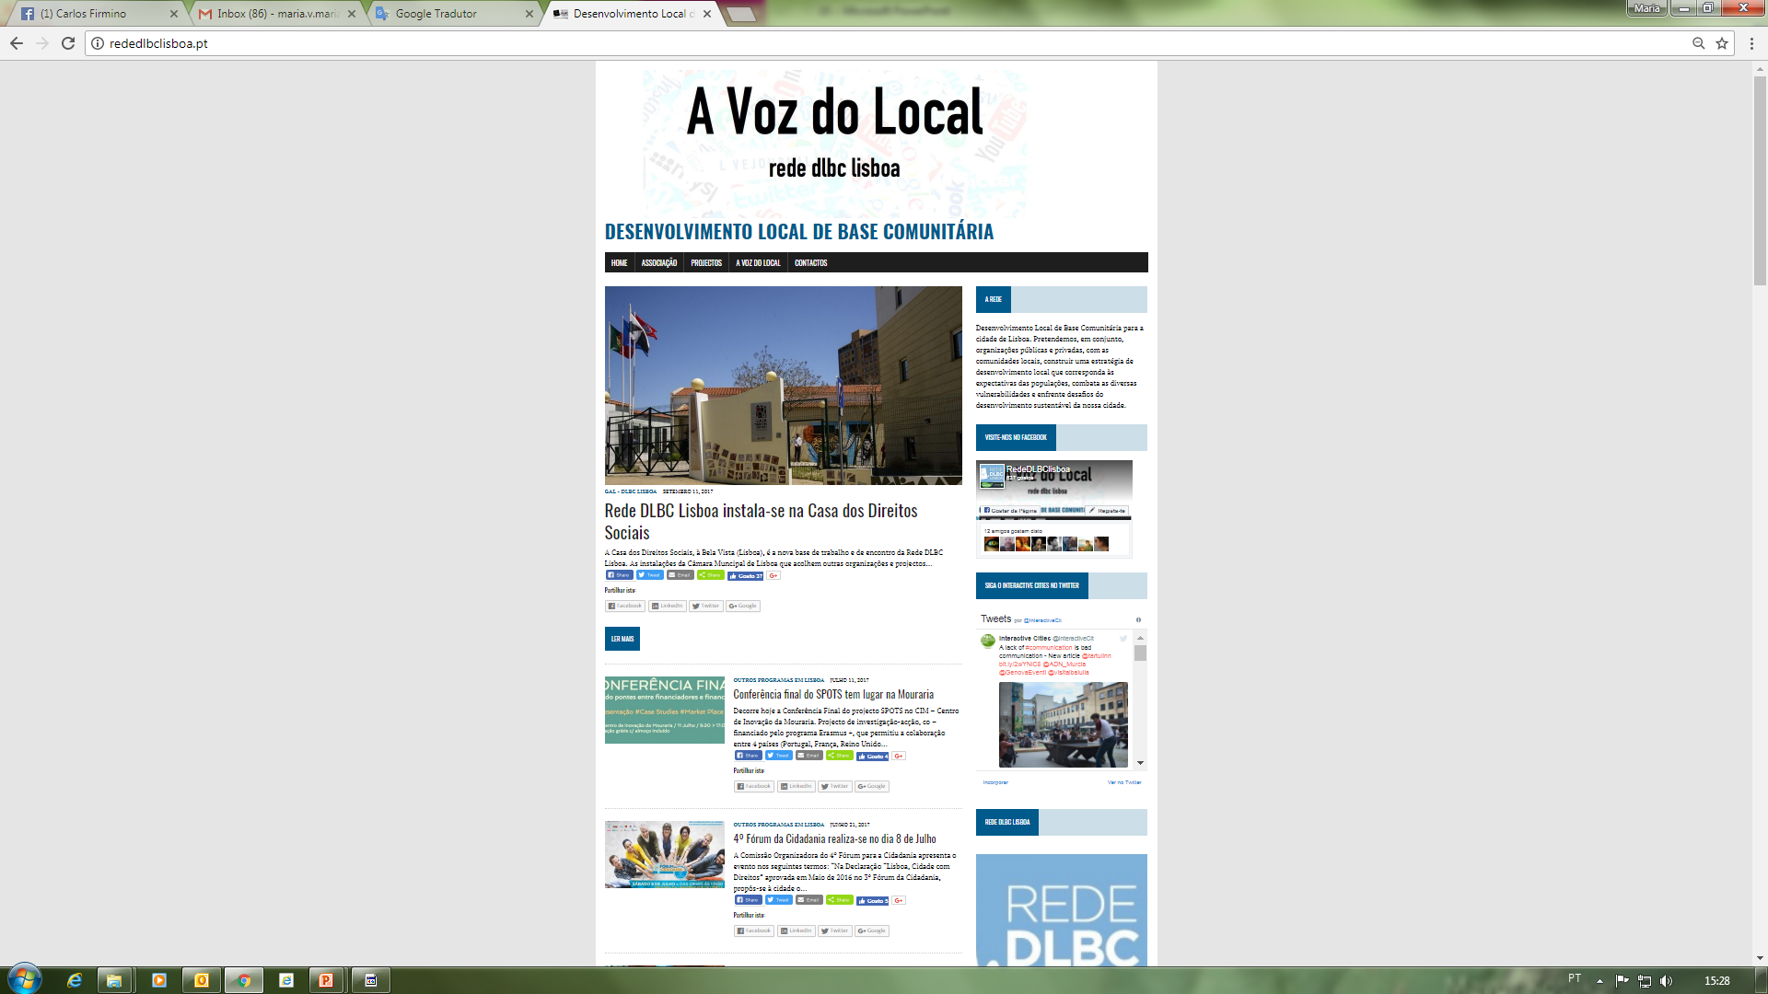


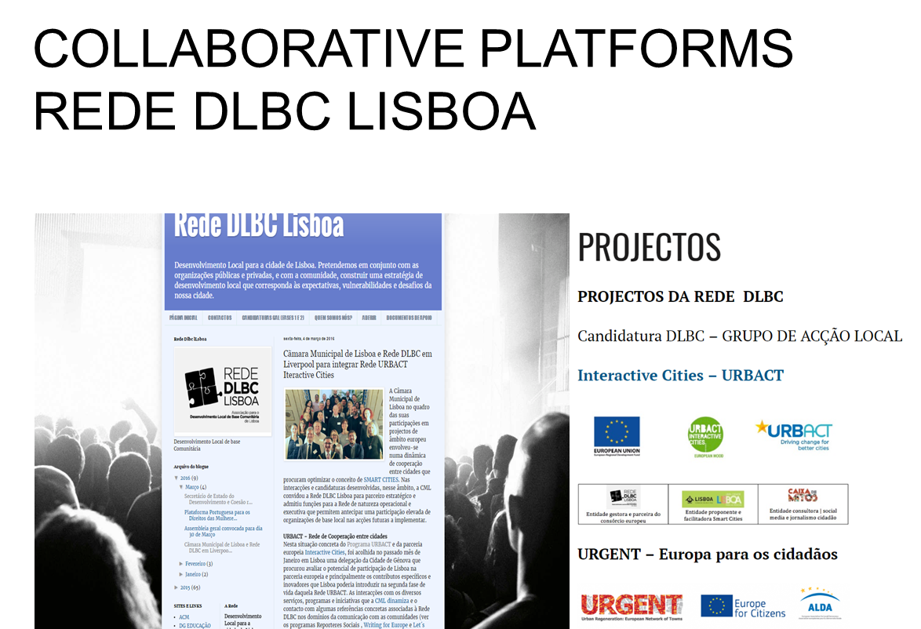
#4
The Lisbon CLLD Network
Community-Led Local Development
EU Reg. 1303/2013
The “BIP/ZIP - Network”
Lisbon clld networ

Slide 9
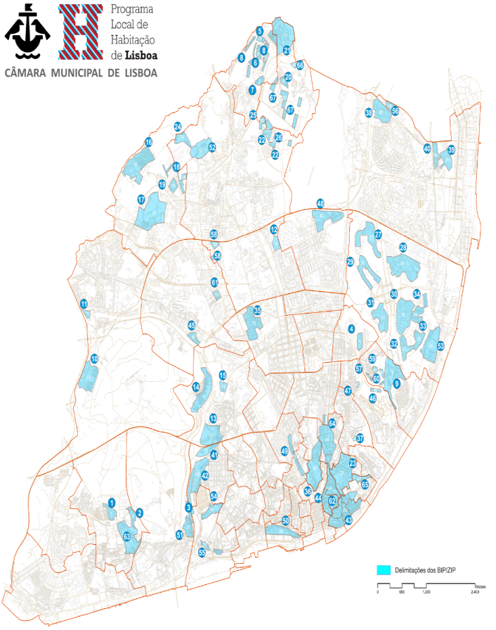
# BIP/ZIP Boavista
A participatory and integrated Local Development Plan
Notes:
Situated on the western outskirts of Lisbon and surrounded by the Monsanto Forest, the Boavista District was built by the Municipality in the 40s, with a view to rehousing families from the shanty towns.
Subject to successive phases of rehousing, its current population is estimated at around 5,000 inhabitants; 1,559 houses, 41 of which have already been bought by the families; of the rest, 510 in the older ‘alvenaria’ area.
In 2011 the district was classified as a Priority Intervention District (BIP), due to economic, social, environmental and urban deficits, integrated in the Priority Intervention Districts Map on the Lisbon Master Plan.

Slide 10
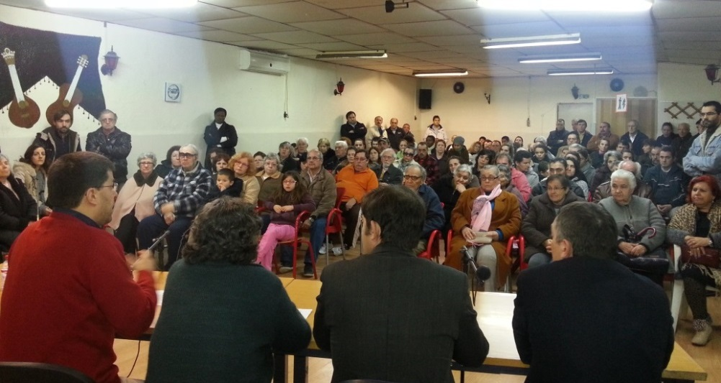
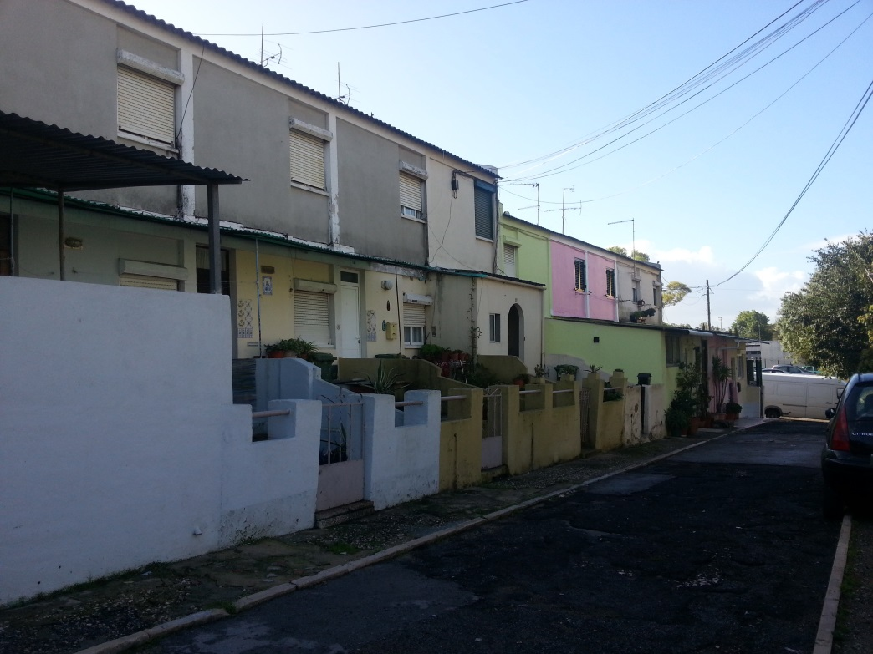
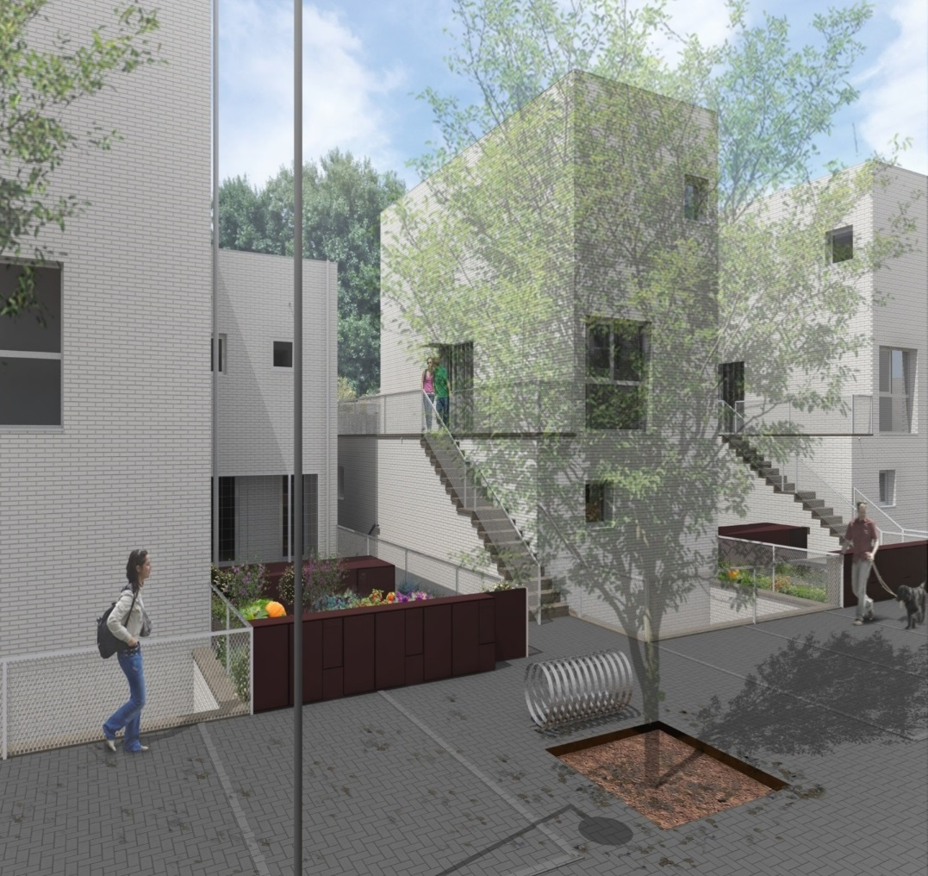
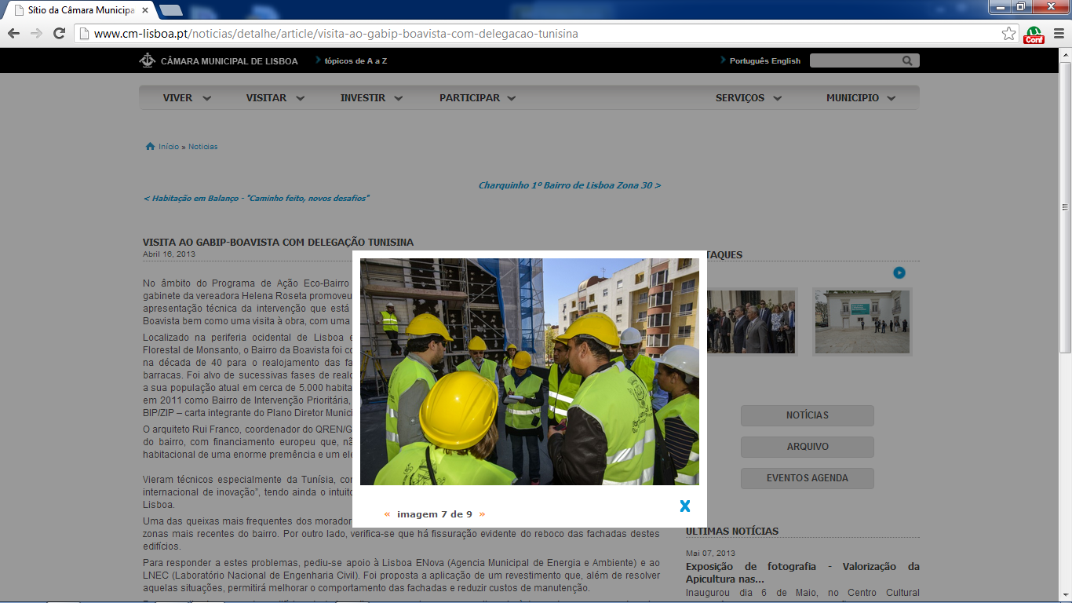

Slide 11
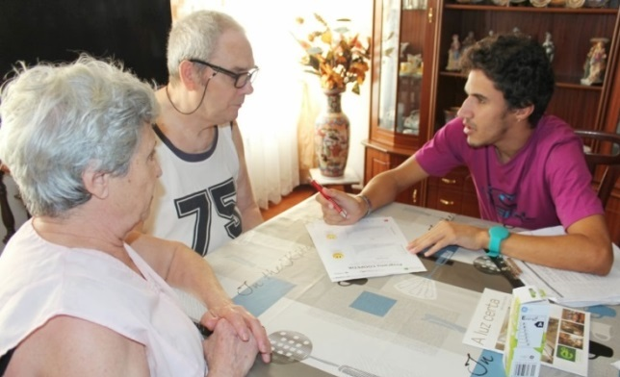
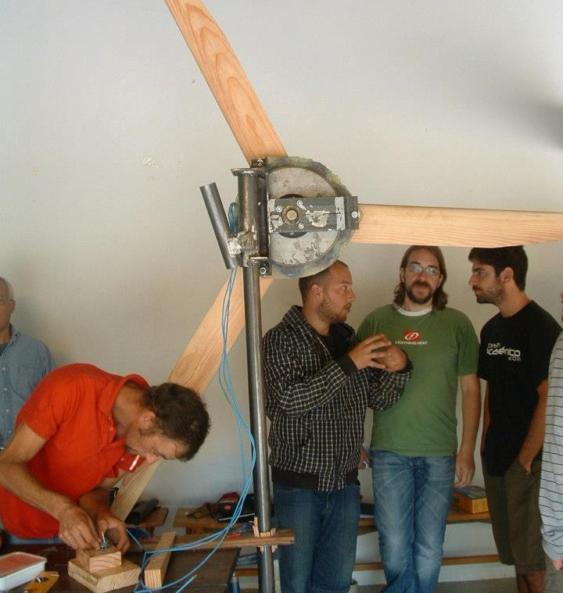
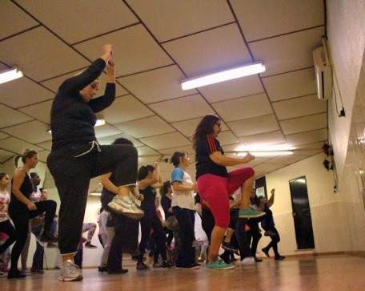
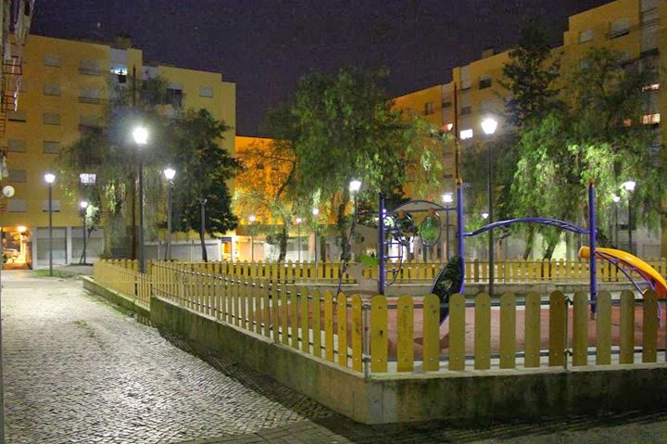
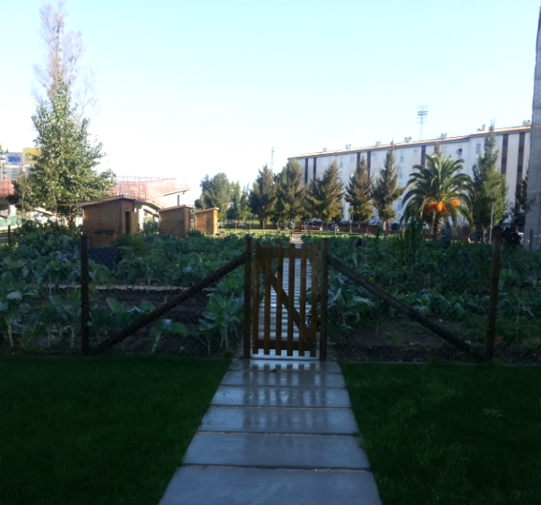

Slide 13
Question from the critical friend
What are the experiences of Lisboa with the CLLD? Is it a useful instrument to achieve the goals Lisboa has set for this project?

