Slide 1
RENEWAL AND REGENERATION OF THE PLANINA RESIDENTIAL NEIGHBOURHOOD IN KRANJ
Sanja Kožman, Municipality of Kranj, Department of Environment and Spatial Planning
Tallinn, 4.10.2017

Slide 2
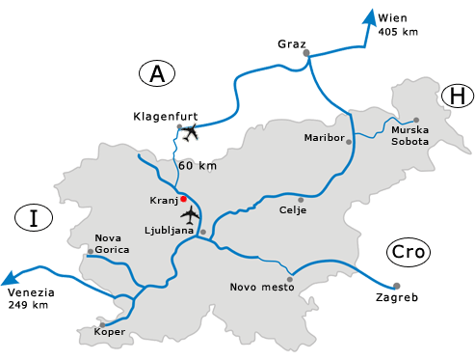
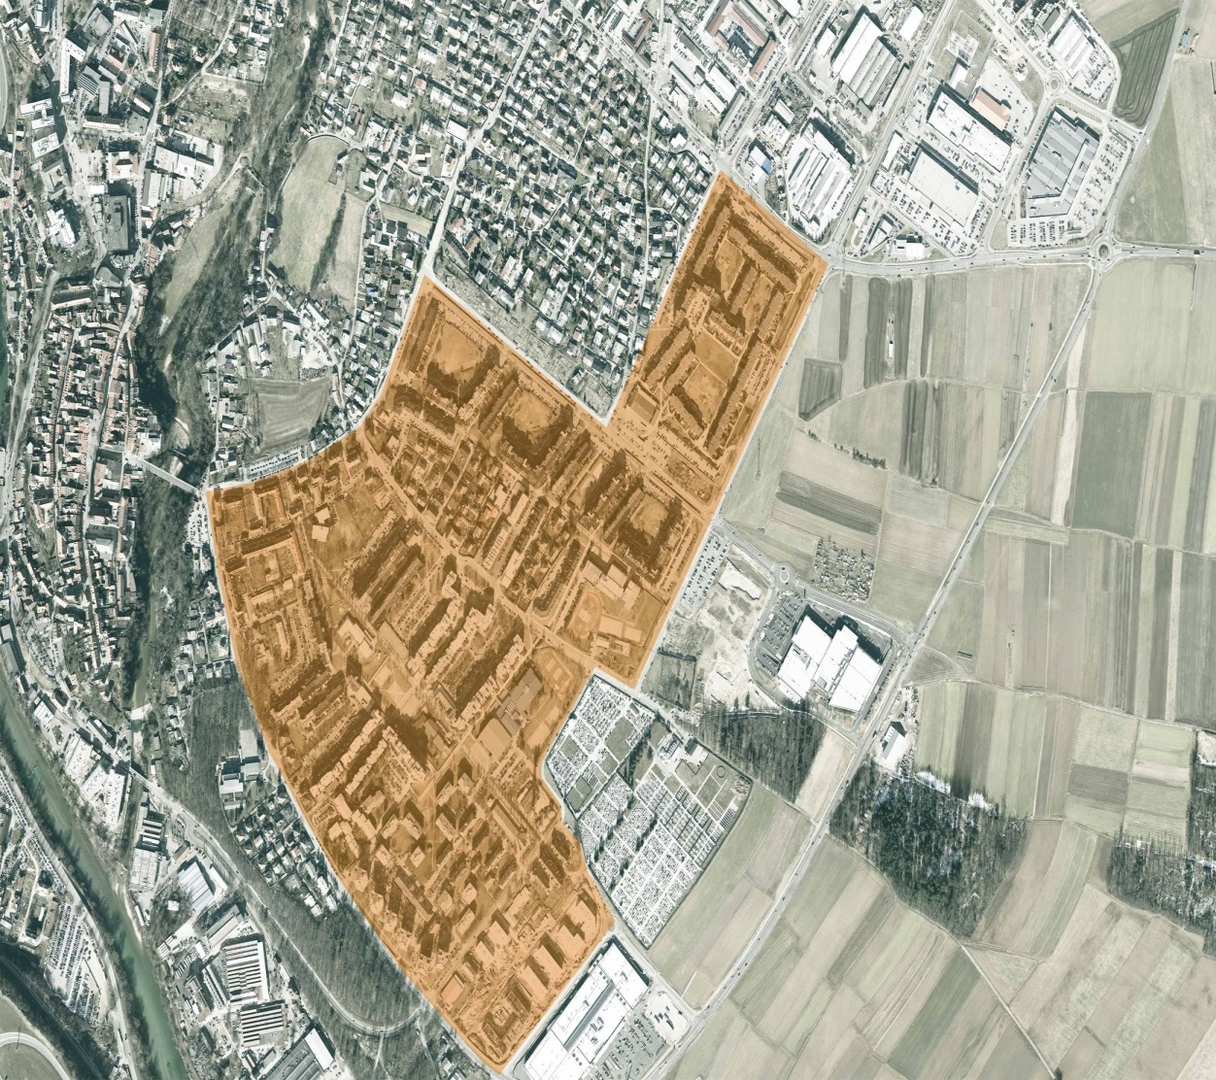
Basic informations
City Municipality of Kranj
third largest city in Slovenia
located 20 km from Ljubljana
55.000 inhabitants
Neighbourhood Planina
52 ha
more than 140 apartment buildings
12.500 residents
Built from 1970s to the mid-1980s

Slide 3
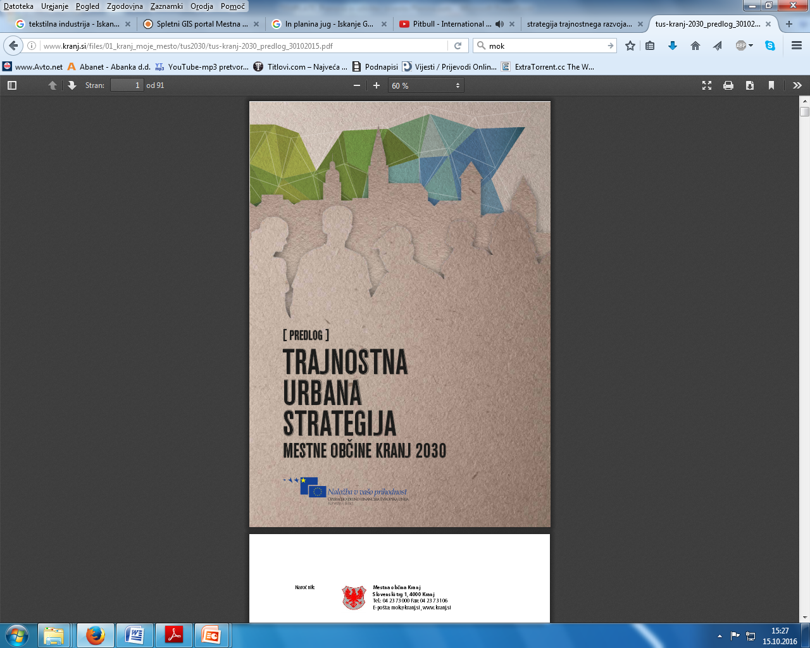
Important document
Sustainable Urban Strategy of the City Municipality of Kranj
Accepted in year 2015
Document defines neighborhood Planina as a pilot area for renewal.
Planina is a socially degraded area – only suspicion.
European funds from Integrated Territorial Investments (for urban renewal, sustainable mobility and energy rehabilitation of buildings).

Slide 4
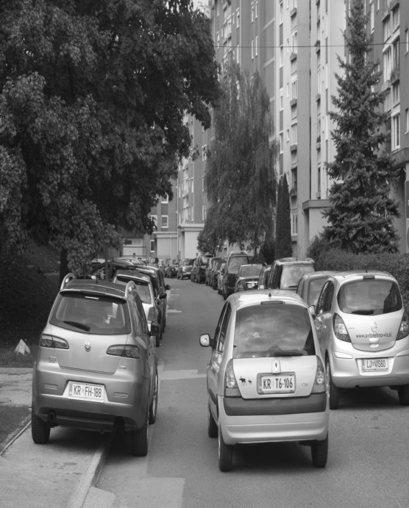
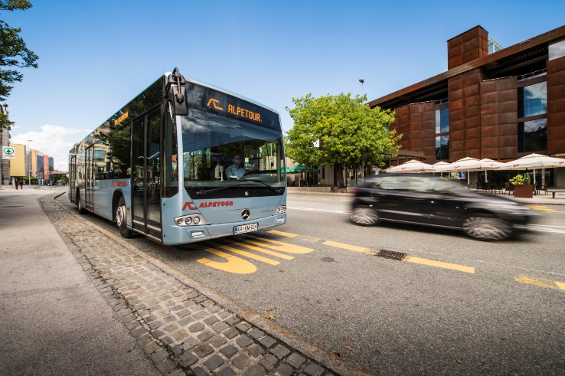
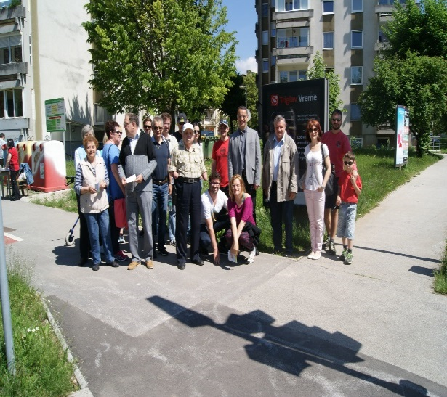
Problems
Potential
lack of parking spaces,
low use of public transport,
outdated urban furniture,
low energy efficiency of buildings,
a lack of better children’s playgrounds etc
Residents of Planina

Slide 5
Year 2016
Systematic beginning of renewal of neighborhood Planina.
The biggest quastion was:
How to include as many residents as possible into the renewal and regeneration of the neighbourhood?
Interdisciplinary working group was established - informal form of the local renewal office.

Slide 6
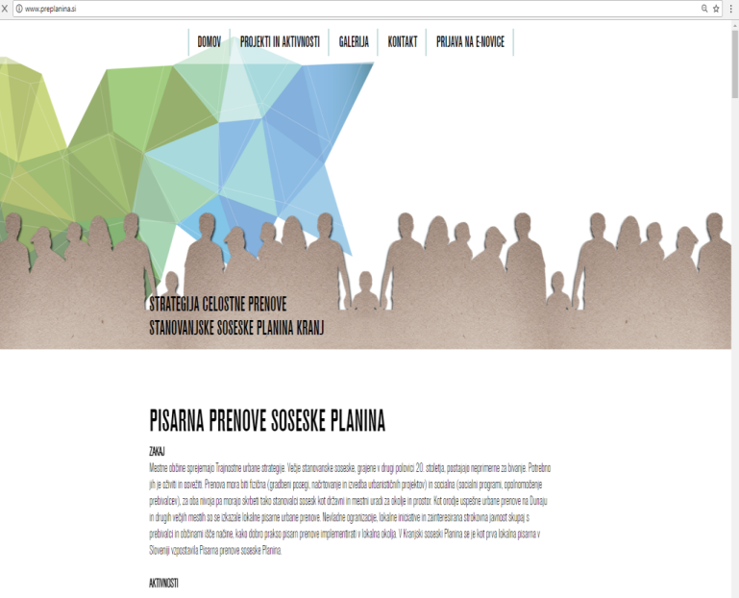
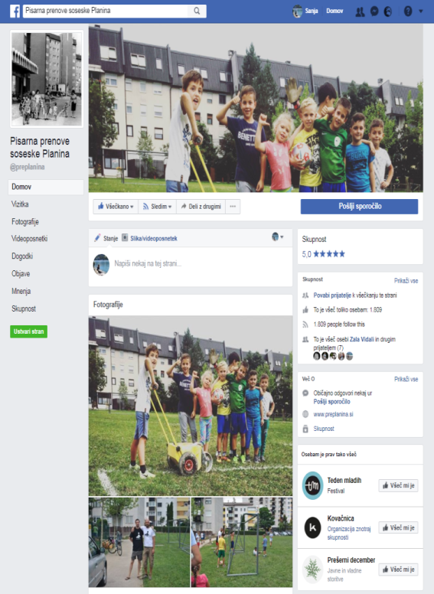
Workshops – ways of inviting
Municipality web side (www.kranj.si)
Web sides of local communities
Facebook page of Municipality
Facebook page of local renewal office
local renewal office web side (www.preplanina.si)
posters
radio
Local newspapers (Kranjske novice, Gorenjski glas)

Slide 7
Workshops
February 2016 – March 2016 – 6 workshops
First workshop – 150 residents, representatives of local communities and NGOs.
Participants were divided according to the topic they chose. Six groups were formed:
the Transport group,
the Safety group,
the Children's Playgrounds group,
the Green Area group,
the Sport and Recreation group
the Urban Equipment group.
Each group was working on their chosen topic and tried to find solutions for problems, that were present within that topic.

Slide 8
Mini projects
Each of the groups was then given a small amount of money (250 €) to carry out a so-called mini project, mainly to draw the attention of other residents towards the specific problem and possible solutions. The mini projects have been completed and presented at a public event in the neighbourhood, organized with the help of different NGOs.

Slide 9
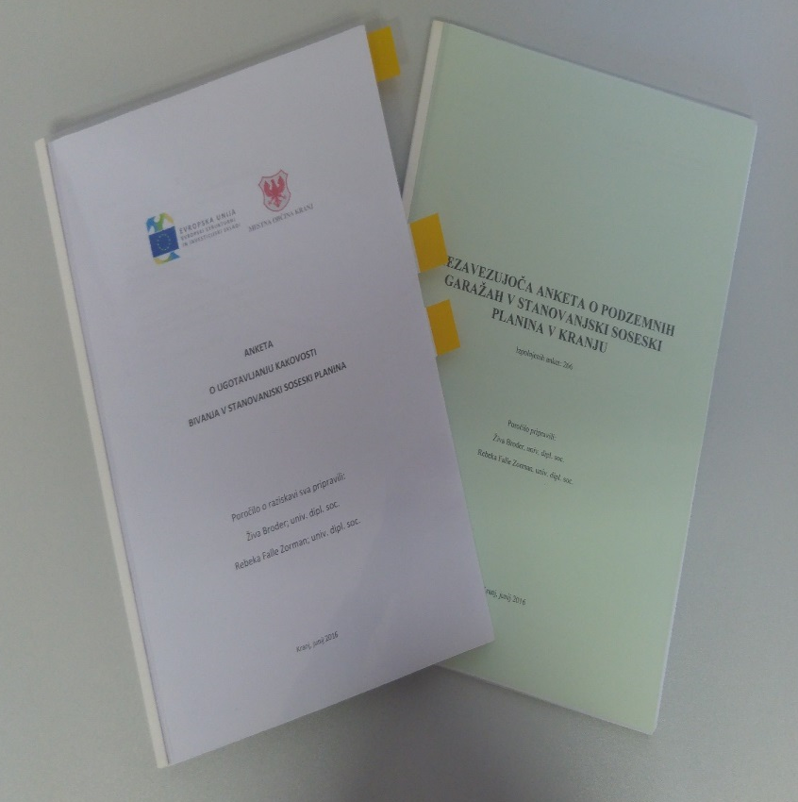
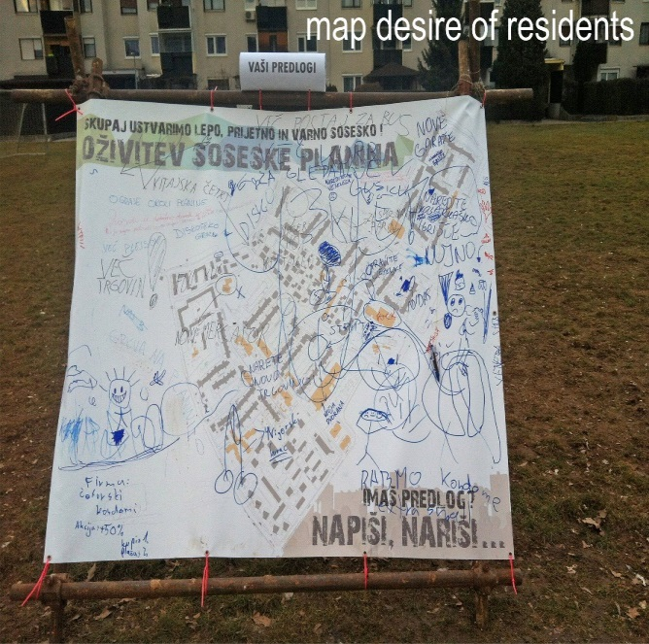
Other ways of collecting informations
Surveys
two surveys
  about determining quality of life in Planina
  about resident’s interest in buying a parking place in a garage house
Posters

Slide 10
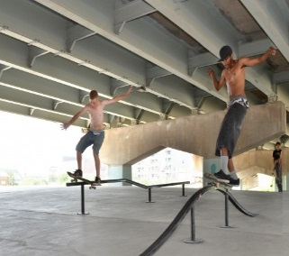
Results
The results of workshops, surveys, data collected directly on the field are projects that will be brought to life by year 2020.
Projects:
renovation of two under-passes,
modernization of urban equipment,
establishment of a central connecting route through the neighborhood,
a cycling polygon - pumptrack,
a community space (urban gardens, playground, park),
an urban sports center - covered space for informal socializing and recreational exercise with outdoor recreational facilities surfaces and cycling polygons,
a Family Center - a central covered and open space for socializing and children's play and Sustainable Mobility Center
local renewal office.

Slide 11
Sanja Kožman
E-mail: sanja.kozman@kranj.si
Phone: 00386 4 237 31 45

Slide 12
Question from the critical friend
A participatory approach is not something public servants are used to. How did you stimulate your colleagues at the municipality to actively engage with citizens in this project?

