Slide 2
^{ENTREPRENEURSHIP PANEL}
MODERATOR: JIM SIMS
QUESTION FACILITATOR: ALISA ALITI VLASIC
How to identify your city's business assets? Can culture be a good business? What kind of business support for social economy?

Slide 3
Silvia Porretta
^{Project Manager, Incredibol!}
^{Municipality of bologna}

Slide 4
Link

Slide 5
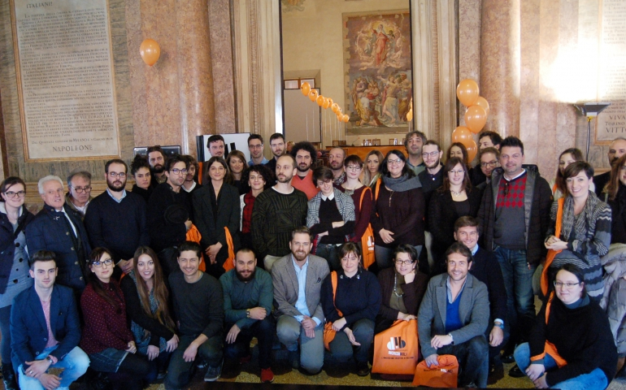
^{IncrediBOL!} ^{CREATIVE INNOVATION}
BOLOGNA / ITALY
An innovative support scheme for Cultural and Creative Industries which supports companies and professionals in their start-up phase by offering a combination of services and opportunities provided by public & private sector partners.

Slide 6
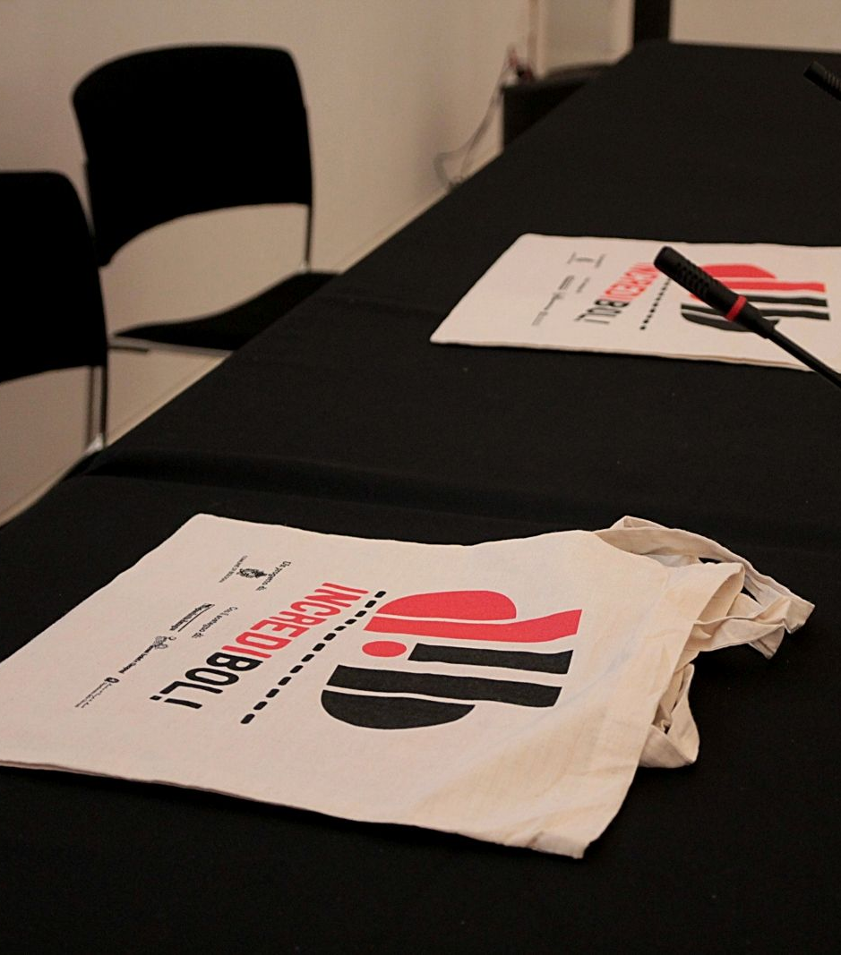
How?
Periodic OPEN CALLS for projects in the CCIs field providing small GRANTS and TAILOR-MADE SUPPORT usng a toolkit made up of different benefits
NETWORK OF PUBLIC AND PRIVATE PARTNERS offering in-kind services
Opportunities and information on CCIs field shared via MEDIA CHANNELS
RENT-FREE SPACES belonging to the Municipality of Bologna
Open HELP DESK SERVICE
ORGANIZATION of free events, workshops, B2B networking,focus groups etc.

Slide 7
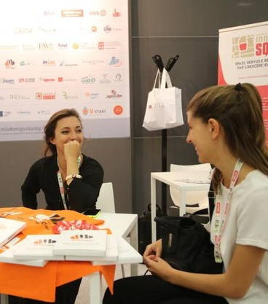
Who benefits?
Creative Talents (expecially young)
Partners (they specialize in certain aspects of CCIs)
The Municipality of Bologna and the Emilia-Romagna region (using an innovative, holistic, integrated, transdisciplinary, target-based approach for the development of the territory)
Traditional businesses (thanks to the 'creative spillover effect')
Citizens and Property Owners (increased sense of security and a more lively and creative environment)

Slide 8
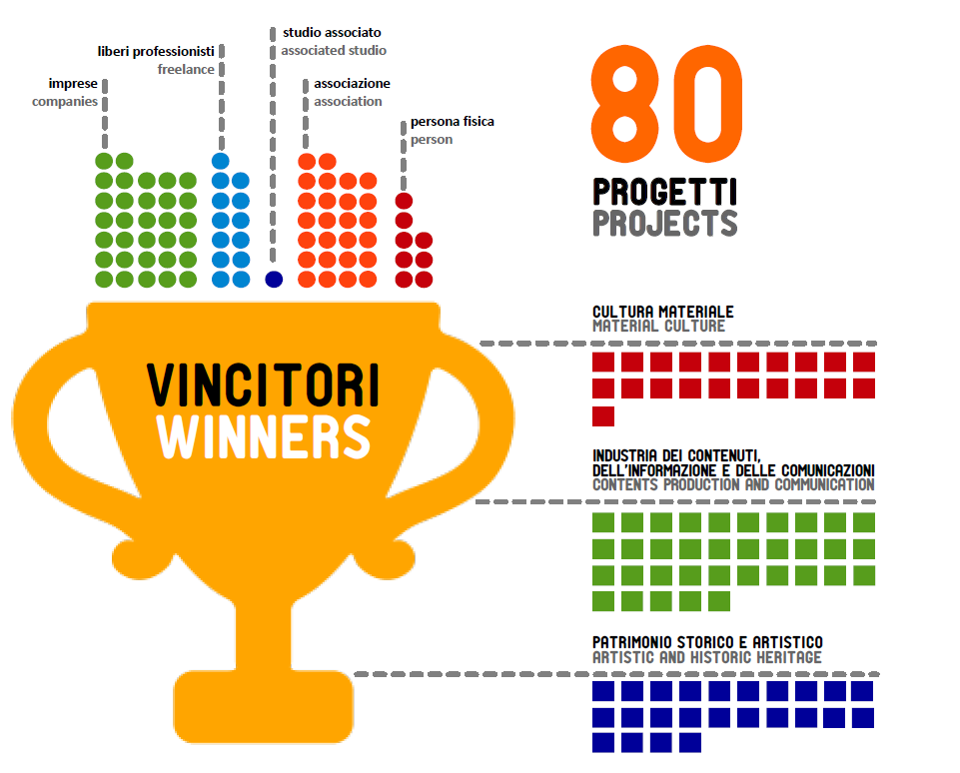
Impact
7 years and 6 editions of the main call
538 project ideas and 80 winners
1667 particpants to call for start-ups
80 winners
50% women
30 rent-free spaces
9% mortality rate

Slide 9
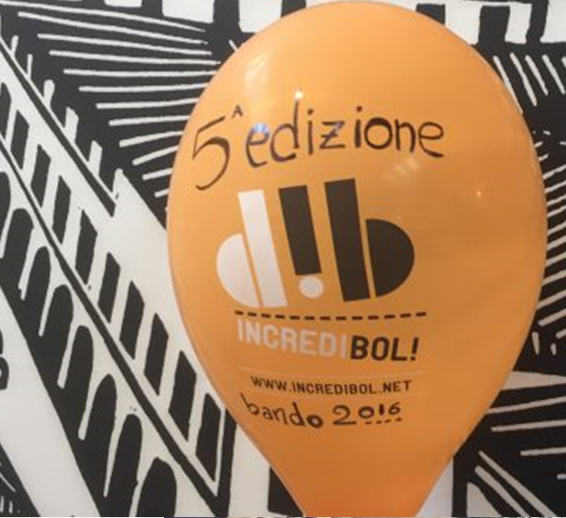
Results at an institutional level
Smart specialisation strategy of the region
2013 – European Enterprise Promotion Award
2014 – Eurocities, Good Practice
2015 – European Training Foundation, Good Practice
2017 – Urbact, Good Practice

Slide 10
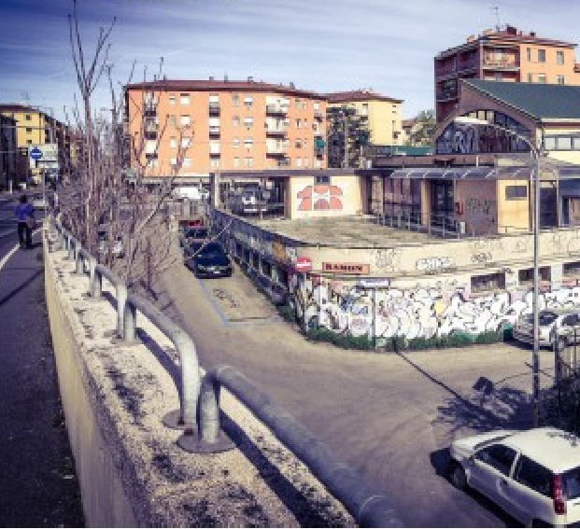
Mercato Sonato Case Study
A deteriorated and abandonded former market redeveloped and relaunched by ORCHESTRA SENZA SPINE
Seeding:
Involvement of the community to
Co-design the activities
Sprouting:
Pilot activities and redevelopment works
Fruit:
Structuired activities and concert season

