Slide 2
HOUSING FOR ALL
What can be done to avoid evictions? Can low-carbon housing be affordable? How to allocate new social housing? How to provide housing to young graduates of the city?
Good Practices of Barcelona, Tampere, Dupnitsa and Poznan
Moderator: Ivan Tosics, URBACT PE
Critical friend: Raffaele Barbato, UIA

Slide 3
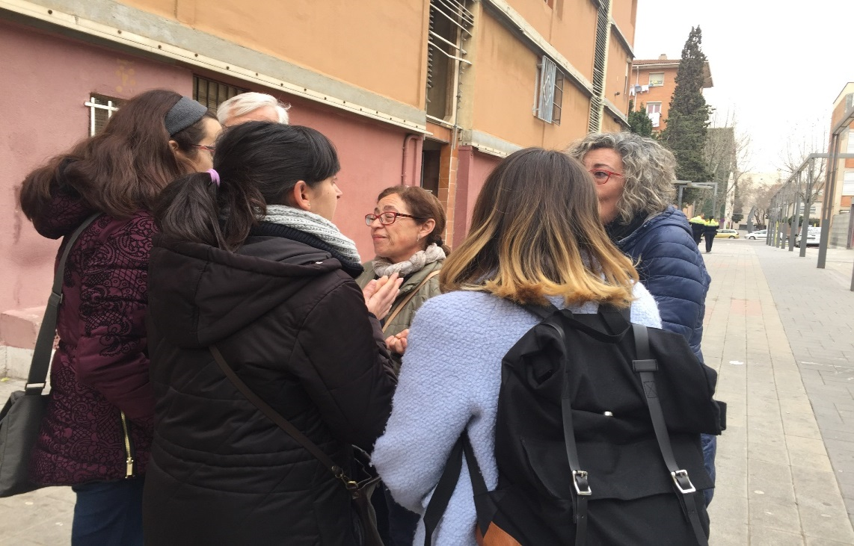
Housing Last:
INTERMEDIATION SERVICE FOR PEOPLE IN PROCESS OF EVICTIONS AND OCCUPANCIES

Slide 4
Some recent data from Barcelona:
“Rent bubble”, increase of 7,8% last year
House Price increase of 9,2% last year
Executed 30 evictions a week, (81% non payment of rental)
Number of homelessness increased in 162,3% since 2014 (25% directly related with an eviction)
30% of rental, the rest ownership (above the Spanish average)
Social housing lower than 2%
Vacant houses, estimated in 11%

Slide 5
CITY 1,6 M / METROPOLITAN AREA 3 M / GDP 68.000 M€/ 11% UNEMPLOYMENT
According to data from Barcelona´s Dean Court , in 2015:
6.632 eviction processes were initiated
3.098 evictions were executed
Out of the 4.232 received petitions of evictions resolutions, 2.390 were finally executed (2014- 2015)
83% of evictions resolutions of Barcelona were consequence of the implementation of the LAU, (Urban Rental Law) beyond the State average of 53%
Annually, 7% of evictions carried out at State level take place in BCN city.

Slide 6
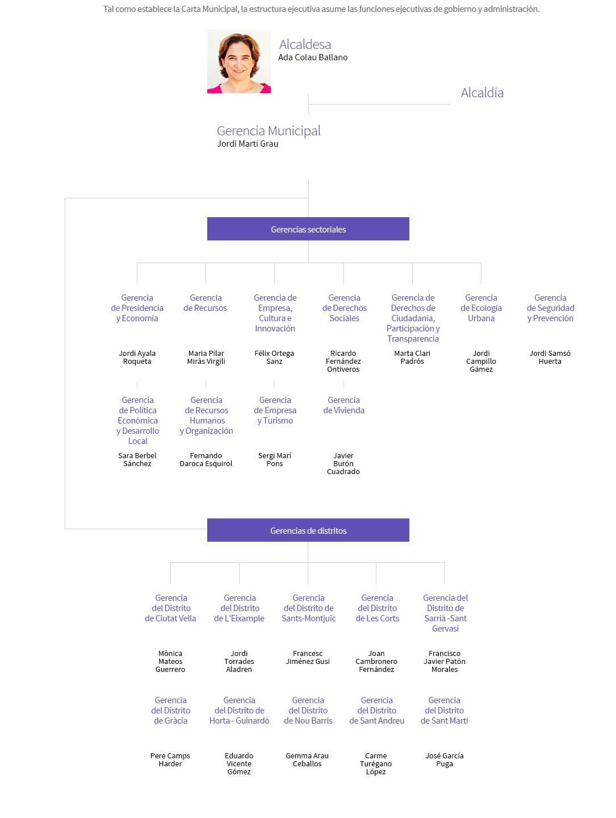

Slide 7
Housing became a political priority: Right to Housing Plan 2016-2025
1) Housing Emergency
1) Prevention of residential exclusion
2) Support during eviction processes
3) Support to people who can not access to housing
2) Good use of housing
1) Vacant houses into the rental market
2) Keeping residential use of houses
3) Improve social housing management
3) Increase the number of affordable houses
1) Increase public housing stock
2) Extend and improve rental subsidies
3) Promote private houses into the rental market
4) Promote social housing market
4) Rehabilitation and maintenance of housing while avoiding gentrification
1) Improve management of private rental market
2) Rehabilitation policies with social standards
3) Improve public intervention capacity in rehabilitation

Slide 8
Goal: to improve the preventive measures, in a way that the burden of cases currently addressed by the Municipality at this urgent stage gradually shifts to previous ones through improved `early warning´ channels and case identification that would allow earlier intervention.
Target: cases where evictions orders are being executed and debt settlements arrangements and income continuance have not been explored or have not been accepted
Tasks: mediation between landlords and tenants, as well as between lenders and mortgagors, options to assume the existing debt and arrears and allow occupants to remain in place, arrangements for legal aid, advice and assistance, and competency to allocate alternative housing where evictions cannot be avoided.

Slide 9
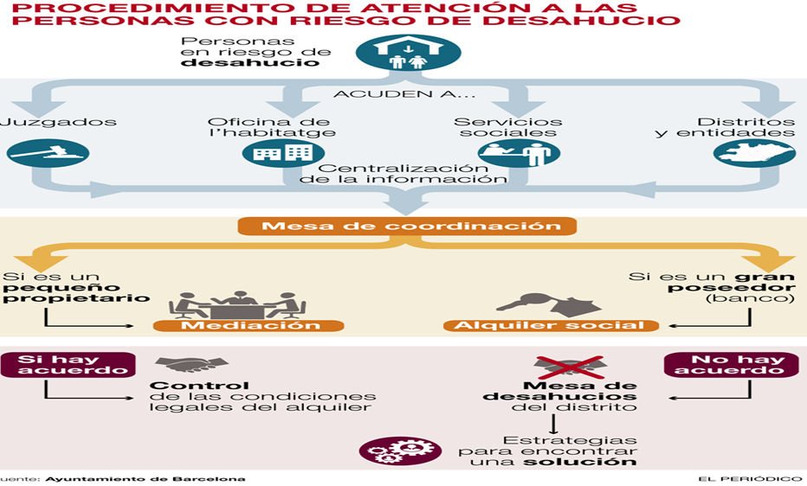
There is a Housing Office per District (10) which together with the Social Service Offices address coordinately vulnerable situations
The Housing Offices are integrated by:
Housing Office Manager
Lawyer: legal counceling and mediation
Techncian for social emergencies
Technical architect: rehabilitation and other interventions
Technician: focused on eviction processes and occupancies
3 administrative officers

Slide 10
Housing emergencies addressed through 3 services:
- Information and legal advice on Housing and mediation, offered through specialized attorneys in the City Hall Network of the city. Its purpose is to avoid the los of the homes by activating a mediation with the owners or with the mortage executors. The result can be the agreement of a social lease, the file with debt settlement of rent or mortagage payments through financial aid, ...
- SIPHO (Intermediation Service for People in Process of Evictions and Occupanices) Accompany those affected by judicial eviction throughout the process to, if possible, redress the situation or reduce the effects on affected families
- SPIMH (Service of Prevention, Intervention and Mediation in Housing) Service that acts primarily in públic Housing or managed in a public program, in situations of delays, conflict, community intervention,....

Slide 11
Coordination is essential to be effective:
General coordination: Meets weekly, for situation assessment and analysis of more delicate cases, as well as diagnostic functions of the situation of occupancy of objects intervention.
Territorial coordination: The Housing Office submits the information to the Eviction Panel of each territorial district, consisting of Director and SIPHO of the Housing Office, Municipal District Technicians, the Social Services of the territory so that all parties have knowledge of what has been done in each case, what has been the result and to define the intervention strategy on the day of eviction before the judicial commission that intends to execute the launch
General list: centralizes all the launching processes known to the courts, housing offices, municipal districts, Social Services, the Center for Emergency and Social Emergencies of Barcelona (CUESB), entities of the third sector or others; it determines the causes, the vulnerability of the affected ones, the type of property, temporary forecast of the launch ...

Slide 12
Main lines of rental assistance to avoide Housing loss;
1- To meet the payment of accumulated debt
2- For the monthly paymet of rental
3- To formalize a new lease under the Rent Housing Exchange program: rent guarantees for the owners, incentive equivalent to the accumulated debt, works subsidy, subsidy property and property tax, defense insurance legal and home, social and technical follow-up of the tenants.
4- One-off assistance from Social Services

Slide 13
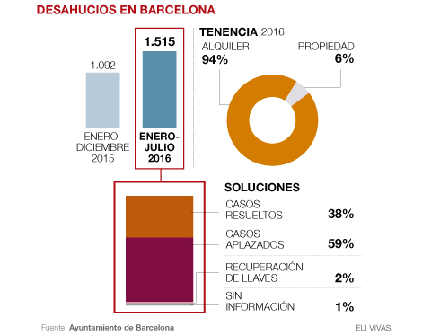
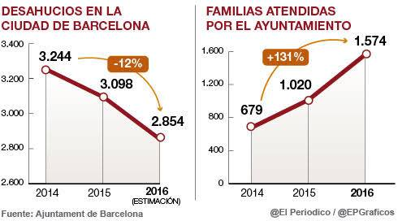
An annual increase of almost 50%. This number do not corresponds to an increase of evictions cases, quite the contrary. In 2016 the number of evictions decreased in 8%, however it remains extraordinary high, with 30 evictions a week just in Barcelona. Therein, the rapid increase of families attended by this homelessness prevention project responds to the firm commitment to strengthen this service by the local administration. Today 80% of eviction processes are attended by it.

Slide 14
PREVENTIVE MEASURES: FROM HOUSING FIRST TO HOUSING LAST
Traditionally, homelessness has been addressed as a social services issue. It is evolving from a `staircase´ model, where the person has to meet certain conditions to gradually have access to better and more stable housing to the `Housing First´ model, based on direct access to long term housing together with social support.
The Housing Last program, takes this same logic but applied to preventive measures deriving from housing policies. If `Housing First´ puts housing at the centre of social integration, this same principle should remain when evictions take place in case of vulnerability and exclusion. This program is the last resource against homelessness.

Slide 15
HOMELESSNESS AND LACK OF AFFORDABLE HOUSING A GROWING TREND IN THE EU
In line with other current initiatives in the EU:
European Pillar of Social Rights, art. 19 on Housing and Homelessness
European Urban Agenda, “Housing Partnership”, have identified homelessness and access to housing as key challenges
Human Rights Based Approach:
“To ensure presence of government officials or their representatives during an eviction” (General Comment Nº6 of the Committee on Economic, Social and Cultural Rights)

Slide 16
Housing last
WORK WITH US IN A TRANSFER NETWORK!!!

