Slide 1
Dupnitsa is a town in western Bulgaria. It is at the foot of the highest mountain in the Balkan Peninsula – the Rila Mountain, and about 50 km south of the capital Sofia. Dupnitsa is the second largest city in Kyustendil Province at the crossroads of the roads from Sofia to Thessaloniki and from Plovdiv to Skopje.
Total area 329.06 km2; Population 44 988.00;
Boryana Sapundzhieva
Senior expert Europrojects
Dupnitsa Municipality
Republic of Bulgaria

Slide 2
HOME FOR EVERYONE
Funding: Operational Program "Regional Development 2007-2013", the Grant Scheme "Support for provision of modern social housing for vulnerable, minority and indigent groups of the population and other disadvantaged groups", priority axis 1 "Sustainable and integrated urban development", under European regional development fund /ERDF/.
Specific objectives:
providing modern social homes for vulnerable, minority and indigent groups of the population and other disadvantaged groups;
ensuring social inclusion, spatial integration and equal access to adequate housing conditions for people in disadvantaged and vulnerable situation;
TARGET GROUPS: 1. Homeless people and/or those living in very bad living conditions, who do not have their own dwelling and do not own movable or immovable property and/or ideal parts of it that can be a source of income; 18.00% for the municipality. 2. Parents with children, incl. underage parents, large families, children with poor health and disabilities; 62.00% for the municipality. 3. People at risk of poverty and social exclusion, persons whose average income per family member for the previous year from all sources is lower than the statutory monthly amount of the guaranteed minimum income for the country (BGN 65). 20.50% for the municipality.

Slide 3
HOME FOR EVERYONE
15 new multi-family residential buildings
Equipment and furnishing of social housing
150 families from the target group were accommodated in newly built dwellings
414 direct users of the project results/social houses
apartments | people | pupils | children 0-7 | romas | unemployed | homeless | parents with children | people at risk of poverty
150 | 414 | 114 | 8 | 72 | 15 | 73 | 209 | 93
 | % | 27.54 | 1.93 | 17.39 | 3.62 | 17.63 | 50.48 | 22.46

Slide 4
Parallel with the construction works “social package" were ensured - complementary services in four main areas:
Access to employment; Registration of the unemployed in the Labor Office Directorate; Survey; Professional orientation; Motivation training; Communication in foreign languages; Digital Competence; Public and civic competences; Learning to learn were the most visited measures!
Access to education;(Retention measures in the education system; Services for children and young people and their parents for better adaptation to the education system and the requirements of the labor market; Conducting courses for adult literacy);
Social inclusion;(Individual consultations, Social services and social and health mediation of the representatives of the target groups; Raising parenting awareness about responsible parenting requirements; Ensure the protected employment of the target group in municipal social enterprises);
Measures for permanent desegregation.
The soft measures were financed by INTEGRA financed under Operational Program Human resources development and European Social Fund /ESF/

Slide 5
Right to apply for social housing have the persons who meet the following conditions at the same time:
Bulgarian citizens with permanent address on the territory of the Municipality of Dupnitsa more than 5 years without interruption;
Do not have a dwelling, villa or common parts of such properties suitable for permanent dwelling or right of use on them;
Do not own a non-built-up landed property for residential or villa construction, ideal parts of such property or right to build on it;
Do not own factories, workshops, shops, commercial and business warehouses or shares of such properties;
Have not transferred properties under items 2, 3 or 4 to others in the last ten years, including a mortgaged property withdrawn in favor of a bank, with the exception of termination of co-ownership, transfer of shares to a third party or donation to benefit of the municipality;
Do not own property, including motor vehicles of a total value greater than the market value of a dwelling in the municipality of Dupnitsa, corresponding to the needs of the family - (the household);
One quarter of the total annual income of individuals/members of their families (households) can not cover the cost of a market rental price for a home corresponding to the needs of the household (household).
* In case of non-compliance with one of the above conditions, the application shall be rejected.
If the applicants meet the above conditions, thеn they are ranked on the basis of the total number of points obtained under the inclusion criteria set out below:
POINTS | EMPLOYMENT | AGE | EDUCATION | HEALTH STATUS | FAMILY STATUS
5 | Working | 29-50 years | Higher | Persons with permanent disabilities with over 90% reduced working capacity | Single parent with one or more children
4 | Unemployed from less than 1 year | 16-29 years | Secondary | Persons without disabilities | Family with 4 children
3 | Unemployed from 1 to 2 years | 50-65 years- | Primary | Persons with 71 and over 71% reduced working capacity | Lonely-living adult
2 | Unemployed over 2 years or retired | Over 65 years | Initial | Persons with 50 and over 50% reduced working capacity | Family without children
1 | Never worked |  | without | Persons under 50% reduced working capacity | Self-employed at working age

Slide 6
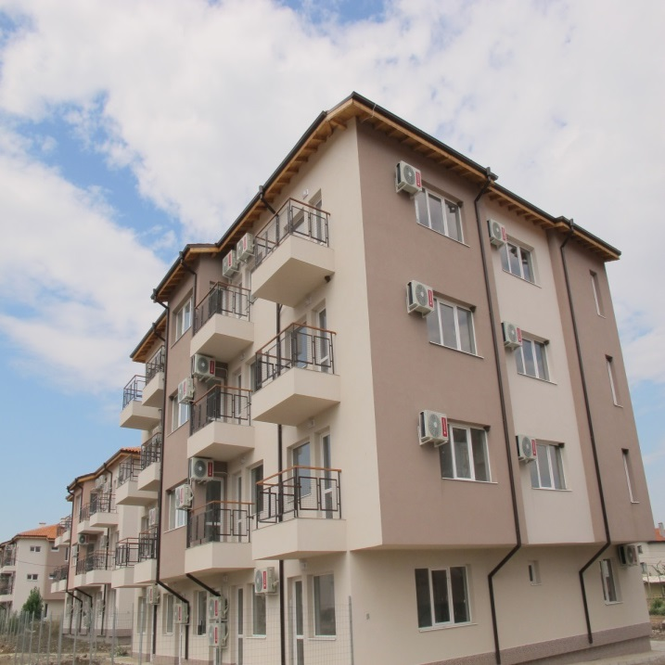
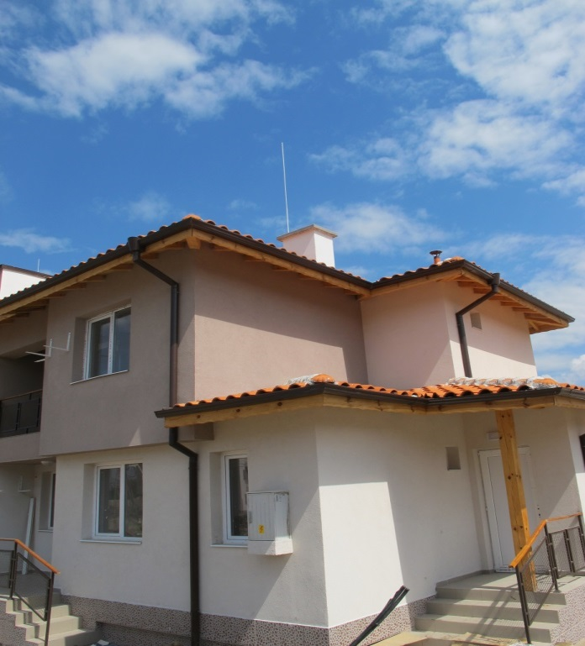

Slide 7
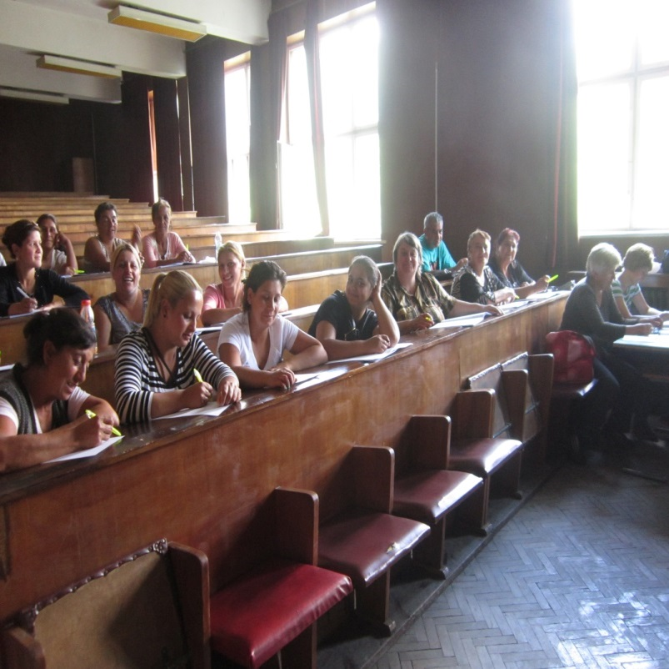
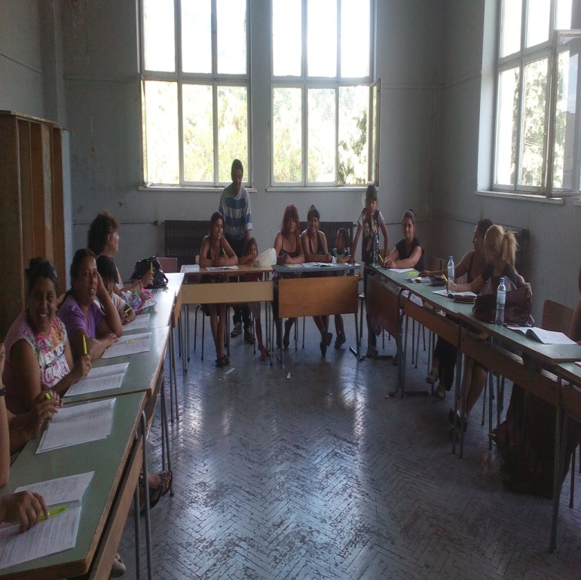

Slide 8
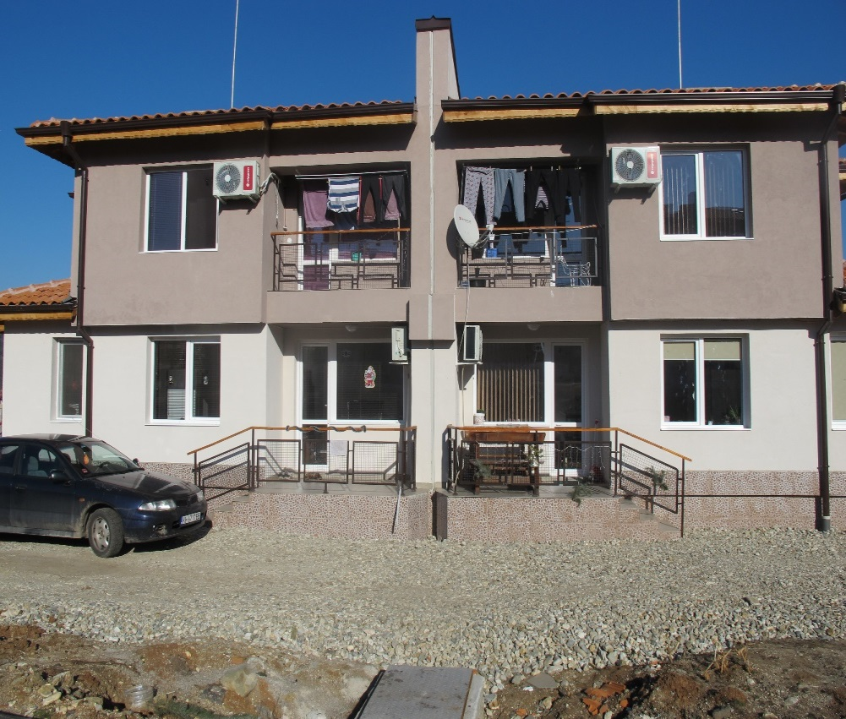
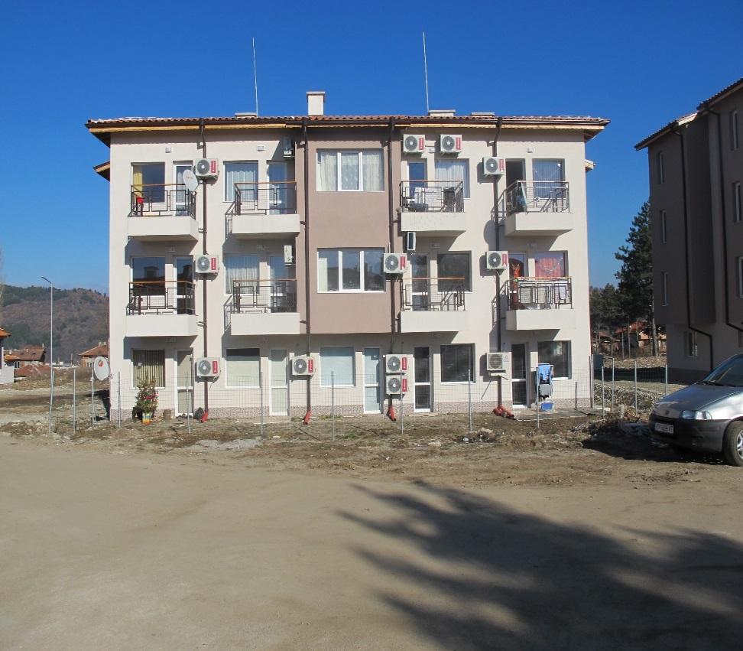

Slide 9
