Slide 2
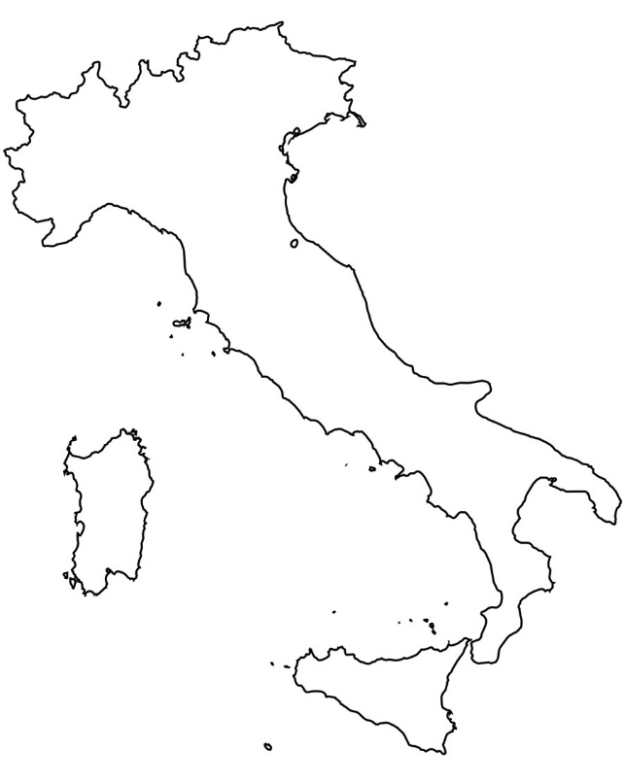
^{CITY TAX MANAGEMENT SYSTEM} ^{GENOA -} ^{ITALY}
Genoa, North West of Italy, 595.000 inhabitants

Slide 3
Raffaella Cecconi
City Marketing, Tourism and International Affairs Department - Municipality of Genoa
Communication and Digital Strategies Staff

Slide 4
^{CITY TAX MANAGEMENT SYSTEM}
^{What it is?}
The City Tax Management System is a governance method which defines and implements the partecipated strategies and actions to promote the city using the resources of the Tax.
It is based on an agreement between the City Hall and the Chamber of Commerce, on behalf of the world of tourism
It was created to involve local business into tourism promotion strategies, and to lower conflicts connected to the Tax adoption itself

Slide 5
^{CITY TAX MANAGEMENT SYSTEM}
^{How does} ^{it work?}
The City Tax Working Group is composed by representatives of the Municipality, the Chamber of Commerce, Hotel Owners, Tourism Stakeholders
It develops the Guidelines and provides the Marketing and Communication Plan, to be implemented by the Municipality
Financed activities - Communication: digital and web marketing, social media, press office - Marketing: workshops and international meetings, Fam Trips - Hospitality: Information Offices management

Slide 6
^{CITY TAX MANAGEMENT SYSTEM}
^{Problems to be overcome}
Lack of trust in the Municipality effectiveness by ^{Hotel owners} ^{and local business}
^{A city} positioning to be redefined and shared with citizens and business
^{Communication and Marketing} ^{strategies to be updated}
Worry about the influence of sharing economy players

Slide 7
^{CITY TAX MANAGEMENT SYSTEM}
^{Lessons} ^{learnt}
City Tax Management System is based on collaborative planning, and allows a co-creating method
A real public-private partnership guarantees a better use of the resources and effectively strengthens the local economy
The use of an integrated approach supports the growth of a sustainable tourism

