Slide 2
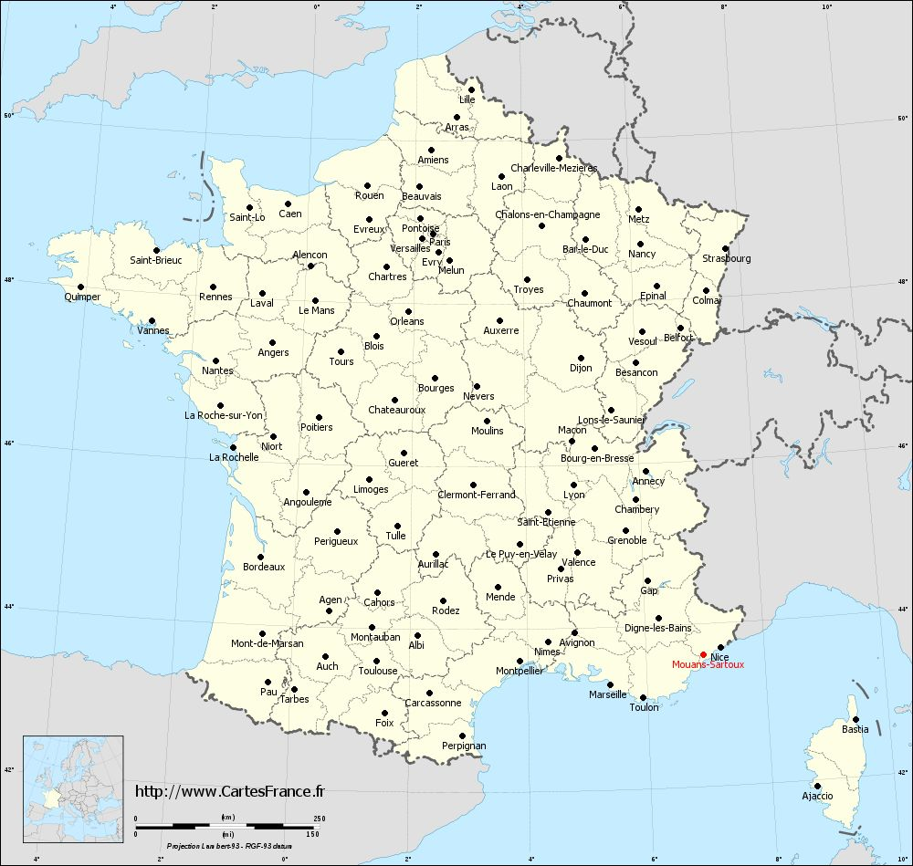
^{Collective school catering}
A sustainable initiative for a territorial agri-food policy
City of Mouans-Sartoux, FRANCE
Gilles PEROLE, Elected representative
Lea STURTON, Food Quality Officer

Slide 3
1999 Mad cow disease: elected representatives become aware of the links between food, health and environment
2005-2006 Review of the menus for a healthier diet
Organic food
2008 One step further to adress environmental issues
Local food
Today: 1000 meals 100% organic and 60% local
A local urban zoning plan that triples agricultural areas to impulse and strenghten local economy in the agri-food sector.

Slide 4
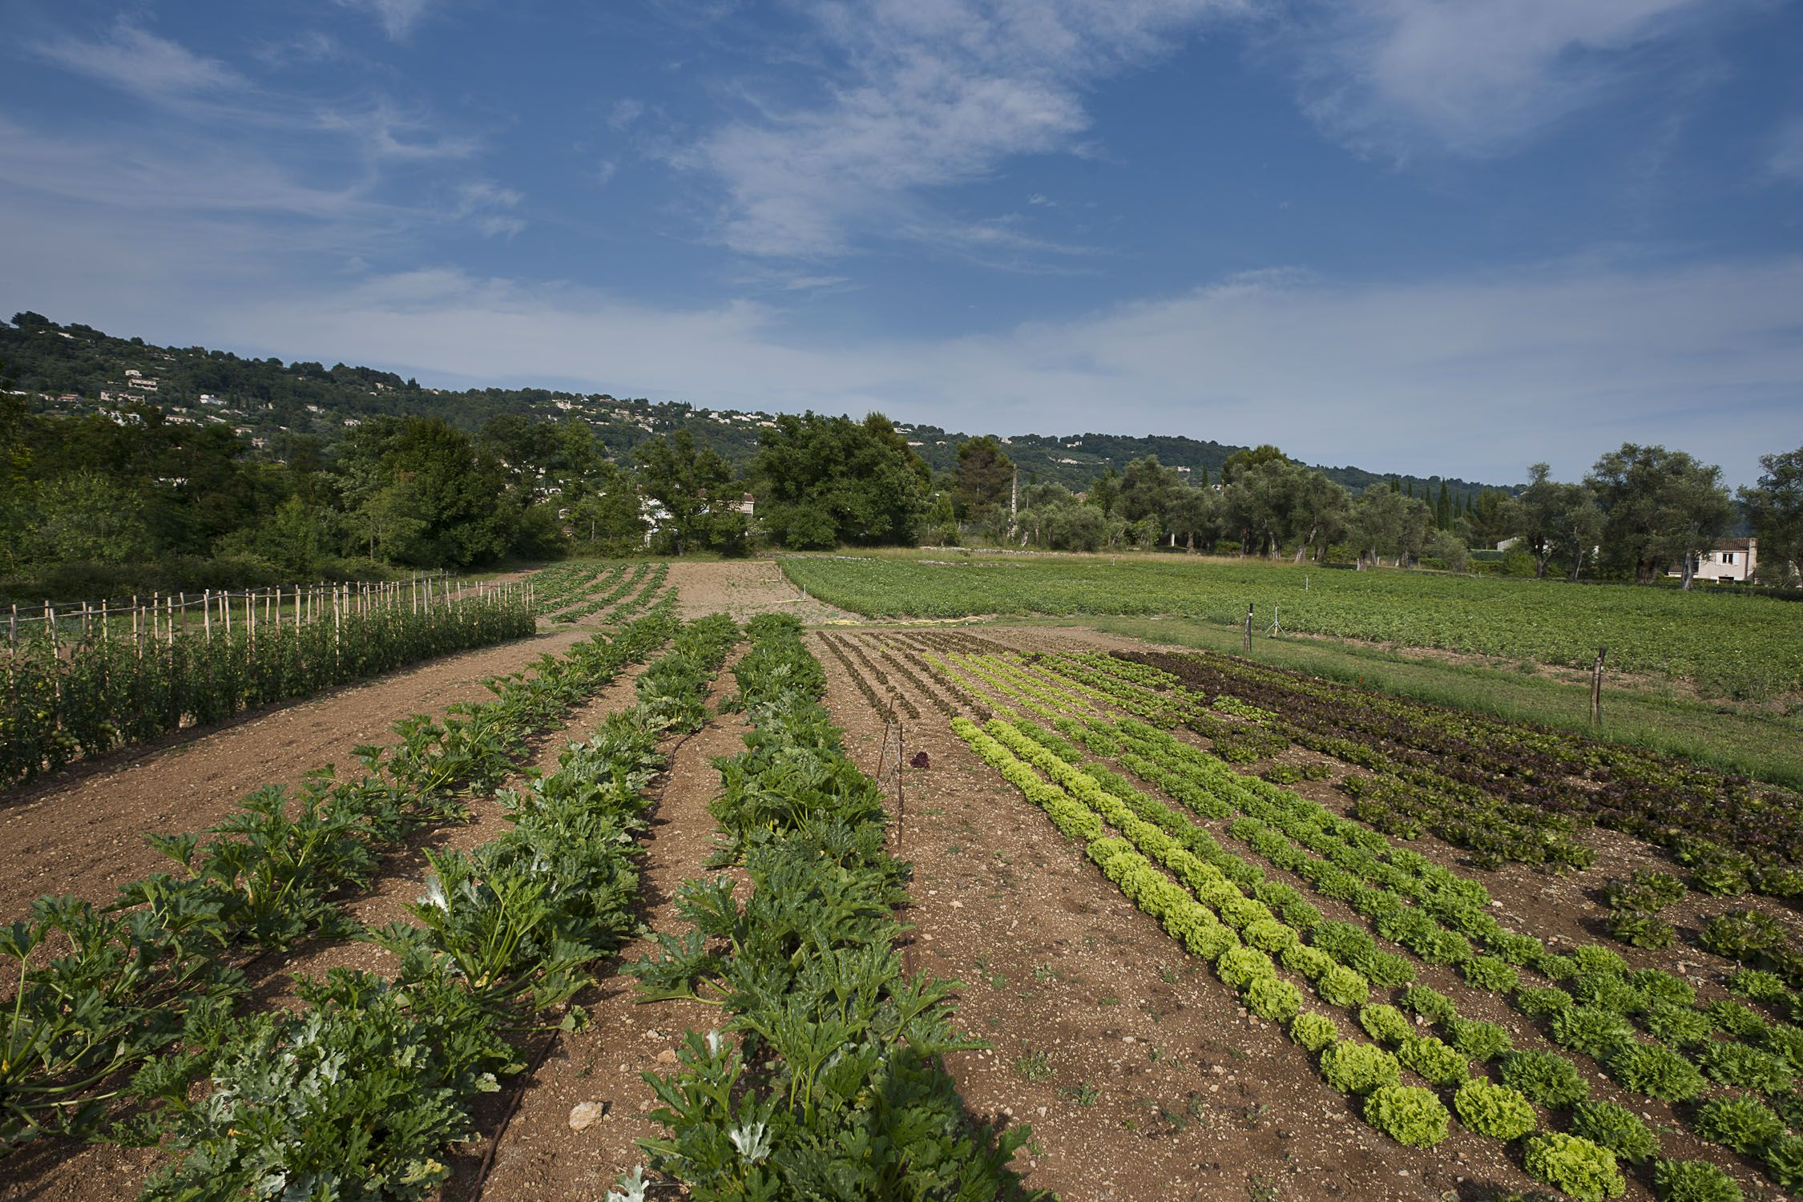
How can school canteens promote local economy ?
2010 : creation of a municipal farm
3 full-time equivalent employees (2 farmers)
Revision of the public procurement policy :
Smaller and specific calls
Mouans-Sartoux bakery, turn towards organic breads
New attribution criteria : 40% quality, 30% environment, 30% price
85% of the parents : modification of food habits
31% shop at a local producer‘s once a week
Global strategy to develop a territorial agri-food sector
Muncipal support towards farm settlements
Fundings for an organic grower in 2014, with a sale point in the city
Creation of a grocery store selling organic, local and bulk products (2 new jobs)

Slide 5
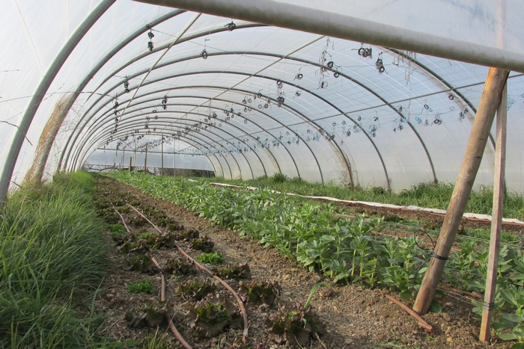
What we had to overcome
Lack of local farms in the Alpes-Maritimes departement, more touristic than agricultural
Tedious public procurement rules
The mental block, from the staff, from the elected representatives or from the partners

Slide 6
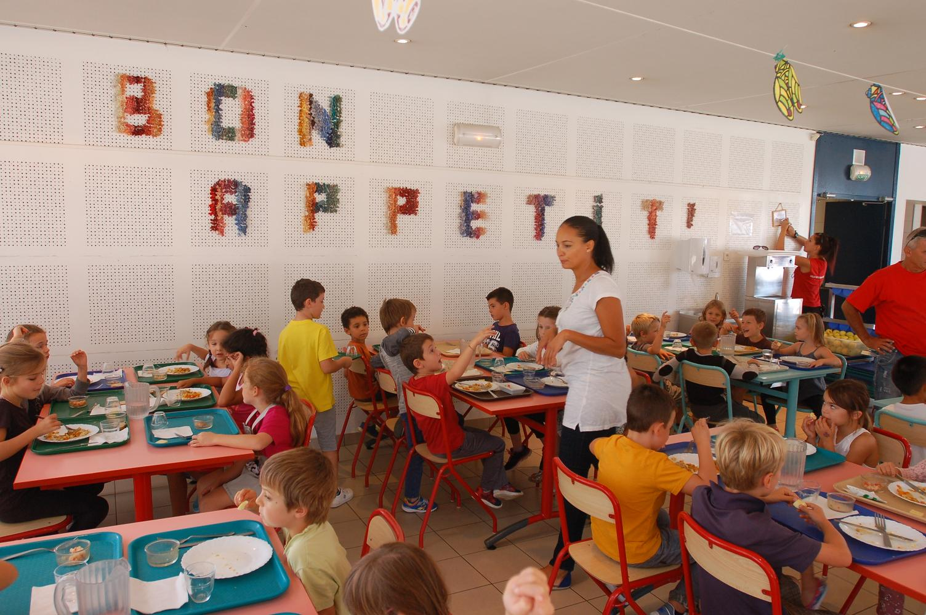
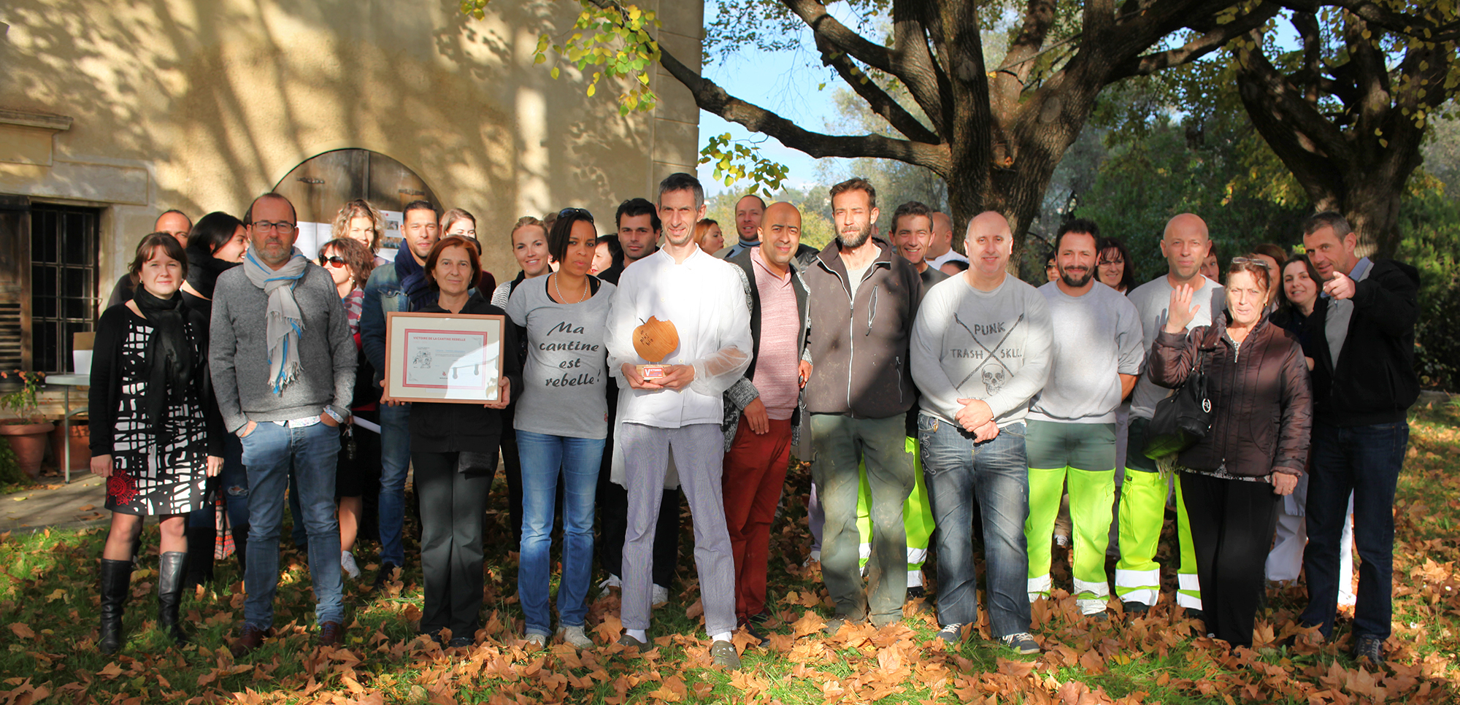
Main lessons learnt
Involve the staff and empower as much as possible
Promote agriculture at local level and have a global reflection
Real adoption of new food habits by parents
Don’t be afraid to do something new!

