Slide 2
^{ENTREPRENEURSHIP PANEL}
MODERATOR: JIM SIMS
QUESTION FACILITATOR: ALISA ALITI VLASIC
How to identify your city's business assets? Can culture be a good business? What kind of business support for social economy?

Slide 3
Alan Davidson
Principal, Co-operative Development Unit
^{GLASGOW CITY COUNCIL}
^{T: 0141 287 7269}
E: alan.davidson@drs.glasgow.gov.uk

Slide 4
Link

Slide 5
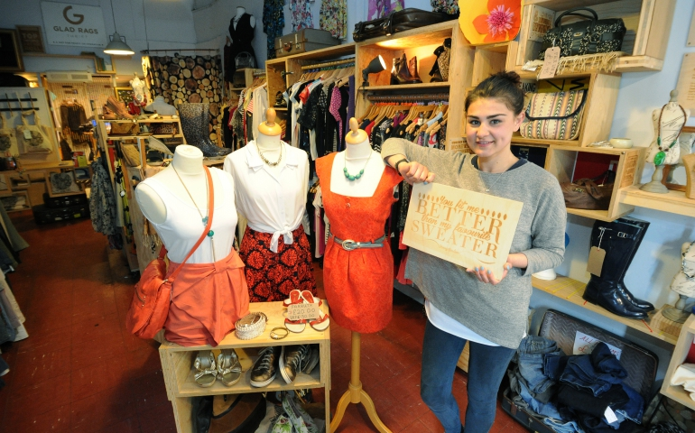
^{CO-OPERATIVE CITY}
GLASGOW / UK
Building new partnerships between public services and local people to foster greater co-design and delivery of local services

Slide 6
Where?
Glasgow is Scotland's largest city situated at the edge of western Europe
Why?
The number of our local authority employees has reduced from 38,000 to 19,000 in 15 years.
However our statutory and other responsibilities have grown.
We are now exploring new ways of service development and delivery.
Who?
Citizens, service providers, partners, NGOs
Glasgow
Population 615,070

Slide 7
What?
Co-design ‘with’ citizens
Grow Co-operative Sector
Encourage External Co-operative Activity
Change how Local Authority Operates

Slide 8
When?
Summer 2013 and ongoing
Long term Commitment to changing culture and practice
Not time limited – continue to embed co-operative values in all our work

Slide 9
How?
Putting co-operative values at the heart of everything we do
Co-operative Champions within Glasgow city Council Service Departments
Projects:
FareShare
Glasgow Peoples Energy
Digital Glasgow
Co-Operative Council Innovation Network
Co-operative Development Fund – Growing the sector
Community Benefits

Slide 10
Inclusive Economic Growth
Economic growth that creates opportunity for all segments of the populations and distributes the dividends on increased prosperity both in monetary and non monetary terms, fairly across society (OECD)
Development of a Social Enterprise Strategy for Glasgow
Widening the scope of our activity for greater impact
Community benefit clauses in procurement
Promoting the Glasgow Living Wage
Digital Glasgow
Fundamental change in Childcare

Slide 11
Inclusive Economic Growth: Case Study
Using Co-operative Methodology, how can Glasgow co-design a more flexible and affordable model of high quality childcare that meets the dynamic needs of Glasgow families?
Strategic Arrangement with Stakeholders embedded from the start;
Creating a shared ambition for childcare provision across all sectors;
Map provision, consult with parents and providers;
Enter into formal co-operative or similar model to find solutions and implement.

