Slide 1
THE HOUSING AGENCY FOR SHRINKING CITIES
Martin Neubert
Project Manager

Slide 2
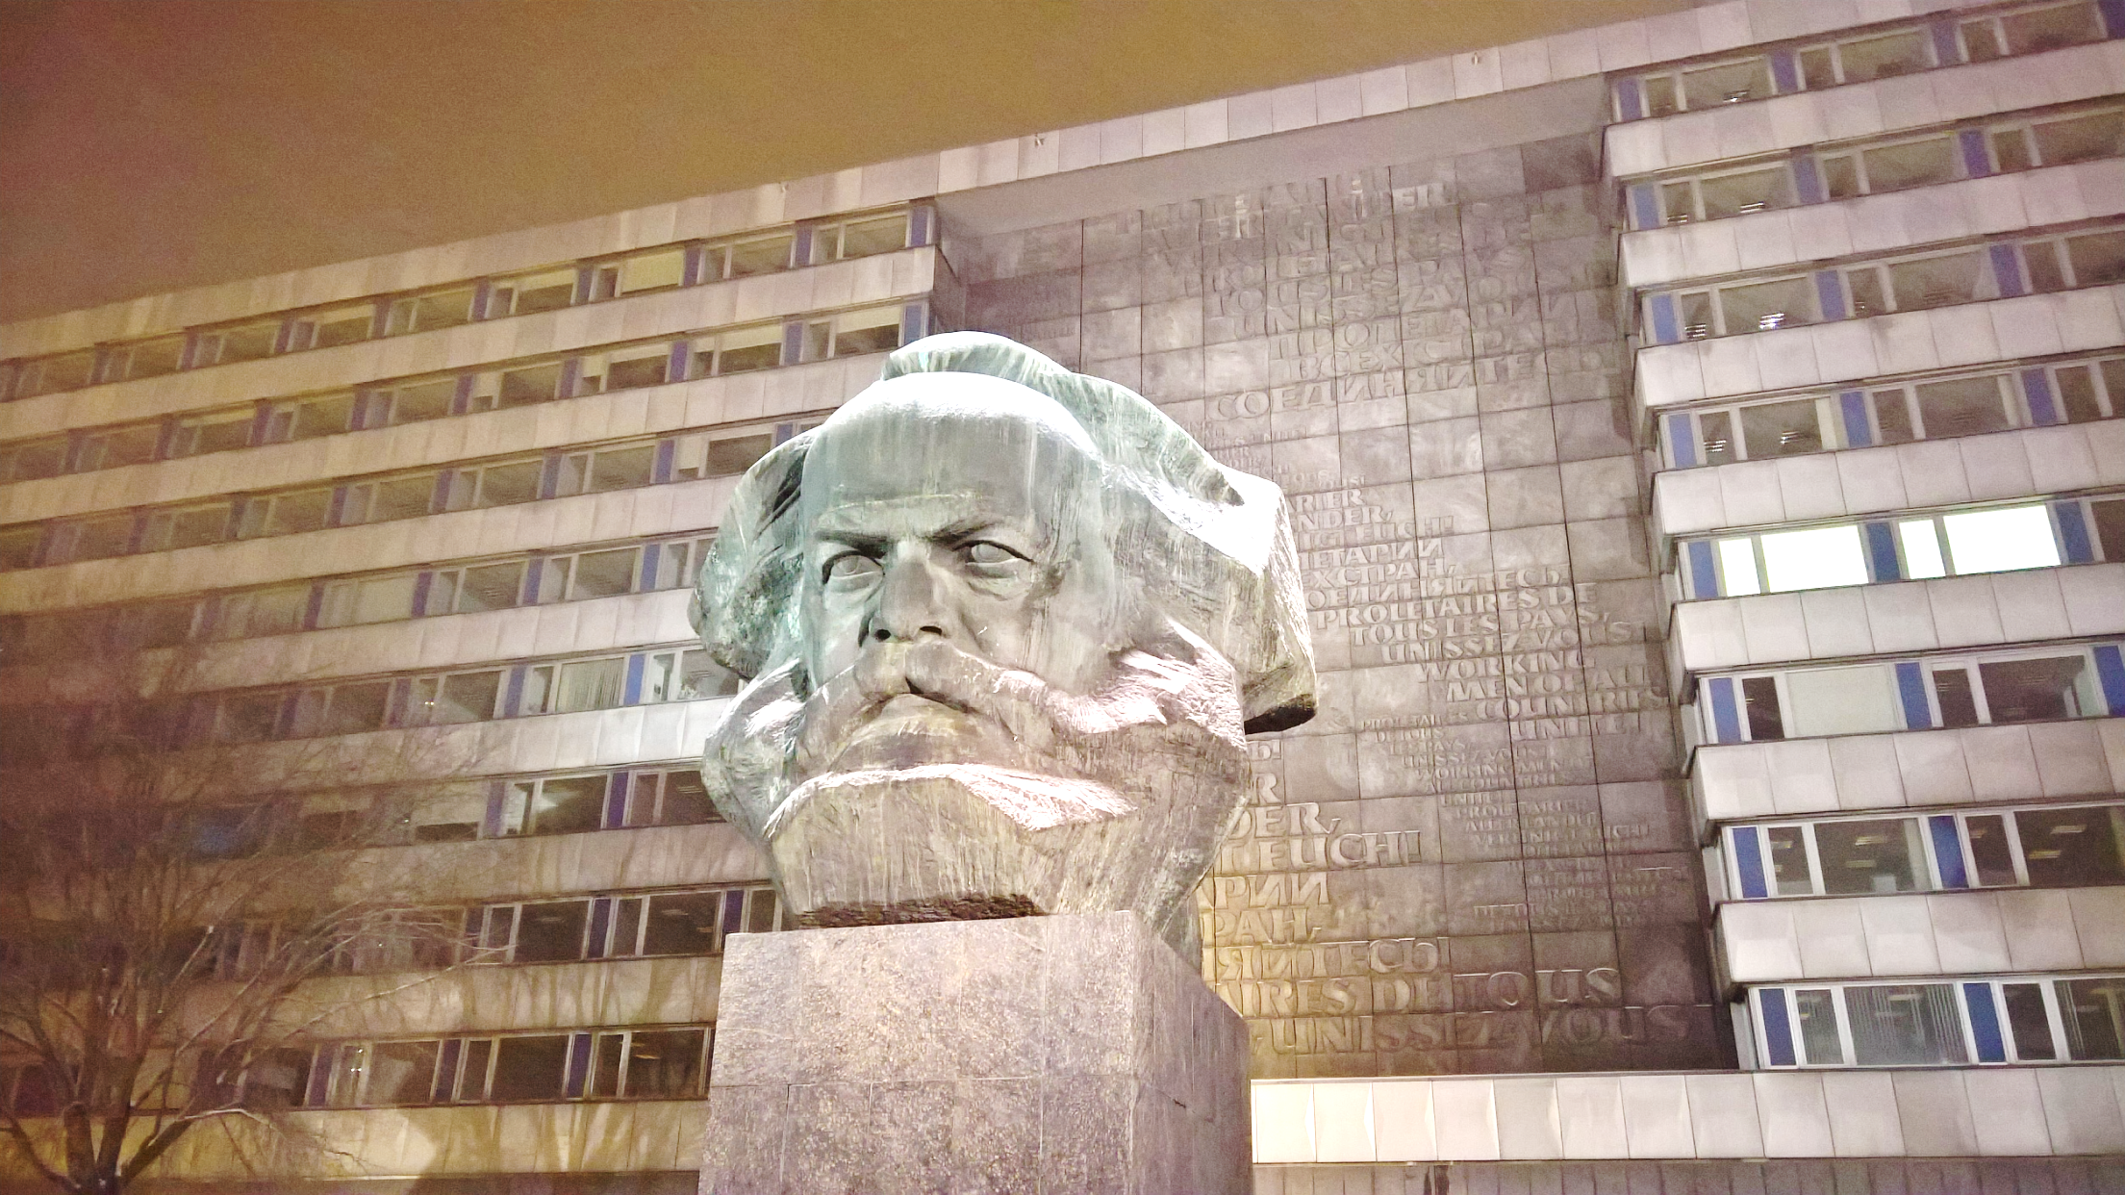

Slide 3
POPULATION DEVELOPMENT

Slide 4
HOUSING SITUATION IN CHEMNITZ
42 % of dwellings built before 1946
19,000 dwellings demolished since 2001 (through federal grants)
24,622 vacant flats (15.7 %)
non-vacant dwellings: 83% rented, 17 % owned
average rents: 4.50-6.50 €/m²
increasing number of (mainly smaller) households

Slide 5
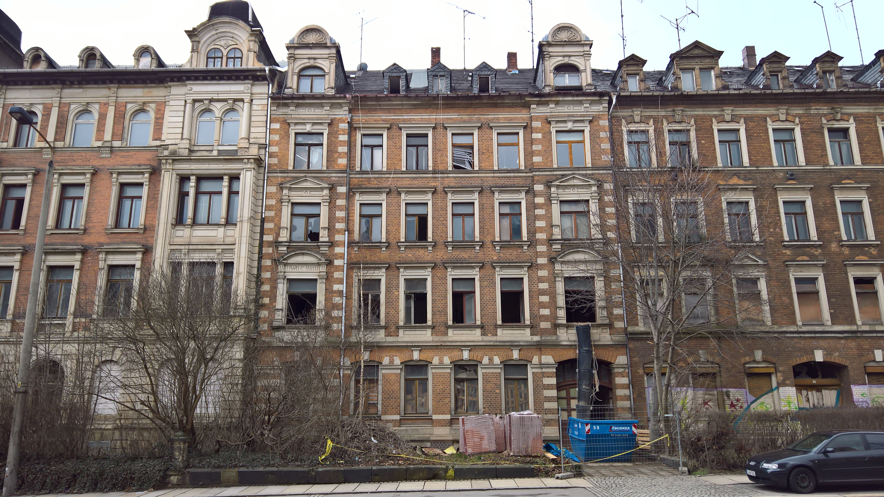

Slide 6
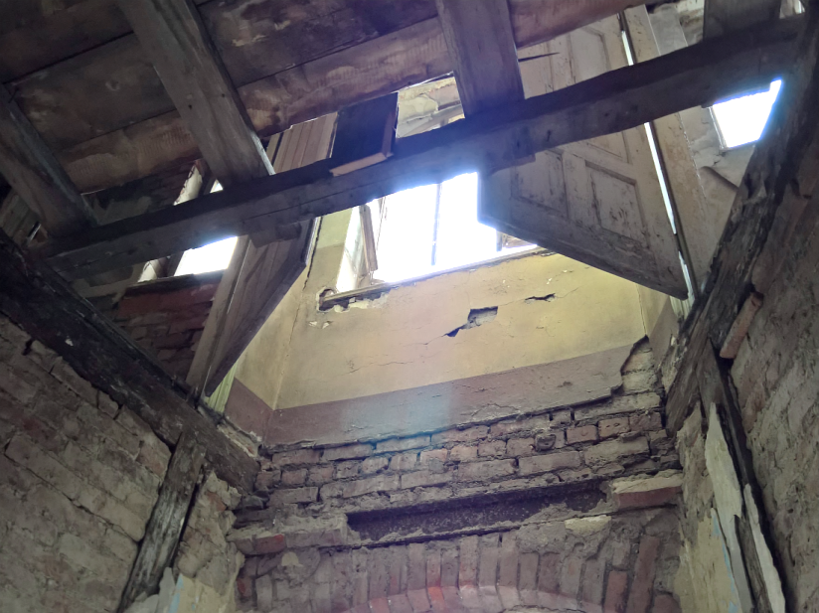
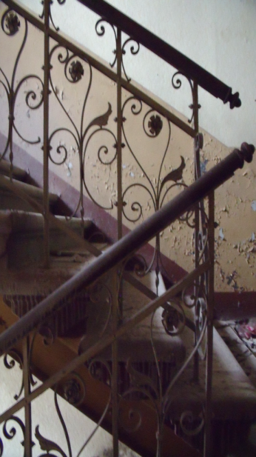
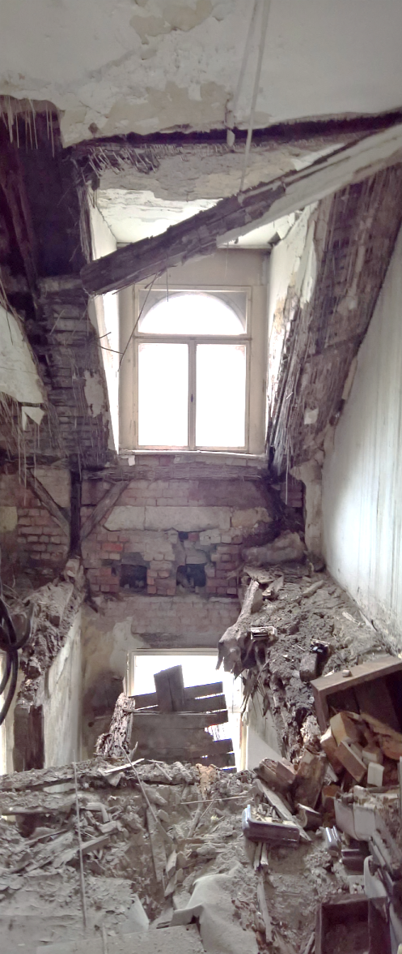
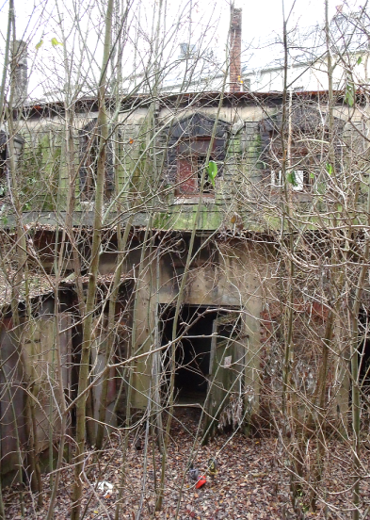
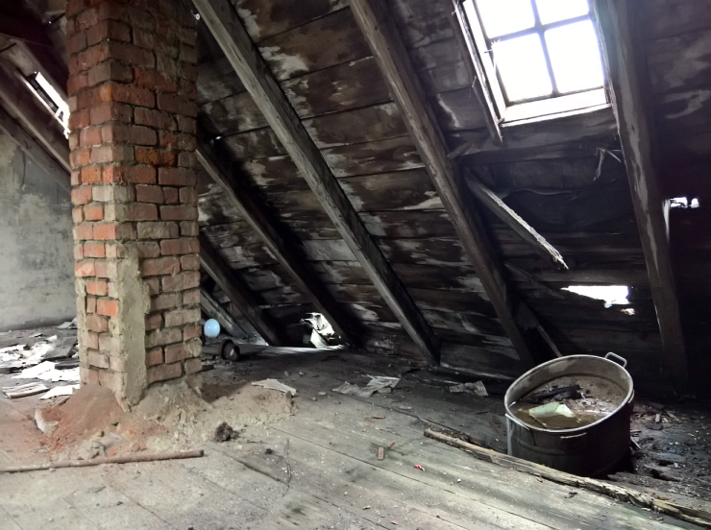

Slide 7
AGENTUR STADTWOHNEN CHEMNITZ
Urban Planning
Building Control
Preservation
Finance and Tax
Public Relations …
Urban development company
Grant management
Urban planning
Strategic development
Building management

Slide 8
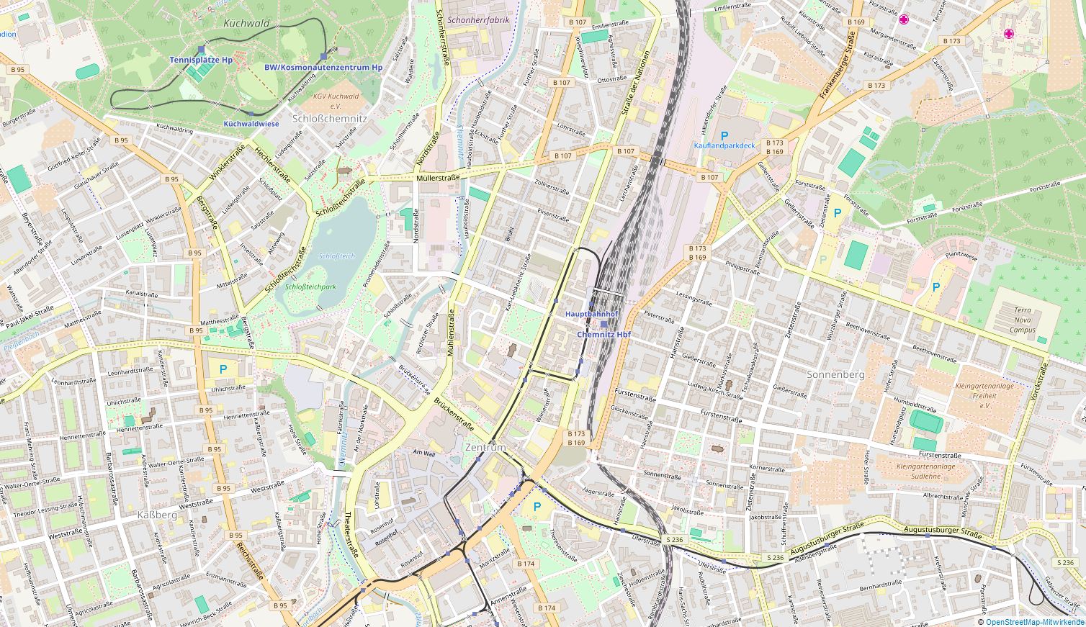
FOCUS
AREAS
CITY
CENTRE

Slide 9
PROCEDURES
1  Identification of buildings
2  Data collection, monitoring
3  Owner contact and activation

Slide 10
PROCEDURES
1  Identification of buildings
2  Data collection, monitoring
3  Owner contact and activation
4  Publication
5  Visit of building with interested people
6  Connecting owners and potential buyers
7  Liaison with administration and stakeholders

Slide 11
AGENTUR STADTWOHNEN CHEMNITZ
Agentur StadtWohnen Chemnitz (moderator)
Public administration
Owner
Potential investors and users
Grant manager and other experts
other stakeholders

Slide 12
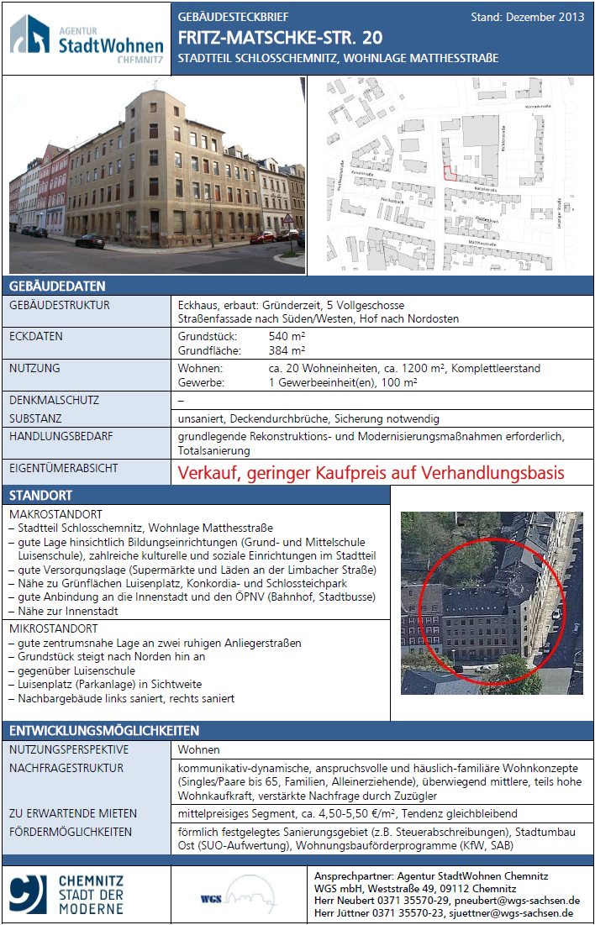
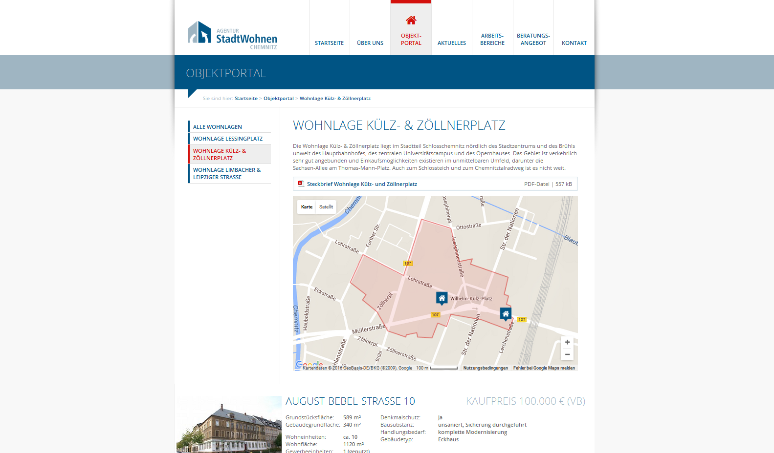
PUBLICATION

Slide 13
100 BUILDINGS
100
100 apartment buildings from the Gründerzeit era (1871-1918)
61 listed

Slide 14
100 BUILDINGS
97
97 buildings with owner contact

Slide 15
100 BUILDINGS
91
91 buildings with owner activation

Slide 16
100 BUILDINGS
40
40 buildings published on the agency’s website
7 on commercial real estate websites

Slide 17
100 BUILDINGS
65
65 buildings with a change in ownership
10 through auction by court order

Slide 18
100 BUILDINGS
52
52 renovation or preparation phase

Slide 19
100 BUILDINGS
15
15 re-used buildings after finished renovation
(mostly dwellings)

Slide 20
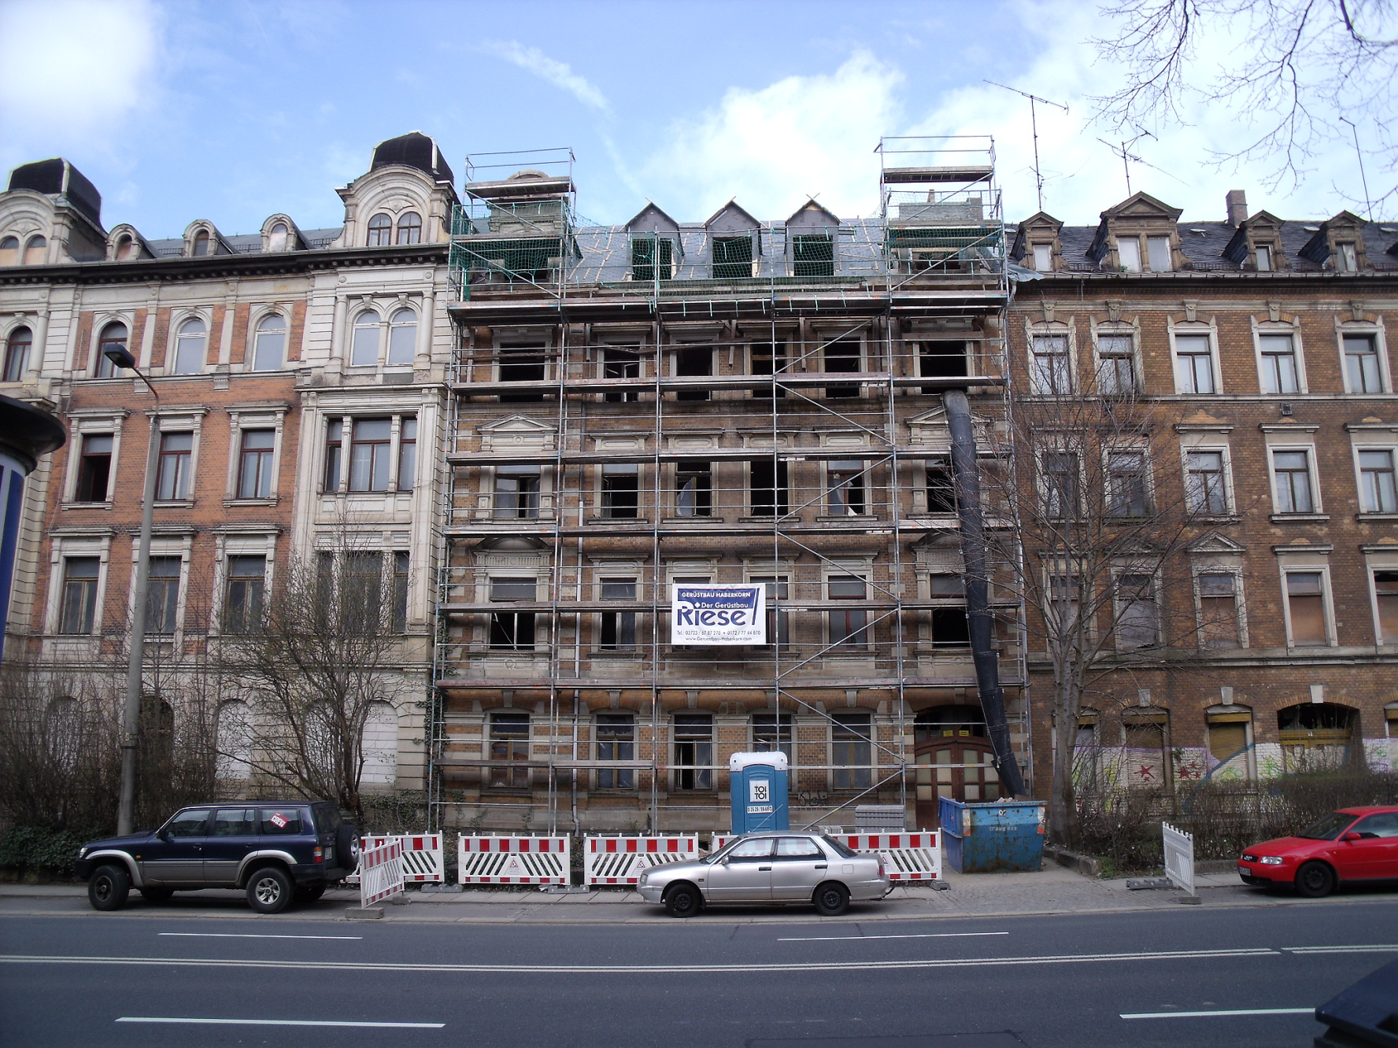

Slide 22
Question from the critical friend
What is the main difference between the agency and a tradition public or private agency? What are the difficulties and advantages of having this public-private structure?

