Slide 1
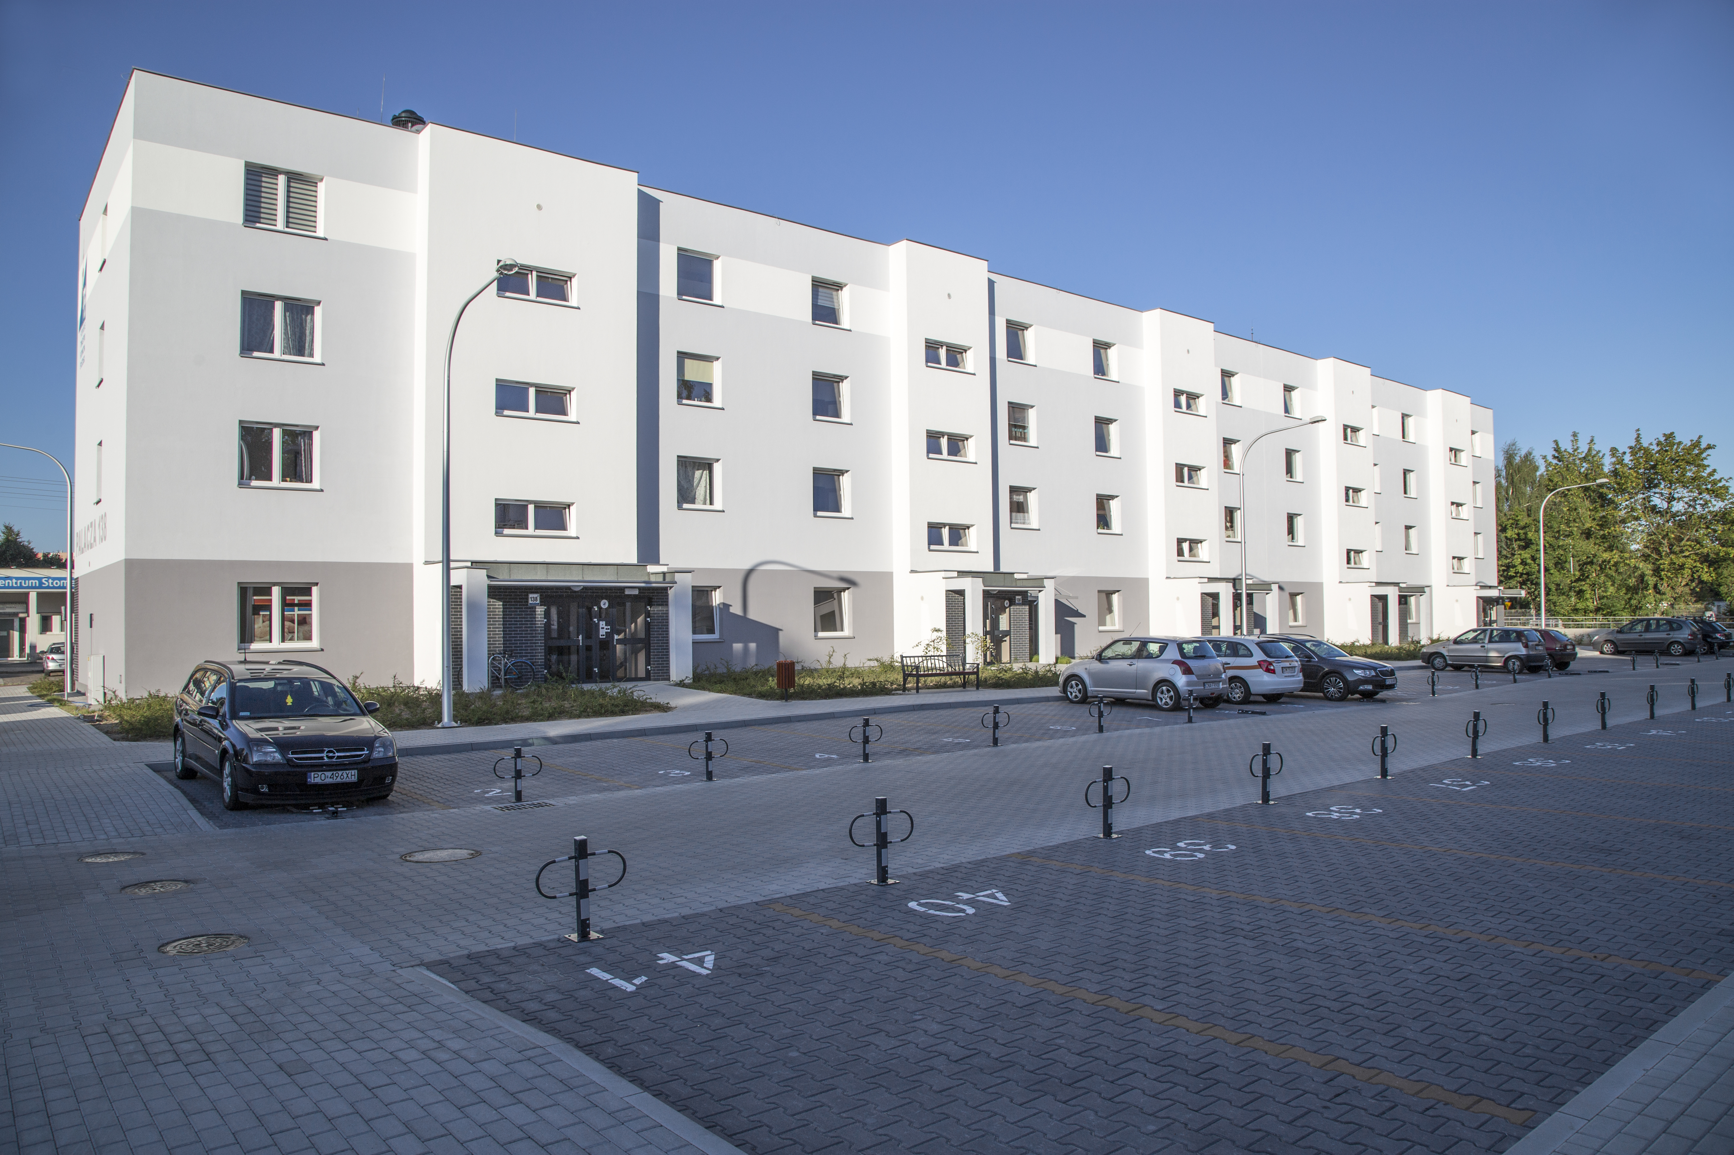
„Apartments for graduates”
Poznań City Hall – Anna Andersz-Jaworska

Slide 2
- Population: over half a million
- Between Berlin and Warsaw
- Entrepreneurship
- Academic city
- Problems: not enough social and affordable housing
Poznań

Slide 3
Apartments for Graduates
- University graduates (5 years)
- Not more than 36 years old
- Income
- Pay taxes in Poznań
- Rental for up to 10 years
- Affordable pricing & good conditions

Slide 4
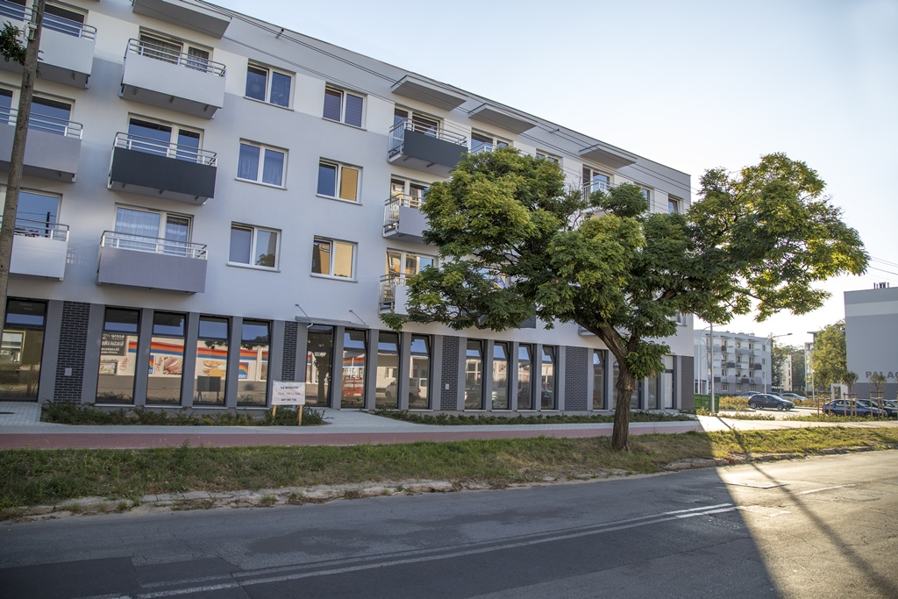
Social vs affordable housing
- Income – in affordable housing programmes minimum and maximum
- Social – guaranteed by Polish law in case of evictions
- Affordable – designed for groups: graduates, elderly, general programme

Slide 5
Management
2 city-run companies:
ZKZL – manages social housing
PTBS – manages affordable housing
Subsidies:
PCŚ (city institution)
Rental subsidy
Electricity subsidy
Rent reduction

Slide 6
Avoiding segregation
- Localisations in different parts of the city
- Kindegarten in the building for elderly
- Buildings, not whole neighbourhoods
- Project: free time activities in the building of social housing that can also be attended by children from affordable housing

