Slide 2
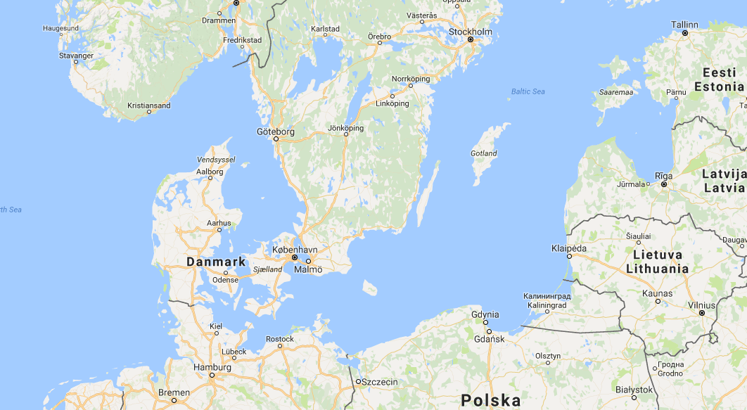
^{PLACEMENT POUR LE TITRE} ^{DU SLIDE MÊME SI IL EST LONG.}
SOUS-TITRE EVENTUEL
Aarhus
Eporum dit, Castant risquam posulissimum inte horemoe ntemque nocatre vivercerem is iam vis hostasdam iam pertem essi prareo, ste, crem patquis opterendium. Onstre derem porende tam potemed atrum Romneque iae poris.
Culture as the intermediary

Slide 3
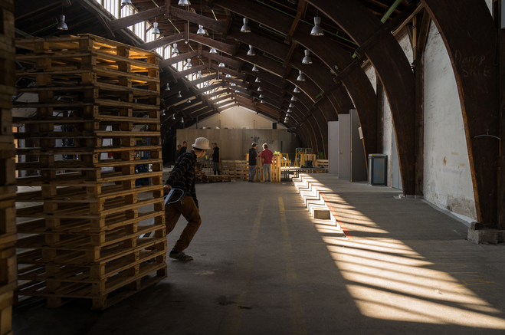
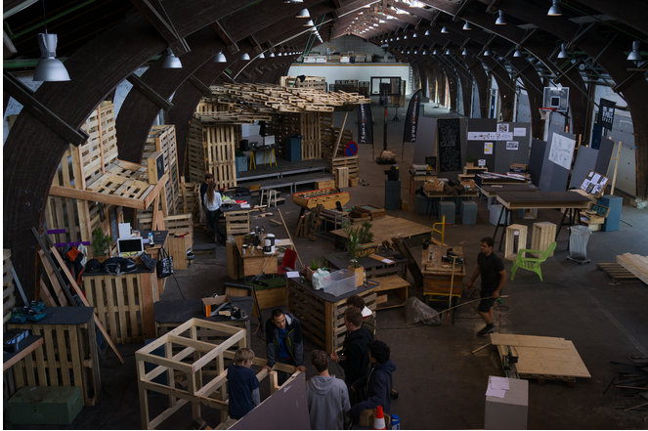
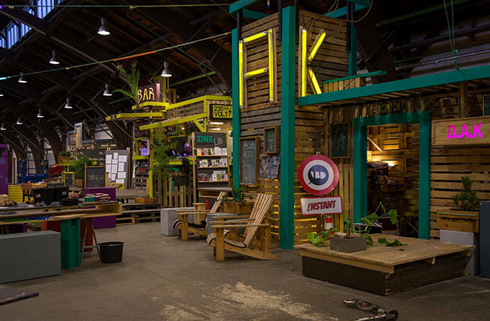
“Culture is a core asset, which is strategically used to build bridges between the municipality and citizens, thus facilitating dialogue.”
Buildings/empty spaces and skills by employees of the municipality are combined in new ways.

Slide 4
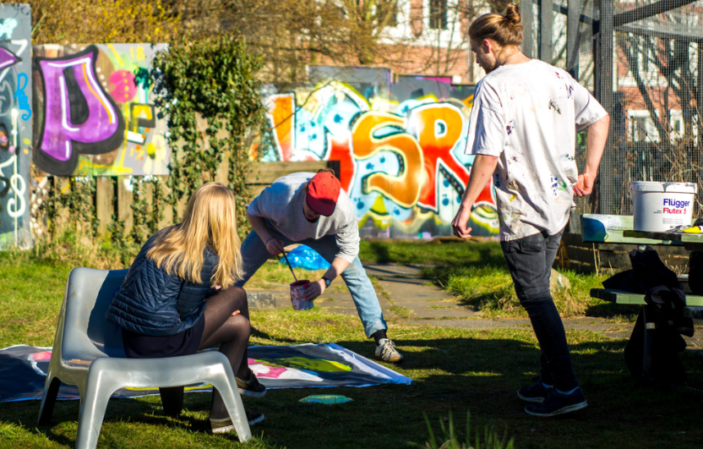
Youth community centre:
Participation around culture is the integrated and leading strategy facing complex problems such as loneliness inclusion of vulnerable young people and youth unemployment
Flexibility: Trying out things in practice and in a temporary context, rather than working with permanent solutions

Slide 5
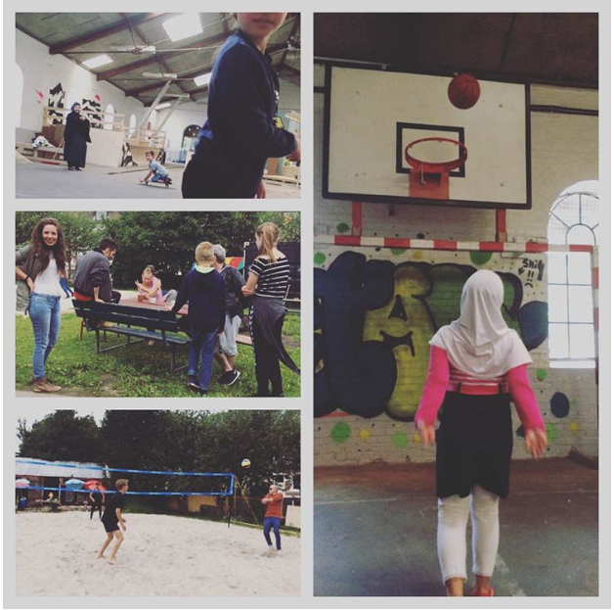
Youth community centre – conclusion from the evaluation in 2017:
Co-creation is important
Inclusion and diversity
Temporality, uncertainty
Focus on coping life
Entrepreneurship
Democracy
Artistic an cultural communities

Slide 6
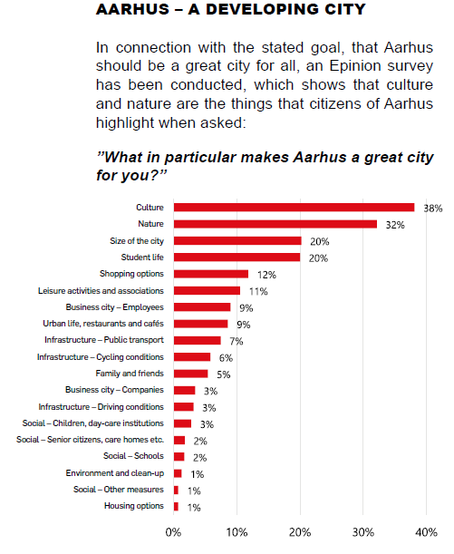
The essence of our good practices is that culture in itself build bridges between municipal subject areas, where we need to find solutions in collaboration with citizens.
It is a strategic element in the cultural policy of Aarhus and has been adopted in the strategy of the development of the city:
“City ​​life before urban spaces and urban spaces before buildings”

