Slide 1
Neighbourhood Regeneration
Good Practice Aalborg
Holistic method for urban regeneration
Anne Juel Andersen
Architect, PhD, Project Manager
Urban and Landscape Department
City of Aalborg

Slide 2
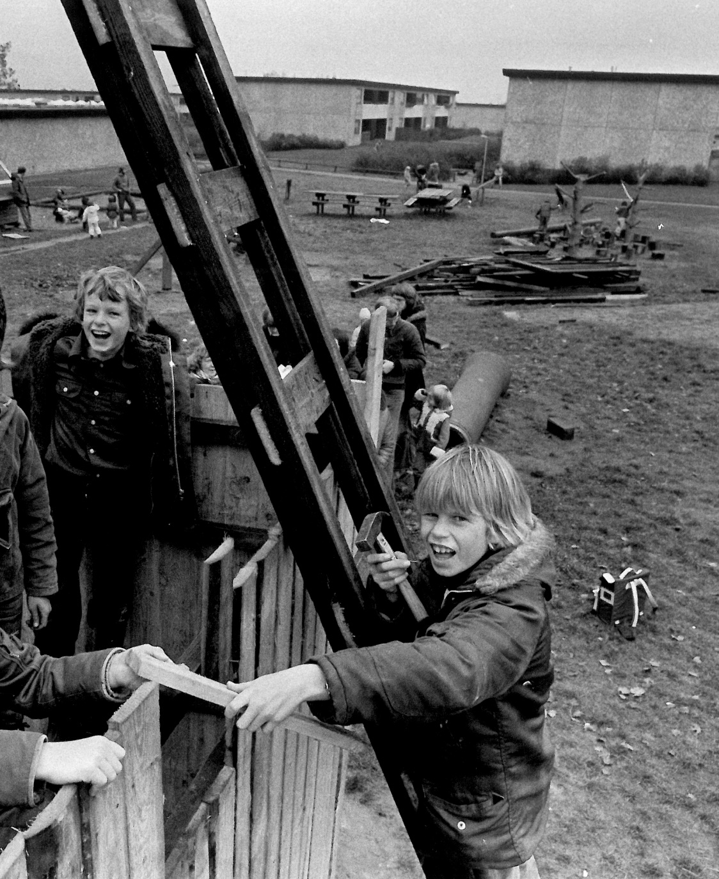
Tornhøj Area – Aalborg East
Suburb built up in 1970’ies
Clearance of inner city slum
Modern appartments - air and light for everybody

Slide 3
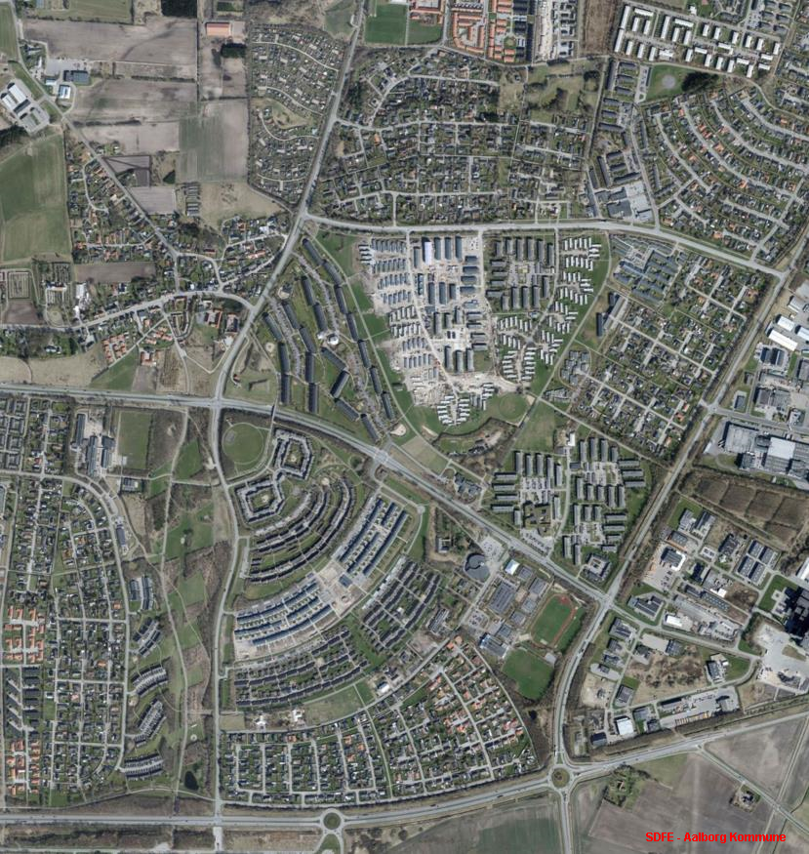
Bad reputation in the city
Need for modernisation
Long history of neighbourhood projects
20 years of working together in a ‘neighbourhood workshop’
But still a need for rethinking and restructuring
Kildeparken
Kildeparken
Neighbourhood workshop
Tornhoj

Slide 4
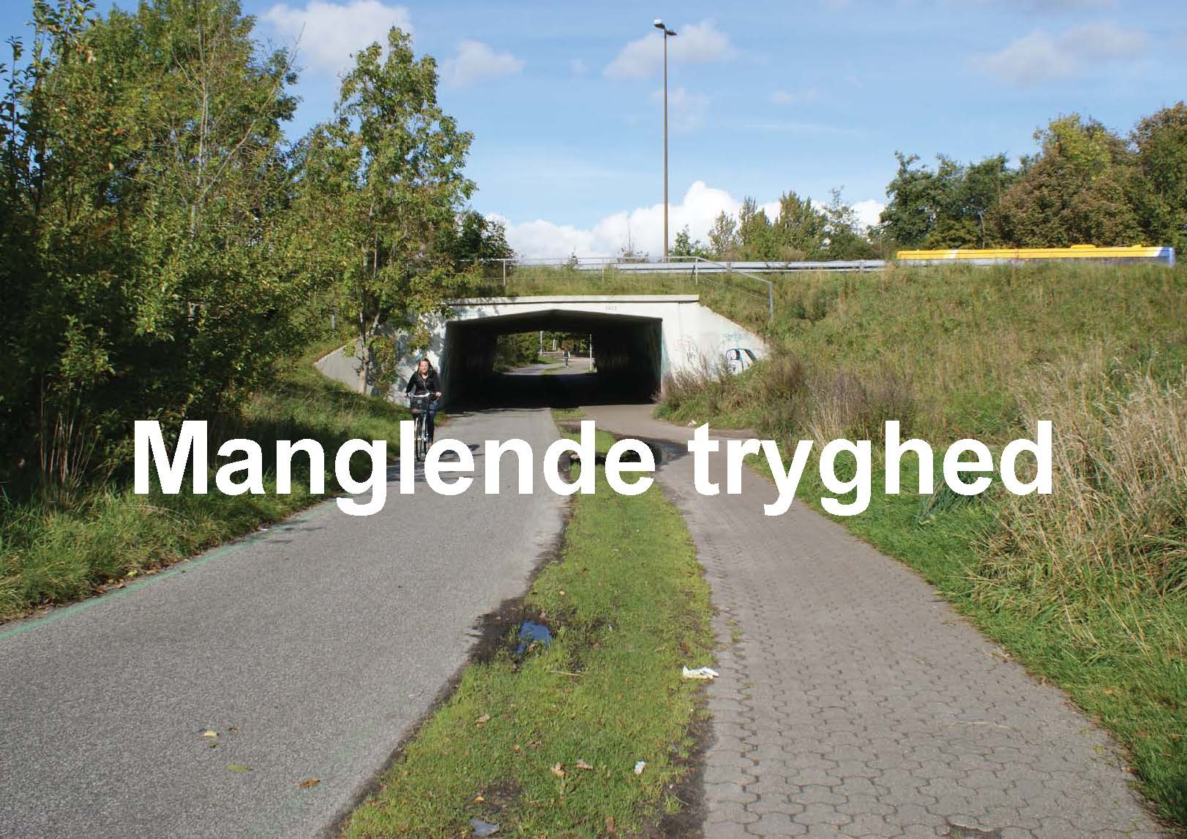
Empty appartments
Lack of security
In and out of ‘ghetto list’

Slide 6
Competition about ‘suburb of the future’ led by Realdania Foundation
Focus on potentials of Aalborg East

Slide 7
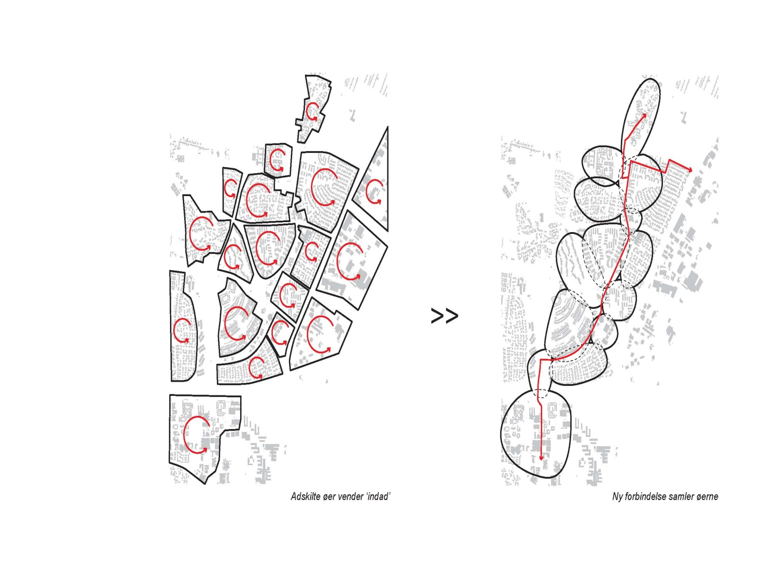
Rethinking of the urban structure
Tornhoj
Separated islands turning inside-out
New connection as a back-bone

Slide 8

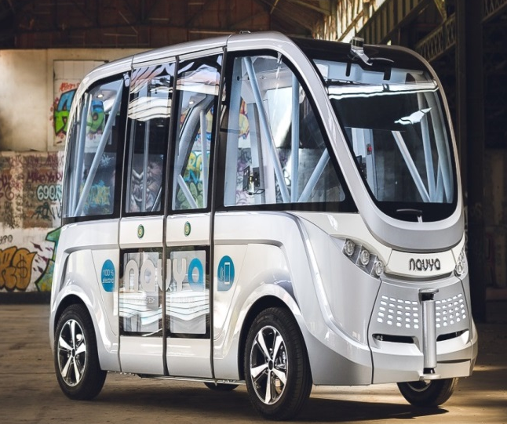
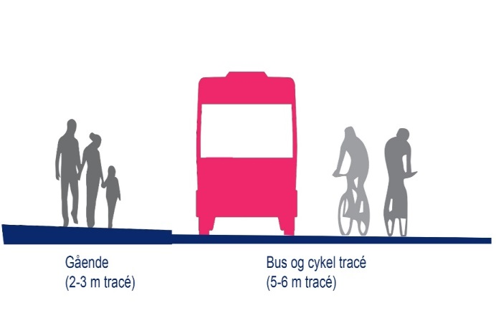
Vision stretch and test section
Driverless bus – ‘first mover’ - 2018

Slide 9
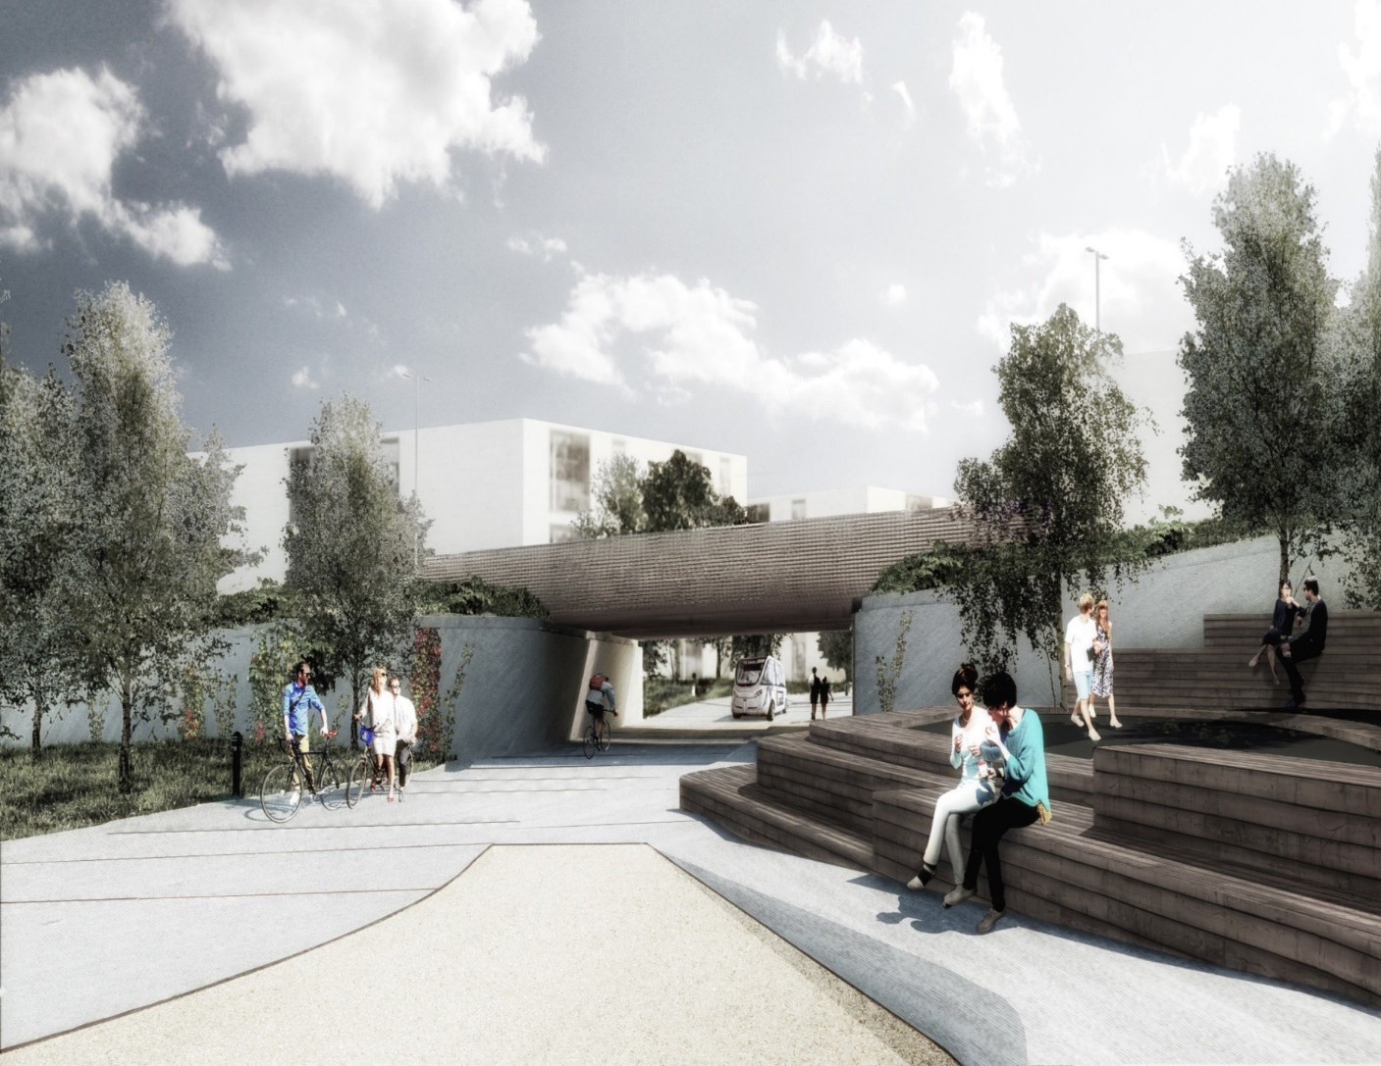
Kickstart Tornhøj – tunnel and urban space
Cooperation Realdania and Municipality

Slide 10
Kildeparken 2020
Renovation of 1000 flats
Housing Association an important partner

Slide 11
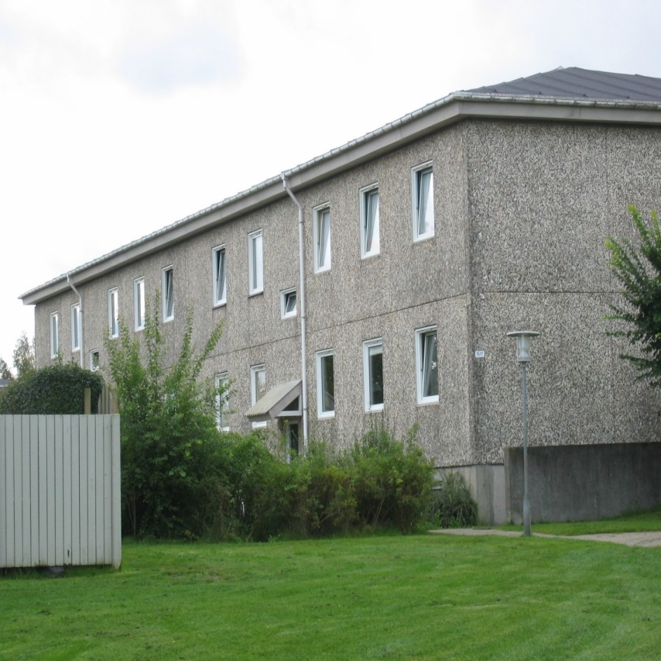
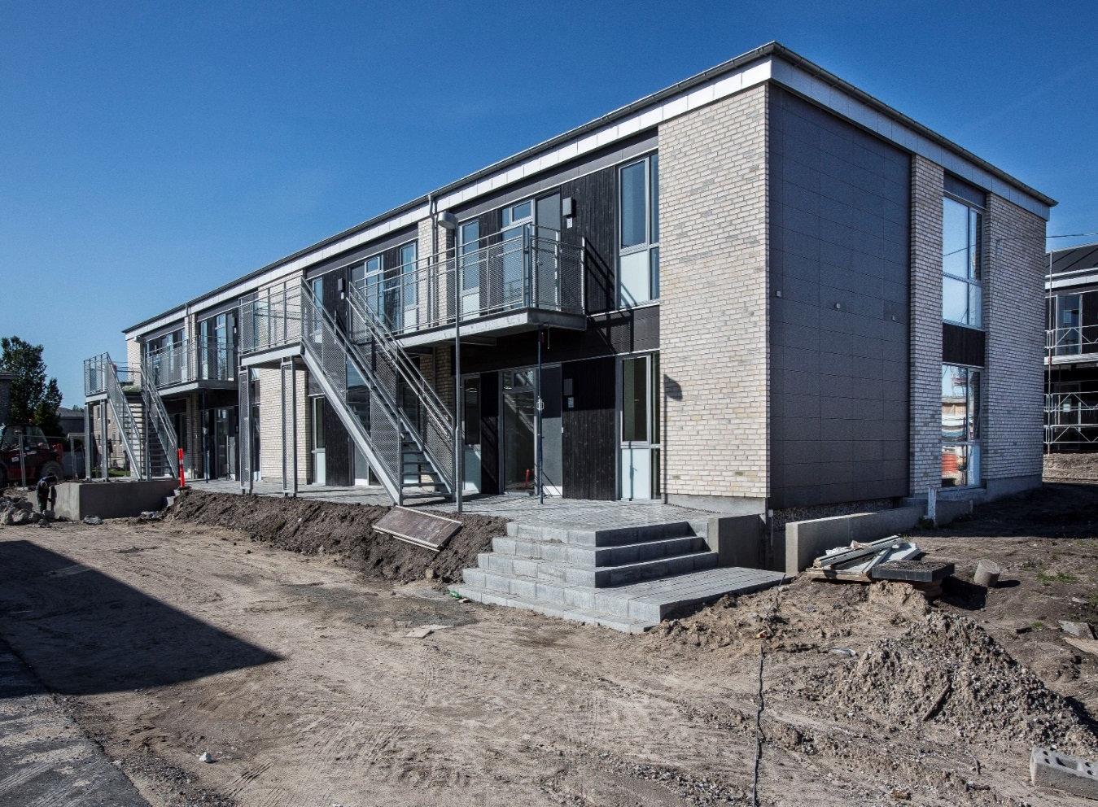
^{ROLE OF THE PUBLIC}
Blåkildevej 1972 and 2017

Slide 12
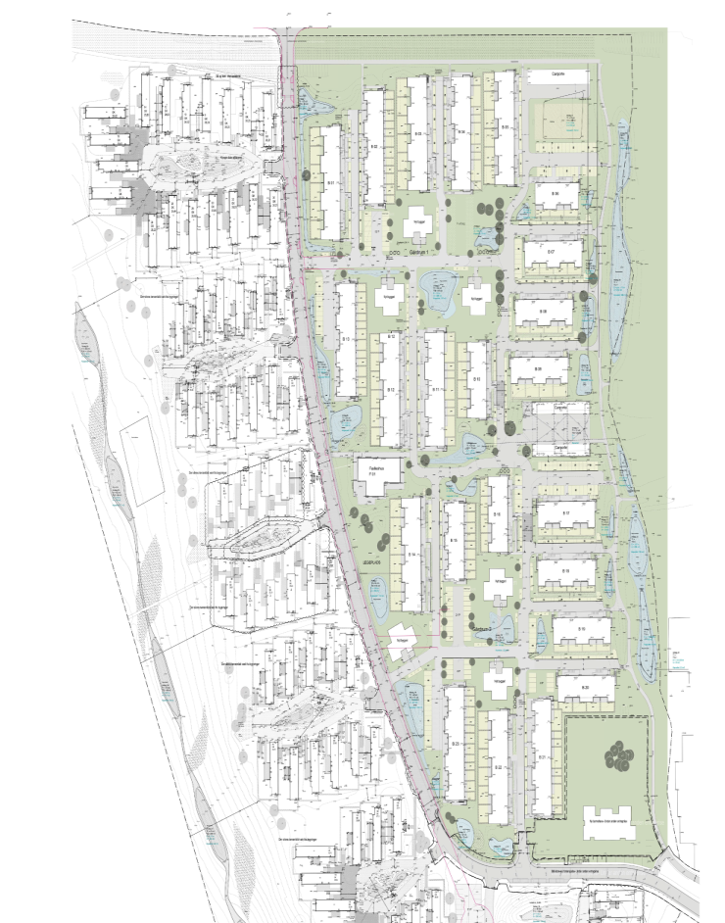
Infill of owner-occupied dwellings
KPF arkitekter m.fl.

Slide 13
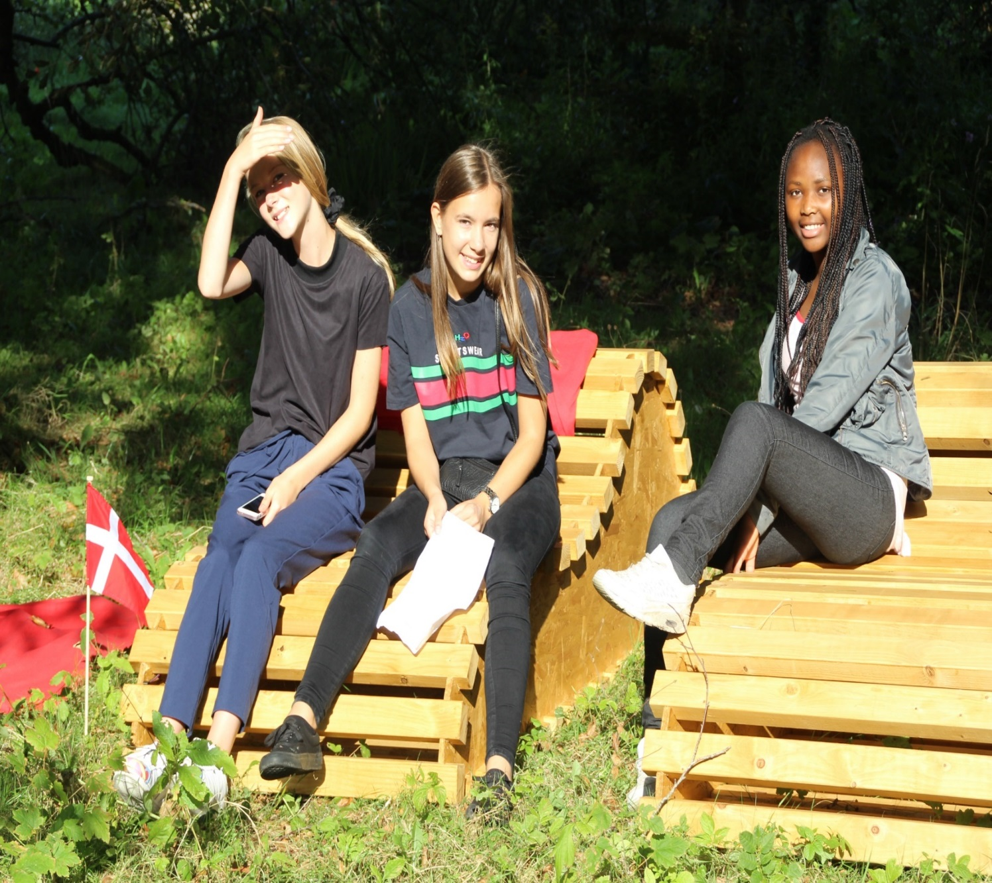
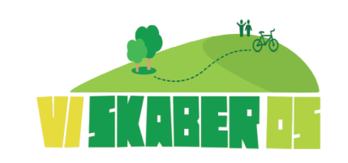
Temporary activities
Making culture
Furniture for the area
September 2016

Slide 14
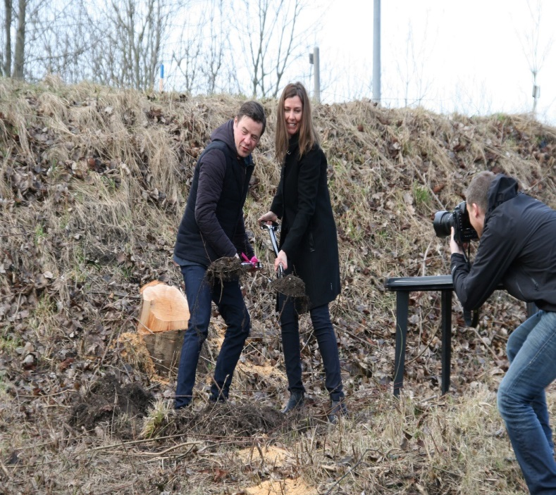
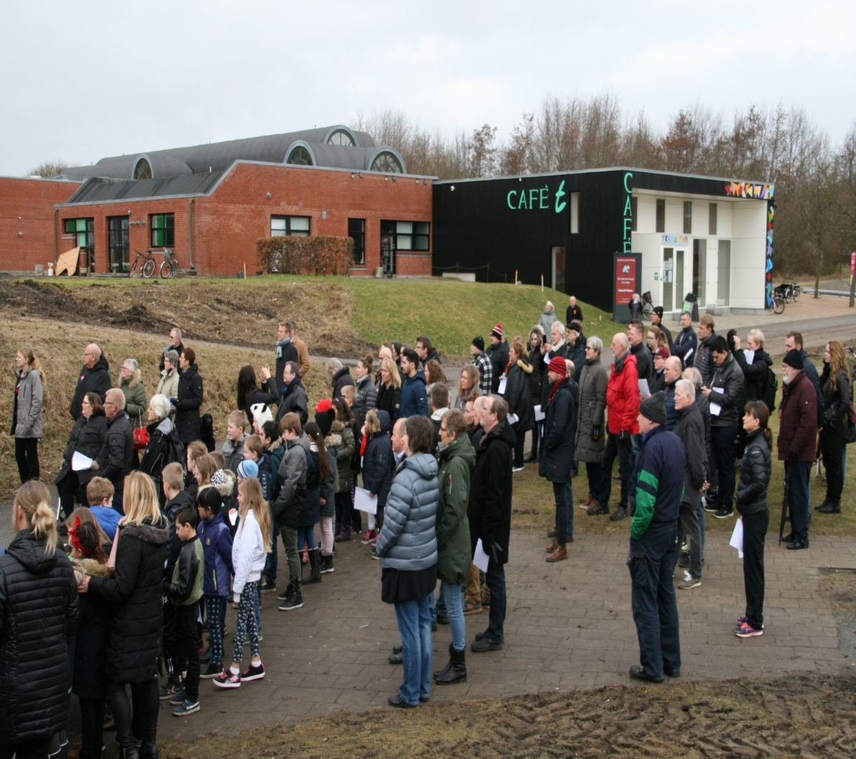
Cutting of the first sod, march 2017 – big interest and community pride

Slide 15
Public involvement and partnership cooperation in Tornhoj project
Architectural competition: City in Between (support from Realdania)
Municipal money and long term public involvement
‘Commitment process’ across partners
Citizen participation through Housing Association and
Municipality
Temporary activities
Lots of information and involvement

Slide 16
Some good advices for the municipality:
Get hold of possible investors and initiate a dialogue
An ‘opening picture’ can be a method for dialogue about the future
Register and involve, interview key partners and local associations
Identify cooperation will and bring people together
Discuss the identity and future of the neighbourhood
Communicate broadly and in many different ways
Resources for temporary activities
Creating new stories and image

Slide 18
Question from the critical friend
In a participatory approach there is the risk of overrepresentation of “usual suspects”, the already active citizens or entrepreneurs. Do you have a strategy to engage citizens and entrepreneurs, who usually do not participate in these kind of projects?

