Slide 2
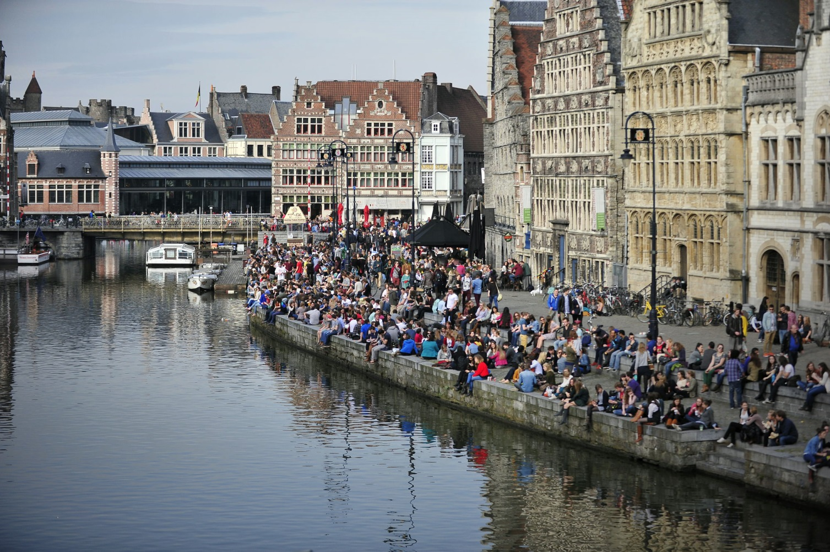
Refugee Solidarity
A pro-active approach for welcoming refugees, starting the integration process from day one.
Ghent / Belgium

Slide 3
Kathleen Van de Kerckhove
Coordinator Refugee Taskforce
City of Ghent

Slide 4
CHALLENGES:
• provide appropriate accommodation (during asylum procedure)
• integration of recognised refugees + pro-active approach (60% rate of recognition)
➲ starting the integration process from day one
Main countries of origin:
Afghanistan
Syria
Iraq

Slide 5
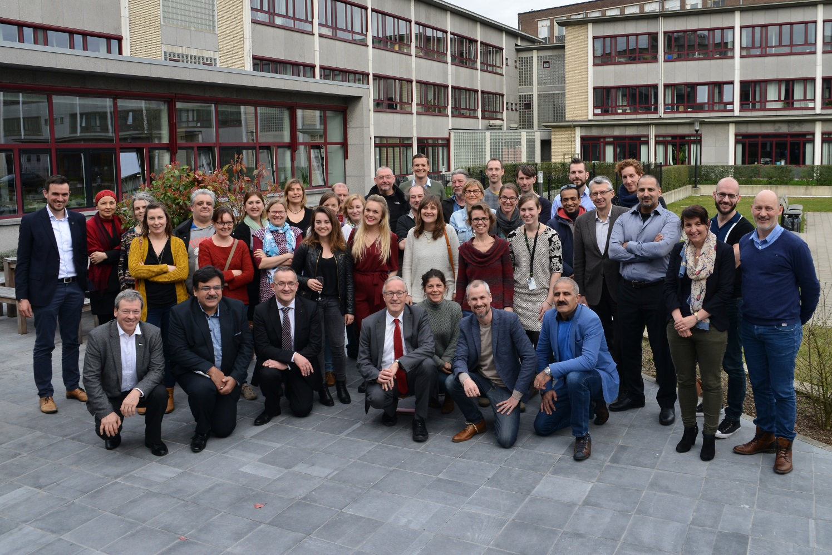
SOLUTION: REFUGEE TASKFORCE
• coordinate cooperation between - city services - public service for social welfare - local NGO’s - volunteers • 3 working groups: shelter, integration, volunteers and public awareness • mission to provide asylum seekers and refugees easier access to social rights  all the relevant stakeholders are involved from scratch on
Evaluation cooperation private shelter initiative

Slide 6
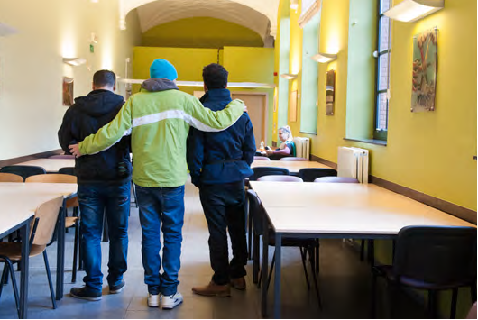
SHELTER
• 3 different shelter initiatives - urban shelter, site 1 & 2 85 places - shelter of NGO: 28 places - private shelter: 250 places Total in Gent 2016: 363 places for asylum seekers (50: 2014)  exchange information, experiences and good practices

Slide 7
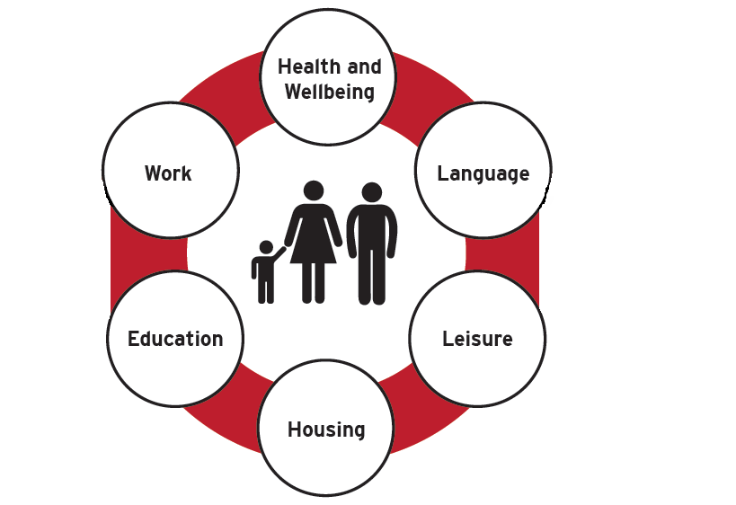
INTEGRATION FROM DAY ONE • immediately bringing asylum seekers into contact with relevant organisations • allowing organisations and citizens to get to know newcomers.  a two-sided approach speeding up the integration process

Slide 8
VOLUNTEERS AND PUBLIC AWARENESS • Involving citizens from scratch on • Giving support to volunteers  negative stereotypes and prejudices against refugees are addressed

Slide 9
INVOLVING CITIZENS FROM SCRATCH ON • Open and transparent communication - website - city magazine - neighbourhood information session • Citizens want to be involved - a volunteer event was hosted - guiding tours in the new shelter - brainstorm  Raising awareness about this group of newcomers and fostering solidarity with other vulnerable groups

Slide 10
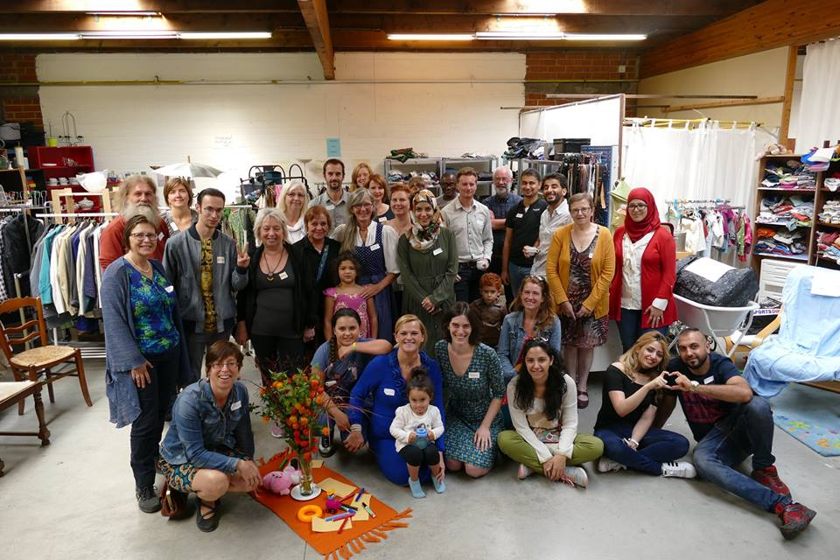
GIVING SUPPORT TO VOLUNTEERS • a give-away shop was set up by an alliance of charities (+ possibility to socialize )
• organizing workshops, trainings based on the needs of volunteers
• aligning buddy initiatives
• an online platform solidair.stad.gent was set up (https://solidair.stad.gent)
➲ Initiatives of citizens are taken in all possible domains: housing, work, education, sports, …

Slide 11
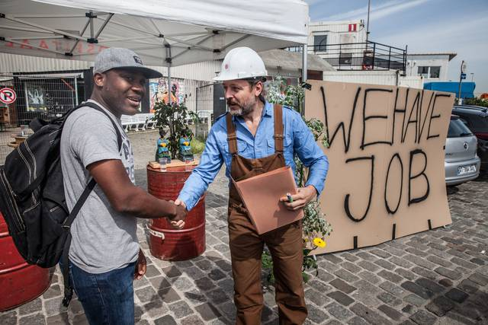
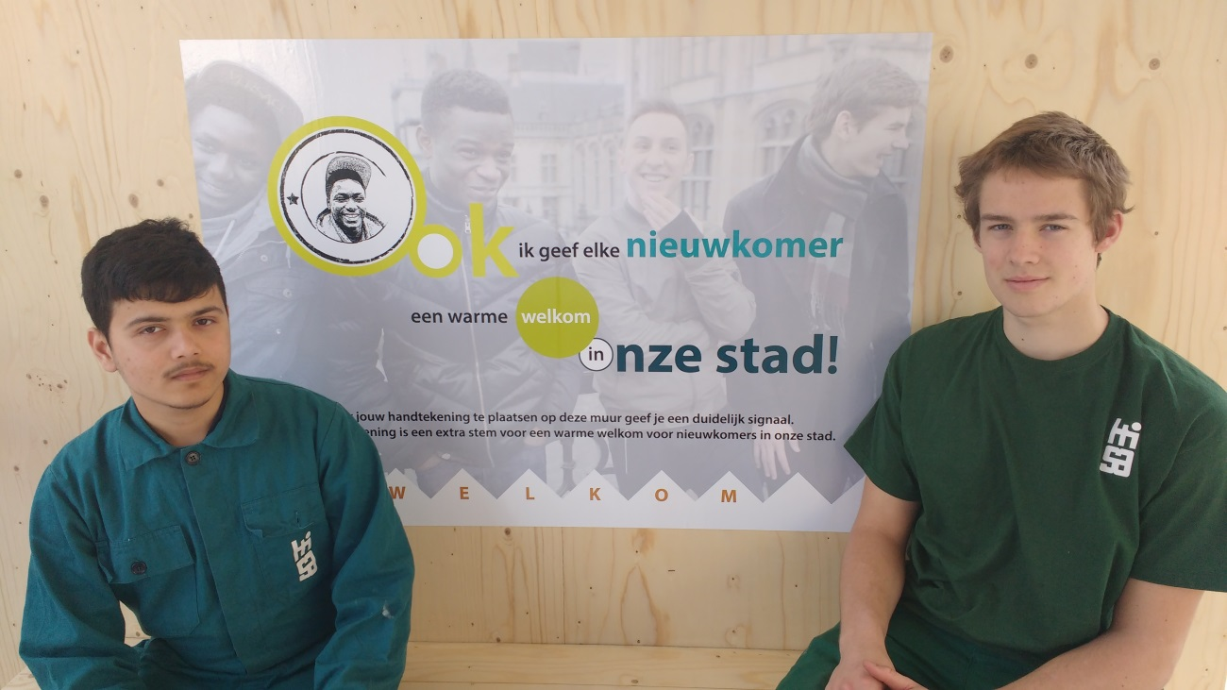
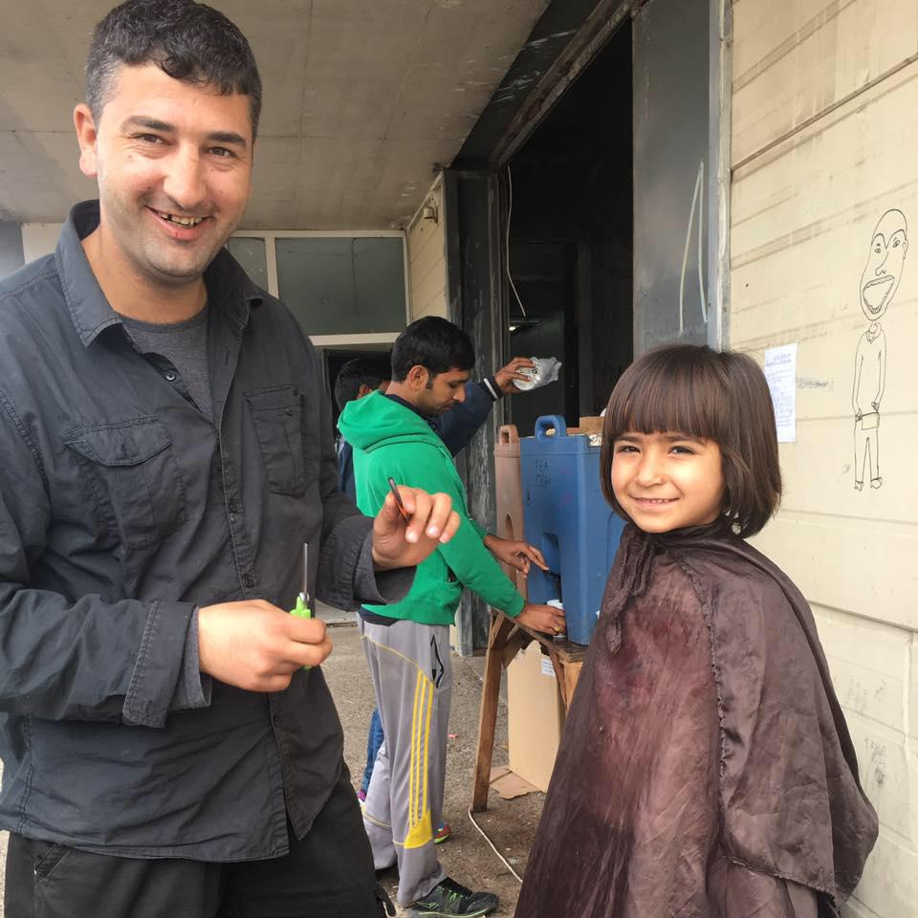
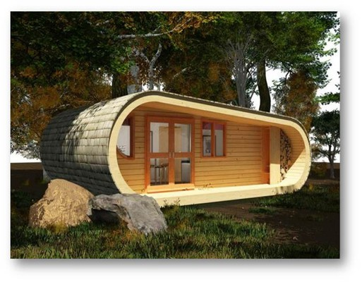
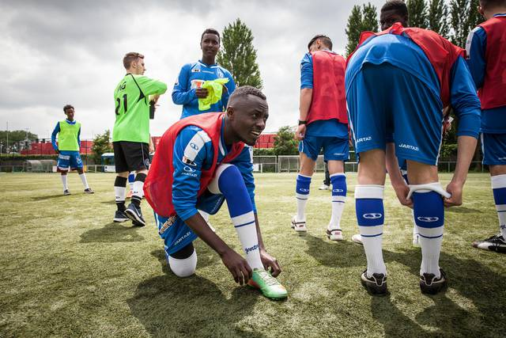

Slide 12
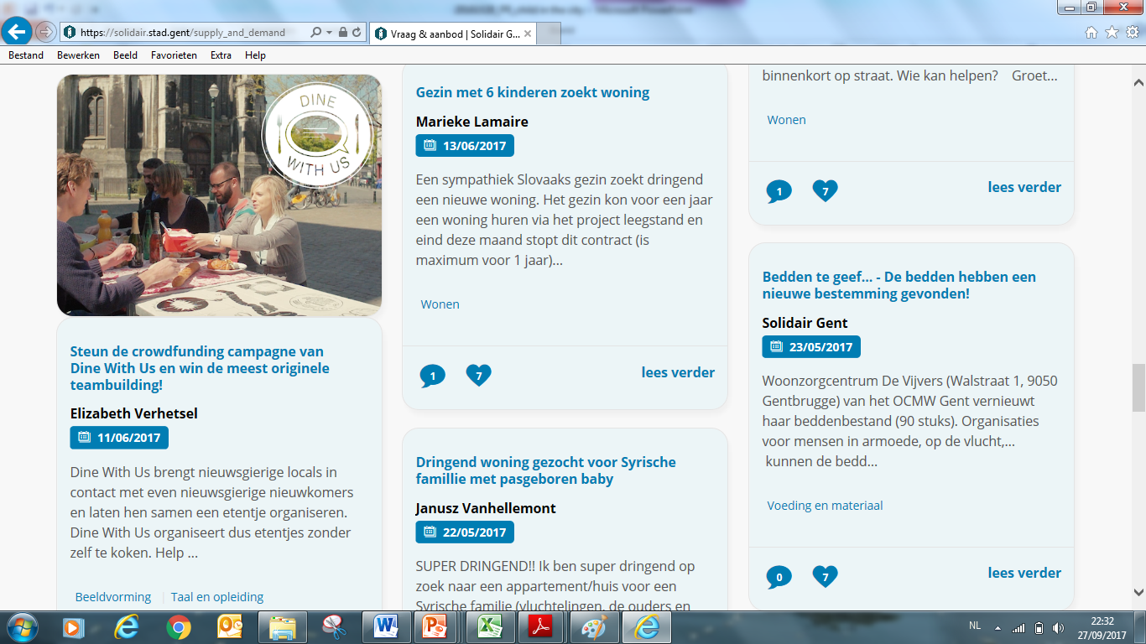
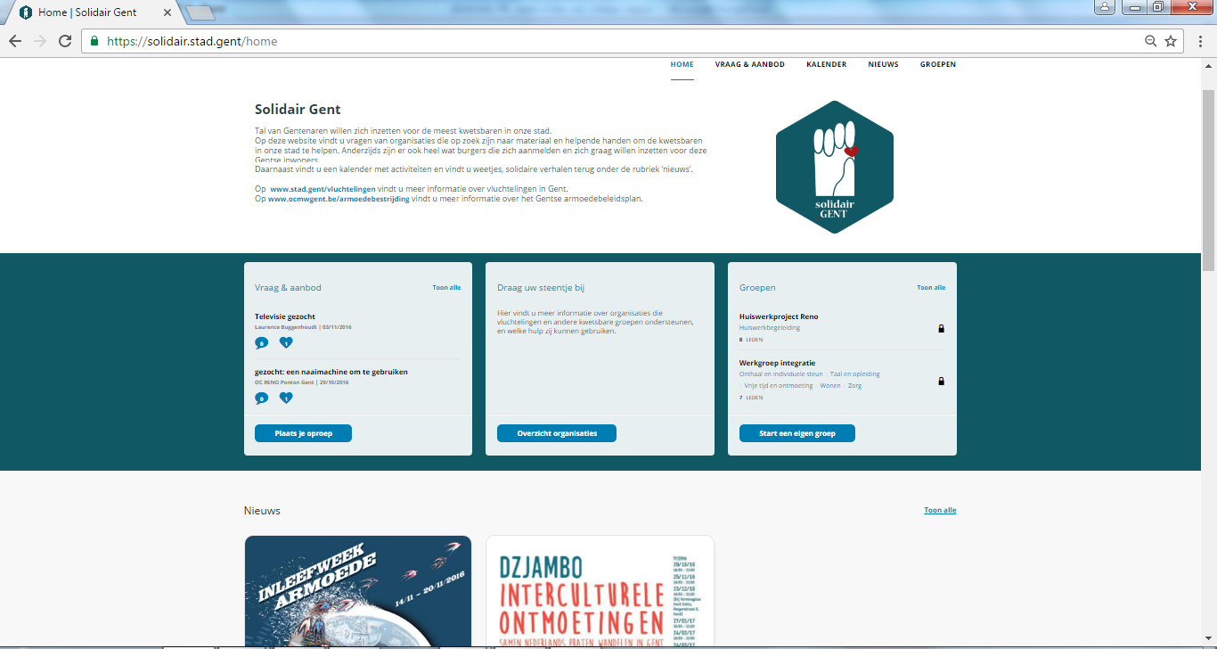

Slide 13
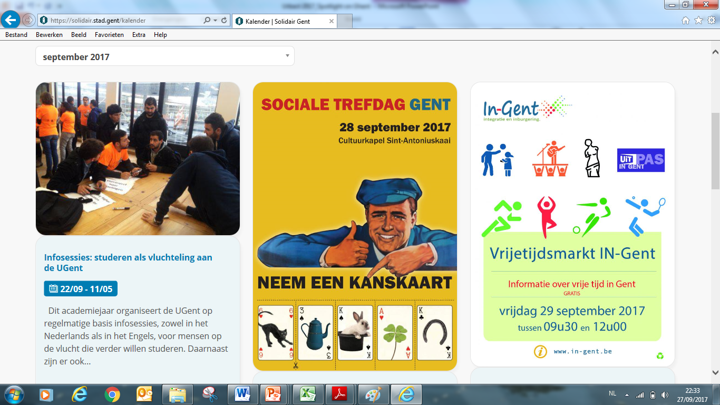

Slide 14
More information?
Linking refugees to the receiving community from scratch on = a win-win
kathleen.vandekerckhove@stad.gent
www.stad.gent/refugeetaskforce
http://urbact.eu/refugee-solidarity

