Slide 1



Sofia Municipality
Involving parents in the prevention of Early School Leaving
The URBACT Info Day in Sofia
29 January 2015

Slide 2
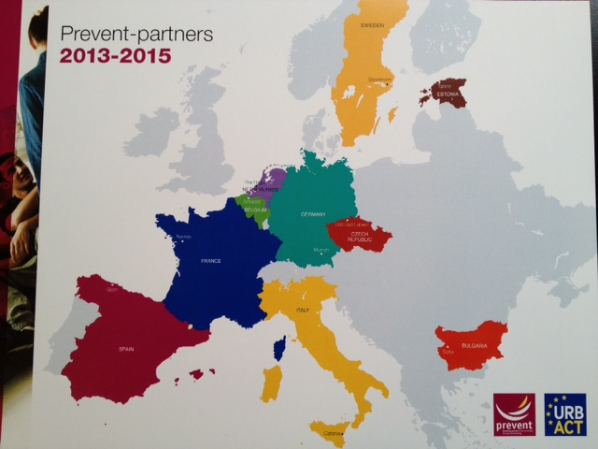
10 project partners
LP – City of Nantes, France
LE – Mr. Ulf Hagglund, (European Mind)
TE – Mr. Paul Downs, (Dublin College)

Slide 3

PREVENT project focus
The Europe 2020 strategy
The role of parents
Migrants and roma parents

Slide 4
Main objectives
to create a sustainable network of professional public and private institutions and organizations amongst EU countries in order to exchange their expertise and best practices for dropout prevention and reintegration of dropouts from school
to synchronize and improve the existing work methods, models and instruments in field of dropout prevention
demonstrating to the public (other institutions, parents, media, local societies) the need of educational programmes for social skills, health and civic education and to develop an effective model for prevention

Slide 5
Challenges
About the topic…
A question of efficiency of public sector investment in education
  we cannot afford young people dropping out of education/society
A more integrated and trans-versal approach
  social innovation, crossover collaboration, silo breaking…
  deficits in communication between institutions, NGO’s and among all interested parties
About the network…
To bridge local and transnational levels
To go from existing «good practice» to even better…
Keep focus on the parental involvement aspect of ESL
PREVENT Outputs
Policy Recommendations Report
Story tellings
PREVENT press-book
LAP’s Panorama

Slide 6
PREVENT porject
ULSG in Sofia
13 members at ULSG in Sofia:
5 experts from Sofia Municipality (The Directorates involved in the project)
3 directors of the Three pilot schools from Sofia
Director of The Sofia Center for work with children
Representative from the Regional inspection of education of the Ministry of education and science
NGOs representatives
"Parents" Association

Slide 7
What are the main issues the participants raise about the topic?
Discussion and analysis of the data in order to develop the Local Action Plan (identification of definitions, terminology, actuality of understanding of “school dropouts” problems; Which main factors and how they influence on dropping out from school (Social, Economic, Educational, Ethno – cultural, other problems and tendencies);
How to work with parents? How to involve them? (Analysis of resources. Purpose and directions of the ULSG program. Levels of realization and mechanism for realization on local school level);
Development of a Plan for effective work with parents at school for the school year 2013-2014 (ToT for teachers; Discussion forums in 3 pilot schools; Guidebook for parents; 3 educational campaigns, contests, ect.)
Creation of a training program for teachers aiming prevention of dropout and working with parents (Nov 29th, 2013)
From Identification - Involvement – Sharing – To Social solidarity

Slide 8
What kind of methodology did you use ?
Participation in all TM within PEVENT project in 2013 (Stockholm and Gijon)
Participation in the Urbact Summer University seminar (Dublin, August 2013)
Summarizing of exciting experiences to develop the GP 1 and GP 2
ULSG meetings and talks; sharing experience;
Analysis of the data in order to develop 1st draft of ULSG local plan
Discussion and development of a plan for the school year 2013*2014
Designing of a training program for teachers aiming prevention of dropout and working with parents
Recent feed-back from ULSG members

Slide 9

PREVENT porject
LAP for Early childhood inclusive education
with specific focus on Roma
Our plan includes the following topics / areas:
Introduction - "dropouts“definition
Normative documents of national and local level related to dropout prevention policy
Database and statistics from the investigation on the reasons for dropout of school
SWOT - analysis of local level, available resources, strengths and weaknesses
Priorities and guidelines in the long term and expected results
Year plan of the school activities 2013/2014, and 2014/2015 (resources and expected results in three pilot schools in Sofia)

Slide 10
Mariya Goncheva
Thank you for your attention!
Senior Expert European Programmes and Projects Department
Sofia Municipality
Mobile: +359 889-455-280
Tel: +359 2 904-13-89
E-mail: m.goncheva@sofia.bg
www.sofia.bg

