Slide 1
We invest in your future!
National Framework for Sustainable urban development 2014 – 2020
January 2015
www.mrrb.government.bg
www.bgregio.eu
oprd@mrrb.government.bg

Slide 2
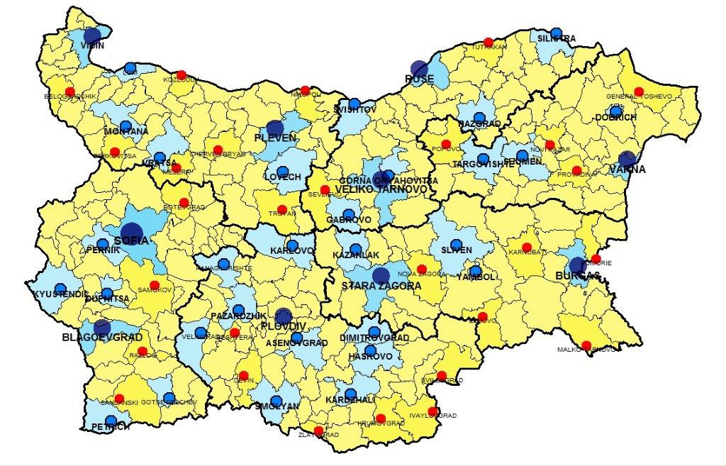
Urban development – national framework
Key documents:
National spatial development concept 2013-2025
Integrated plans for urban regeneration and development (IPURDs)
Polycentric model
Centers of growth
Cities balancers
Supporting centers in peripheral areas
Peripheral areas
Central areas
www.mrrb.government.bg
www.bgregio.eu
oprd@mrrb.government.bg

Slide 3
Support for sustainable urban development under OP “Regions in growth” 2014-2020
IPURDs – main tool for integrated urban investments, in accordance with Art. 7 of the ERDF Regulation 1301/2013.
Support measures:
Improvement of energy efficiency
Urban environment and economic zones
Municipal educational, social, cultural and sport infrastructure
Urban transport
Financial resources for urban development: 840 million euro (54% of OPRG budget)
Direct beneficiaries: Urban authorities of large and medium sized cities of 1st, 2nd and 3rd hierarchical level of national polycentric system and Bodies implementing financial instruments
Social zone
Public zone
Economic zone
www.mrrb.government.bg
www.bgregio.eu
oprd@mrrb.government.bg

Slide 4
MINISTRY OF REGIONAL DEVELOPMENT AND PUBLIC WORKS
DIRECTORATE GENERAL PROGRAMMING OF REGIONAL DEVELOPMENT
THANK YOU FOR YOUR ATTENTION!
Ivaylo Stoyanov
Senior expert, “Programming of Regional development” DG
January 2015, Sofia
www.mrrb.government.bg
www.bgregio.eu
oprd@mrrb.government.bg

