Slide 1
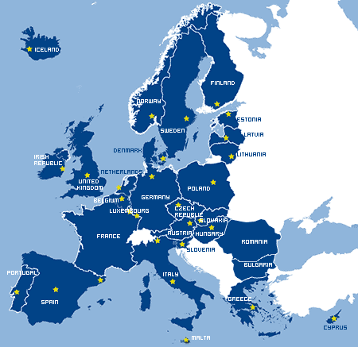
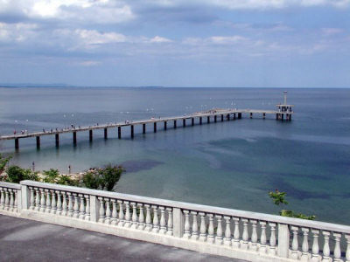
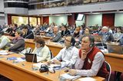
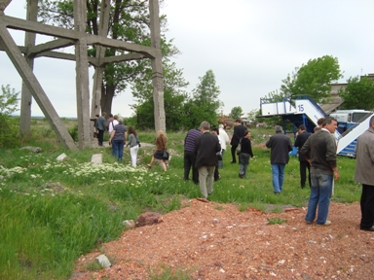
JOINING FORCES
TO IMPROVE
TERRITORIAL COOPERATION
Regions and Cities leading the way to improved territorial cooperation
Sofia, 29 January 2015

Slide 2
JOINING FORCES FOR
ACHIEVING COMMON STANDARTS
JOINING FORCES
Metropolitan governance and
competitiveness of European cities
THE WORKING GROUP:
LEAD PARTNER: Lille Metropole - Agence de développement et d’urbanisme de
Lille Métropole (France)
PARTNERS: City of Brno (Czech Republic)
Brussels-Capital Region (Belgium)
City of Burgas (Bulgaria)
Eindhoven - Samenwerkingsverband Regio Eindhoven (SRE) (Netherlands)
City of Florence (Italy)
Krakow - Instytut Rozwoju Miast (Institute of Urban Development) (Poland)
City of Seville (Spain)
LEAD EXPERT: Tamas Horvath - University of Debrecen (Hungary)
DURATION: Project launched: 21 April 2008
Project Completed : 2010
Regions and Cities leading the way to improved territorial cooperation
Sofia, 29 January 2015

Slide 3
JOINING FORCES FOR
ACHIEVING COMMON STANDARTS
JOINING FORCES
Metropolitan governance and
competitiveness of European cities
THE CHALLENGES:
TO ADDRESS SOME OF THE MOST URGENT URBAN ISSUES IN EUROPE –
COMPETITIVENESS, SUSTAINABLE DEVELOPMENT, COHESION,
MOBILITY, EMPOWERMENT AND GOVERNANCE;
TO EXPLORE DIFFERENT ISSUES CITIES HAVE TO FACE AT METROPOLITAN LEVEL
AND IDENTIFY EFFECTIVE INSTRUMENTS;
TO DEFINE THE RELEVANT SCALES FOR CO-OPERATION AT CITY – REGION LEVEL;
TO INCREASE THE SYNERGY BETWEEN PLAYERS AT CITY – REGION SCALE
AND INTEGRATE THEM IN THE PROCESS OF COOPERATION
Regions and Cities leading the way to improved territorial cooperation
Sofia, 29 January 2015

Slide 4
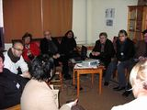
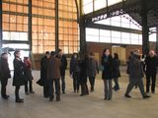
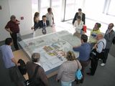
JOINING FORCES FOR
ACHIEVING COMMON STANDARTS
JOINING FORCES
Metropolitan governance and
competitiveness of European cities
THE EVENTS: 7 SEMINARS
Eindhoven “Strategic and Spatial Planning”
Florence “Mobility and Transport”
Seville “Externalities and Environmental Issues”
Brno “Knowledge economy / creativity, research & education”
Krakow “Public / Private Arrangements”
Burgas “Social Inclusion, Participation, Empowerment”
Brussels “Attractiveness and Competitiveness”

Slide 5
JOINING FORCES FOR
ACHIEVING COMMON STANDARTS
JOINING FORCES
Metropolitan governance and
competitiveness of European cities
THE EVENTS: CITY LAB AND FINAL CONFERENCE
MAJOR OUTPUTS:
BASELINE STUDY ON METROPOLITAN GOVERNANCE ISSUE;
WORKING REPORTS FROM THE SEVEN THEMATIC SEMINARS;
LOCAL ACTION PLANS;
COMPENDIUM OF INFORMATION ON LOCAL SUPPORT GROUPS;
SYNTHESIS OF CONCLUSIONS AND RECOMMENDATIONS
Regions and Cities leading the way to improved territorial cooperation
Sofia, 29 January 2015

Slide 6
JOINING FORCES FOR
ACHIEVING COMMON STANDARTS
JOINING FORCES
Metropolitan governance and
competitiveness of European cities
CONCLUSIONS AND RECOMMENDATIONS
THE METROPOLITAN SCALE IS MORE EFFECTIVE TO DEAL WITH
DIFFERENT ISSUES – TRANSPORT, WASTE MANAGEMENT, STRATEGIC
PLANNING ETC.;
CITY REGIONS HELP TO OVERCOME SHORTAGE OF RESOURCES AND
JOIN CAPACITIES;
METROPOLITAN GOVERNANCE IS ESSENTIAL FOR AVOIDING
STERILLE COMPETITION BETWEEN INSTITUTIONS AND MISUSE
PUBLIC MONEY;
FLEXIBLE ADMINISTRATIVE SOLUTIONS;
INVOLVING RELEVANT ACTORS.
Regions and Cities leading the way to improved territorial cooperation
Sofia, 29 January 2015

Slide 7
JOINING FORCES
TO IMPROVE TERRITORIAL COOPERATION
THANK YOU FOR YOUR ATTENTION!
Regions and Cities leading the way to improved territorial cooperation
Sofia, 29 January, 2015

