Slide 1
URBACT INFODAYS BULGARIA
TOWARDS URBACT III
Sofia, 29 January 2015

Slide 2

URBACT IN A NUTSHELL
Objectives
Activities
URBACT II so far

Slide 3
URBACT IN A NUTSHELL
European Territorial Cooperation programme (ETC), financed by ERDF and Member States/ Partner States (Switzerland and Norway)
Main objective
To promote integrated and sustainable urban development in EU cities by
→ facilitating the exchange of experience and learning among cities
→ drawing lessons, identifying and disseminating good practices
→ supporting urban practitioners in developing integrated action plans

Slide 4
MAIN ACTIVITIES
TRANSNATIONAL NETWORKS
Allowing cities to share experiences/ problems/ solutions, to learn from one another, identify good practices to design integrated urban policies
CAPACITY-BUILDING
Enhancing the capacities of urban practitioners and policy-makers to develop integrated and participatory approaches to urban development
CAPITALISATION
DISSEMINATION
Capitalizing and disseminating urban knowledge, practices, policy recommendations to a wider audience of policy-makers and practitioners

Slide 5
NETWORKING in URBACT
Transnational Network
Cities with common problems coming together to learn from one another and work together on integrated solutions
URBACT
Funding
Methods
Expertise
Capacity-building
Knowledge
Good practices, policy recommendations, etc.
Policy
Integrated action plans
City level
Local Stakeholders working in partnership to co-produce Integrated Action Plans

Slide 6
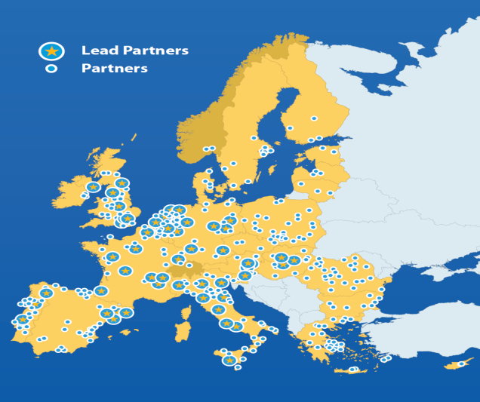
URBACT II SO FAR...
52 networks (3 Calls)
500 partners from 26 MS
& Switz. & Norway
5000 local stakeholders involved in local partnerships for the co-production of Local Action Plans
350 Local Action Plans produced (call 1 & 2)

Slide 7
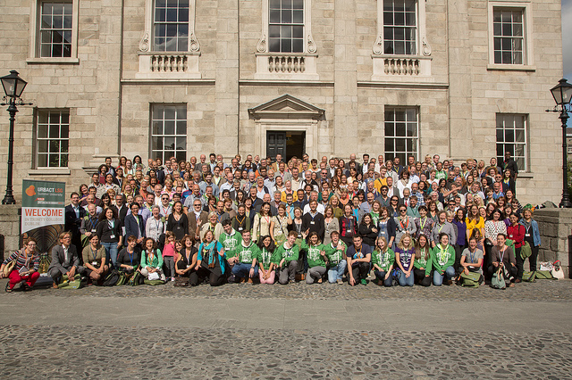
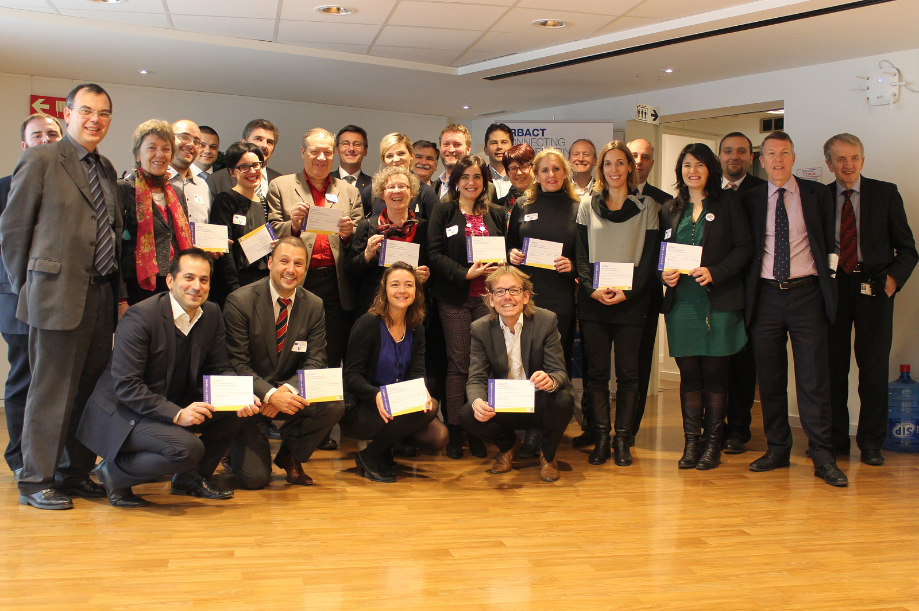
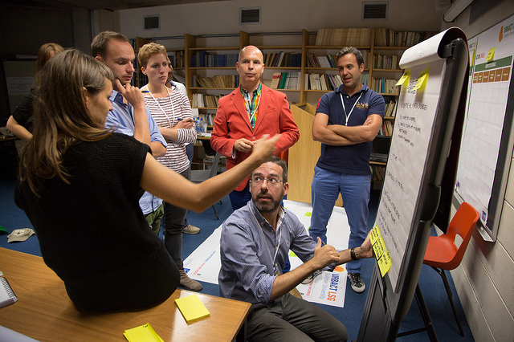

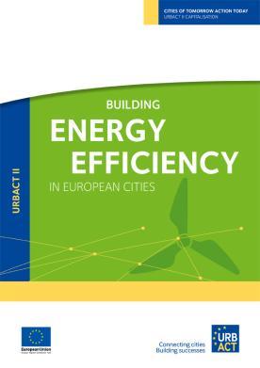

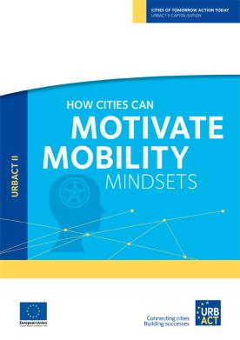
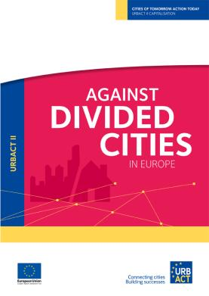
URBACT II SO FAR...
Capacity building activities
2 Summer Universities
National Training seminars
Pilot Training for Elected officials
Capitalisation to share knowledge and good practices about how cities are actually addressing urban challenges

Slide 8
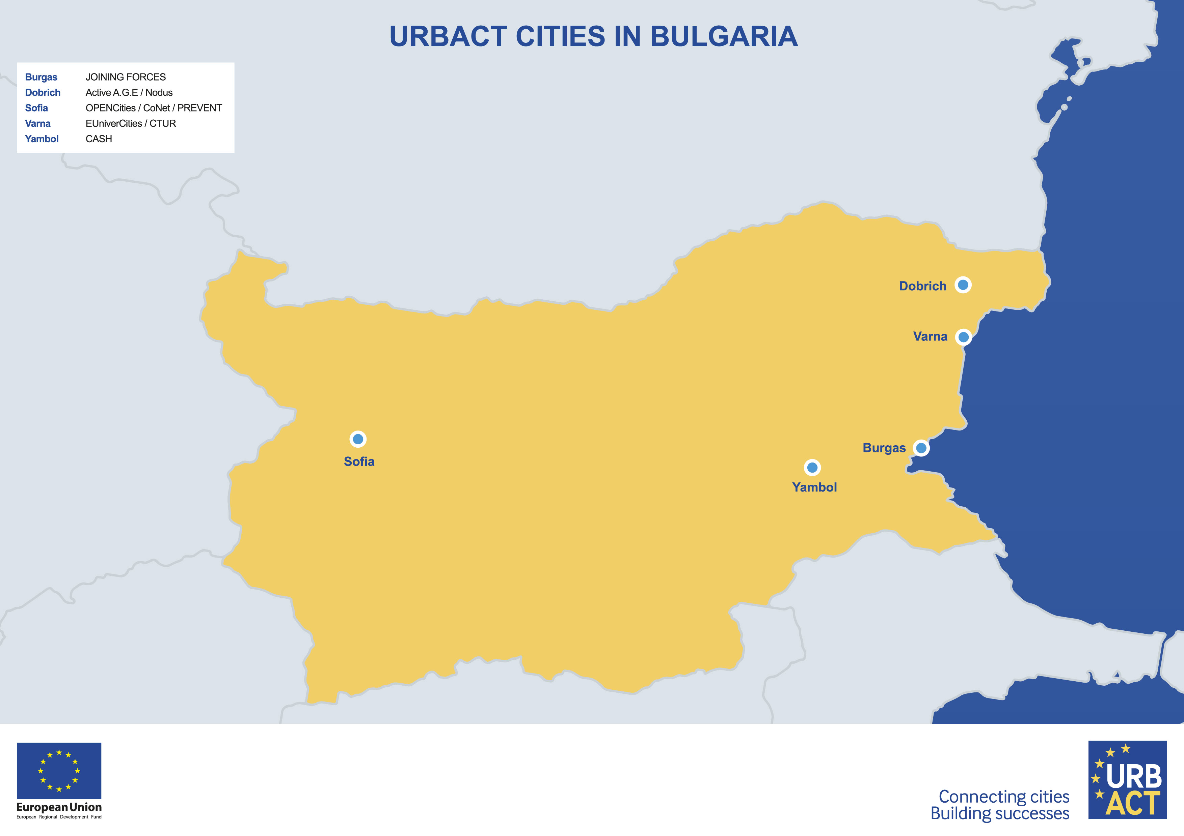
Bulgaria and URBACT II
9 institutions over 3 Calls for Proposals
6 in the First Call Networks (26 projects completed in July 2011)
1 in the Second Call (9 projects completed in January 2013)
2 in the Third Call (15 projects due for April 2015)

Slide 9
Bugaria and URBACT II
Thematic coverage:
Urban renewal: 10 projects (focus on disadvantaged neighbourhoods, historic city centres, new housing stock, high rise social housing, city markets)
Metropolitan governance: 7 projects (focus on multi-polar metropolitan development, functional urban areas, land management, integrated city marketing strategies and use of new financial instruments - JESSICA)
Economic growth and job creation: 9 projects (focus on innovation and creativity, support to SMEs, transformation of traditional industrial sectors, matching supply and demand sides for better jobs)
Social inclusion: 5 projects (focus on specific target groups especially disadvantaged young, migrants and ageing population)
Low carbon cities: 3 projects (focus on low carbon urban transports and sustainable food chain)

Slide 10
Bulgaria and URBACT II
More than xxx civil servants from local administrations involved in the transnational exchange and learning activities (field visits, peer reviews, thematic workshops, etc.)
More than xxx local stakeholders involved in the co-production of Local Action Plans, within the Local Support Groups
xx Local Action Plans produced and actually being implemented (despite the economic crisis and the difficulties in creating functional links with the ERDF/ESF resources available at national level)
More than xx local stakeholders attending the first National Training Scheme for participative urban planning
xx elected representatives involved in the Training Scheme for Local Elected
At least xx local stakeholders to attend the URBACT Summer University in Dublin (August 2013)

Slide 11
The URBACT III programme
Objectives & Activities
3 Types of network
Beneficiaries
How to join
Provisional calendar

Slide 12
URBACT III – 4 main objectives
To improve the capacity of cities to manage sustainable urban policies and practices in an integrated and participative way
To improve the design and implementation of integrated urban sust strategies/ action plans in cities
To ensure that practitioners and decision makers at all levels have access to knowledge and share know-how on all aspects of sustainable urban development

Slide 13
3 MAIN STRANDS OF ACTIVITIES
TRANSNATIONAL NETWORKS
Allowing cities to share experiences/ problems/ solutions, to learn from one another, identify good practices to design & implement integrated urban policies
CAPACITY-BUILDING
Enhancing the capacities of urban practitioners and policy-makers to develop integrated and participatory approaches to urban development
CAPITALISATION
DISSEMINATION
Capitalizing and disseminating urban knowledge, practices, policy recommendations to a wider audience of policy-makers and practitioners

Slide 14

URBACT III Networks – a diversified offer
3 types of networks proposed
Action Planning Networks
Implementation Networks
Transfer Networks

Slide 15
Action-planning networks
Main purpose
To support cities with the design of integrated sustainable urban strategies/ action plans
Who?
Cities sharing common urban challenges and willing to address them by developing integrated solutions
Expected outcomes
Integrated strategies for sustainable urban development
Integrated action plans on one or several policy areas (to operationalise an existing strategy)
Learning and recommendations for EU cities

Slide 16
Implementation networks
Main purpose
To support cities with the implementation of integrated sustainable urban strategies/ action plan
Who?
Cities implementing integrated strategies and action plans having secured different types of funding, including cities implementing integrated urban strategies and actions under article 7 (eg ITI, CLLD)
Expected outcomes
Enhanced implementation of integrated strategies/ action plans for sustainable urban development (monitoring, timely delivery of actions, etc.)
Learning and recommendations for EU cities

Slide 17
Transfer networks
Main purpose
To support cities with the transfer of good practice so as to improve the implementation of integrated sustainable urban strategies/ action plans
Who?
Cities willing to transfer locally practices of integrated urban development identified in other EU cities
Expected outcomes
Transferred good practice in receiving cities
Enhanced good practice
Learning and recommendations for EU cities

Slide 18
Common features of URBACT networks
Beneficiaries
Partnerships
Funding
Notes:
18

Slide 19
MAIN BENEFICIARIES
Main beneficiaries
Cities from EU 28 Member States, Norway & Switzerland including:
        Cities, municipalities, towns without limit of size
        Infra-municipal tiers of government
        Metropolitan authorities & organized agglomerations
Other beneficiaries
Local agencies
Provincial, regional and national authorities
Universities and research centers
All beneficiaries shall be public or public equivalent bodies

Slide 20
PARTNERSHIPS
A lead partner city
A limited number of partners
        8-12 partners in Action-planning & Implement° networks
        6-8 partners in Transfer networks
A majority of cities – 3 non-city partners max
Balance between partners from less developed regions and partners from more developed/ transition regions
Notes:
20

Slide 21
FUNDING
Network budget: 600.000 – 750.000 euros
ERDF + local contributions from cities
Less developed & Transition: 85% ERDF
More developed: 70% ERDF
Additional envelope for expert support
up to 127.000 euros/ network
Ongoing support by the URBACT Secretariat (tools, methods, training, etc.)
Notes:
21

Slide 22
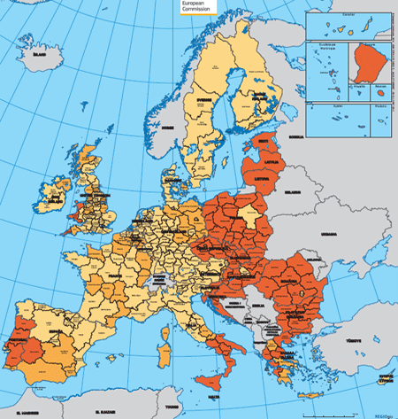
Transnational Exchange
ERDF co-financing
Co-financing from ERDF of beneficiary cities and other eligible beneficiaries for the actions implemented
Less developed and transition regions shall receive 85% ERDF contribution
More developed shall receive 70% ERDF contribution

Slide 23
Willing to join ?
URBACT launches calls for proposals
2 main stages – 2 opportunities for you to join
→ Declaration of interest
- initial partnership (average 5 cities)
- identified urban challenge to be addressed
→ Final proposal
- complete partnership (average 10 cities)
- refined thematic focus and policy issues to be addressed
- baseline study/ state of play in all partner cities
- work plan and list of deliverables

Slide 24
Call for Proposals
Initial partnership
with identified
common
urban challenge
Submission Declaration of Interest
!!!
Eligibility check & Assessment
Approval & funding
Extended
partnership with
complete
network proposal
6-month to develop final proposal
Submission of Final proposal
!!!
Eligibility check & Assessment
Approval & funding
24 month to implement network activities and deliver

Slide 25
PROVISIONAL CALENDAR 2015
Beginning 2015
1° call for Action-planning networks
End 2015
1° calls for Transfer networks
1° call for Implementation networks
Notes:
25

Slide 26
PROVISIONAL CALENDAR 1st CALL FOR ACTION-PLANNING NETWORKS
Partner search
facility on
URBACT website
March 2015: 1st call Action-planning
March-June 2015: applicants preparing bids
June 2015: submission of proposals
July-Aug 2015: eligibility check & assessment
Sept 2015: MC approval funding 6-month preparatory phase
Mid Sept 2015- Mid March 2016: 6-month Prep Phase
Mid March 2016: submission Final Proposals
March-April 2016: eligibility check & assessment
April 2016: MC final approval funding for network
April 2016-April 2018: 24-month for network activities
URBACT FEST
Riga, 6-8 May 2015

Slide 27


contact@urbact.eu
www.urbact.eu
Notes:
27

Slide 28
 | Action Planning | Implementation | Transfer
Phasing and Duration | Phase 1: 6 months Phase 2: 24 months | Phase 1: 6 months Phase 2: 24 months | Phase 1: 6 months Phase 2: 24 months
Lead Partner | City | City | City
N° PP Phase 1 | 4/6 (only cities) – from minimum 3 MS/PS | 4/6 (only cities) - from minimum 3 MS/PS | 4/6 (only cities) - from minimum 3 MS/PS
Geographical Balance Phase 1 | Minimum 2 Less Developed | Minimum 2 Less Developed | Minimum 2 Less Developed **
N° PP Phase 2 | 8/12 (max 3 non-city) | 8/12 (max 3 non-city) | 6/8 (max 3 non-city)
Geographical Balance Phase 2 | Minimum 4 Less Developed | Minimum 4 Less Developed | Minimum 2 Less Developed if 6 PP Minimum of 3 if 7 or 8 PP **
Co-financing rates | 70% More Developed 85% Less Developed and Transition | 70% More Developed 85% Less Developed and Transition | 70% More Developed 85% Less Developed and Transition
Budget | Between 600k and 750k € | Between 600k and 750k € | Between 600k and 750k €
Expertise | 127.500€ | 127.500€ | 127.500€
Capacity Building | yes | yes | yes

Slide 29
How to apply and join ?
A staged process with 7 main steps
Open call for proposals
Submission of Declaration of interest
Assessment & selection of projects to be supported for development
6-month phase to develop network proposal
Submission of Application
Assessment & selection of projects to be funded
24-month phase to implement network activities and deliver expected outputs
2 moments to join a network
Step 2 – Declaration of interest – in the initial partnership
Step 4 – During 6-month dvpt phase – in the extended partnership

