Slide 1
CITIES OF TOMORROW: ACTION TODAY
LAUNCH OF URBACT II THEMATIC REPORTS
JUNE 18 2013

Slide 2
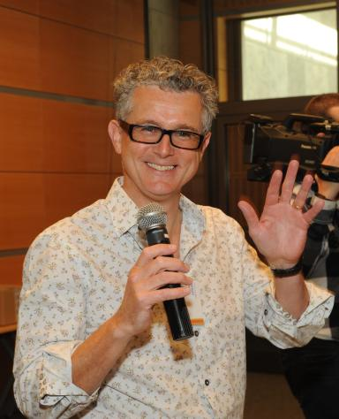
EDDY ADAMS
URBACT Thematic Pole Manager

Slide 3
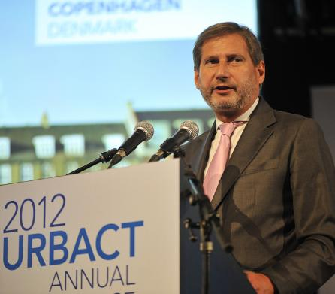
COMMISSIONER HAHN
Welcome

Slide 4
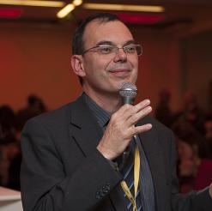
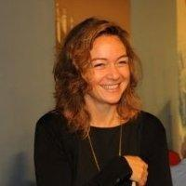
EMMANUEL MOULIN
Director of URBACT Secretariat
MELODY HOUK
URBACT Projects and Capitalisation Manager

Slide 5
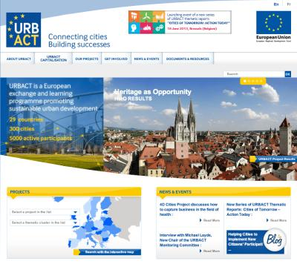
URBACT PROGRAMME
Notes:
EA – 10:30

Slide 6
URBACT II - Objectives
European Programme of Territorial Cooperation 2007-2013:
(Jointly financed by ERDF and the Member States – budget 69 M€)
Main objective:
To promote integrated & sustainable urban development in EU cities
Specific objectives:
To facilitate exchange and learning activities among urban policy-makers, decision-makers, practitioners (Exchange & Learning)
To draw lessons and build knowledge based on ground realities (Capitalisation)
To support local policy-makers and practitioners to develop integrated action plans for sustainable urban development (Capacity building)
To disseminate good practices and lessons drawn from the transnational exchanges (Communication & Dissemination)
Notes:
EA

Slide 7
CAPITALISATION
Building new knowledge for urban practitioners and policy-makers (all governance levels)
Building on evidence and on experience of cities involved in networks
Bridging with other programmes/networks…

Slide 8
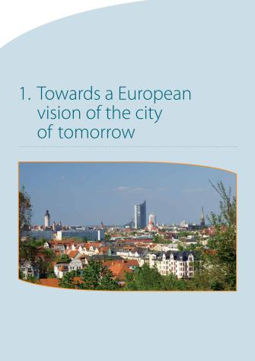
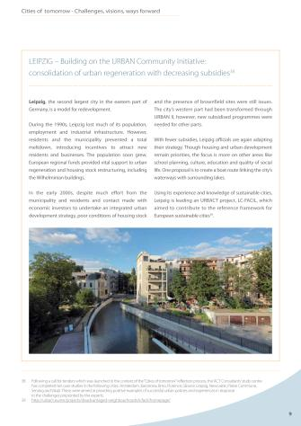
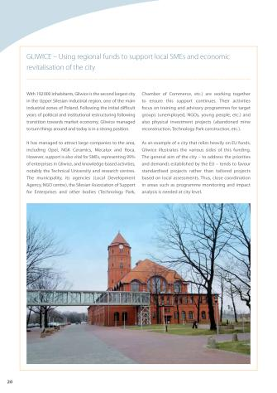
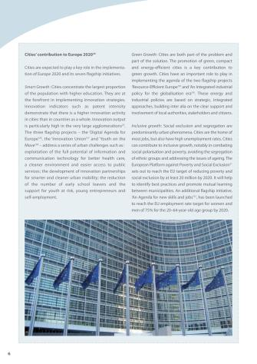

Slide 9
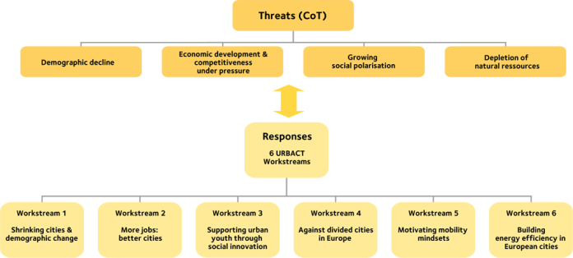
URBACT RESPONSE

Slide 10
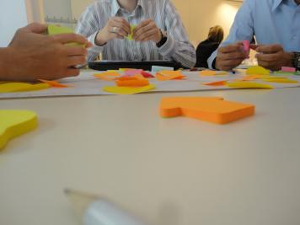
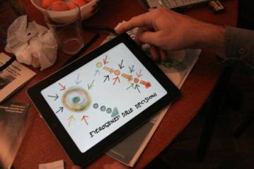
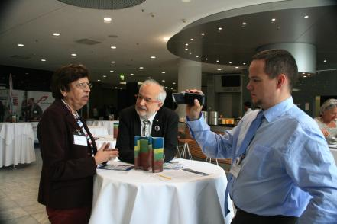
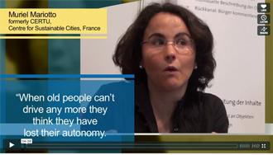
WORKSTREAM METHODS

Slide 11
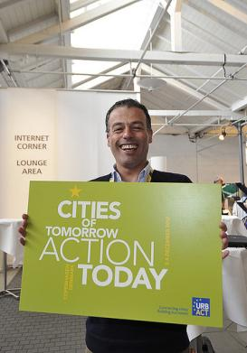

Slide 12
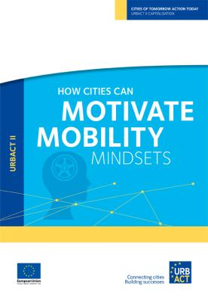
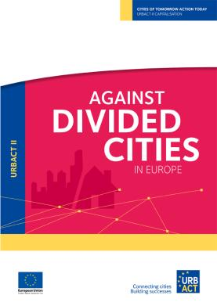
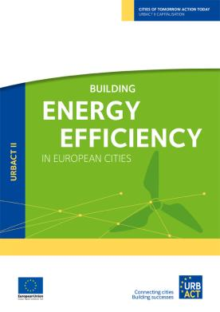

Slide 13
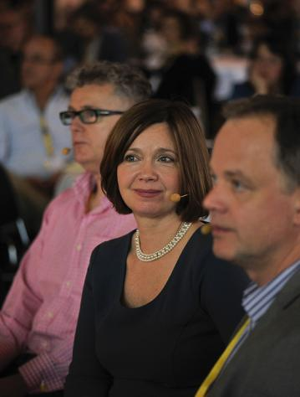
SALLY KNEESHAW
Highlights of capitalisation reports

Slide 15
MORE JOBS: BETTER CITIES
A FRAMEWORK FOR CITY ACTIONS ON JOBS

Slide 16
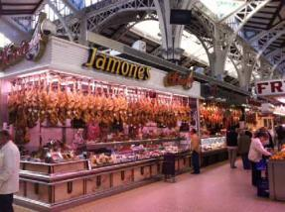
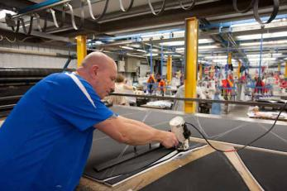

Slide 17
JOBS
ECONOMY
LABOUR MARKET
COMPETITION

Slide 18
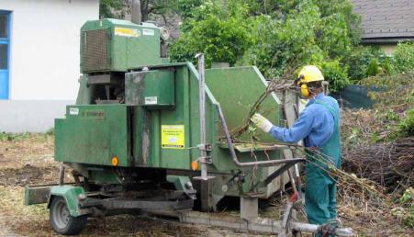
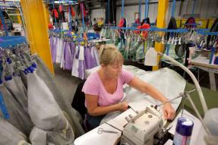
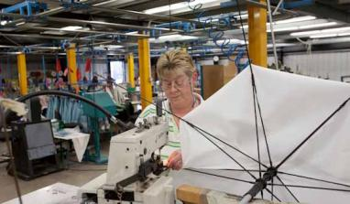
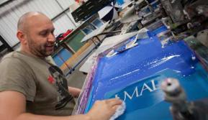

Slide 19
JOBS
PEOPLE
GROWTH
ECONOMY
DEMAND
LABOUR MARKET
INTELLIGENCE
ECONOMIC
STRUCTURE
COMPETITION

Slide 20
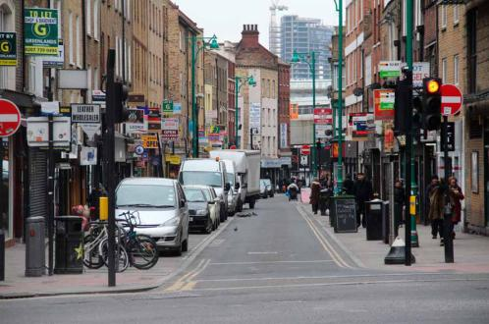
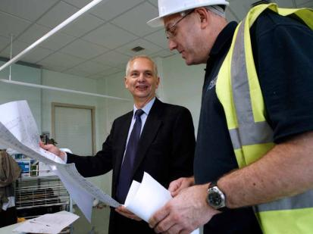
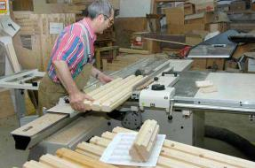

Slide 21
GOVERNANCE
JOBS
GROWTH
SKILLS
PEOPLE
ECONOMY
CAPACITY
LABOUR MOBILITY
DEMAND
ECONOMIC
STRUCTURE
LABOUR MARKET
INTELLIGENCE
CONNECTIONS
COMPETITION

Slide 22
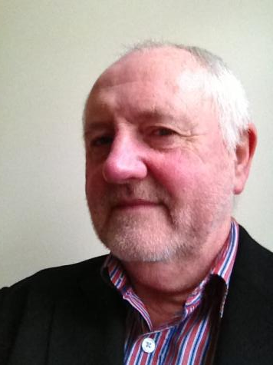
PROFESSOR MIKE CAMPBELL
Workstream Member

Slide 23
MORE JOBS: BETTER CITIES
A FRAMEWORK FOR CITY ACTIONS ON JOBS

Slide 24
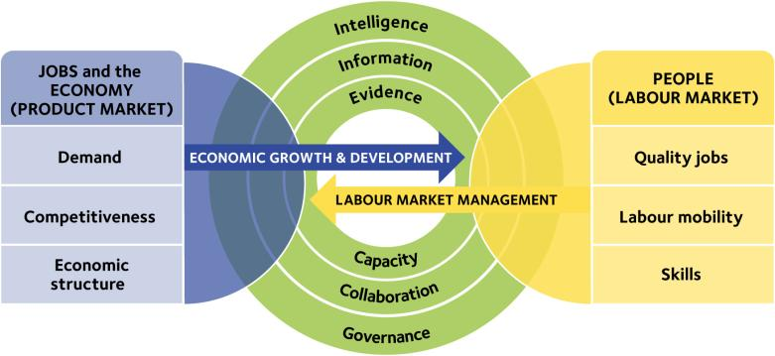

Slide 25
26,000,000
18,000,000

Slide 28
SUPPORTING URBAN YOUTH
THROUGH SOCIAL INNOVATION:
STRONGER TOGETHER

Slide 29
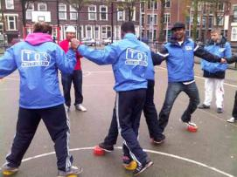
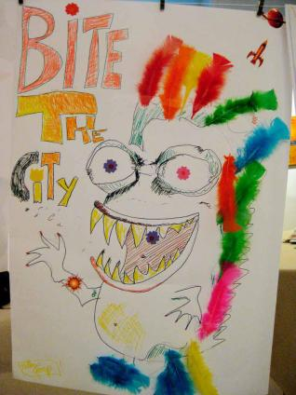
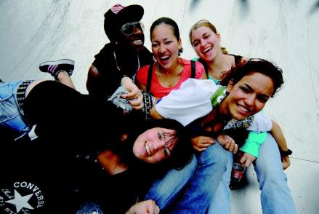

Slide 30
TRUST
RESILIENCE
SOCIAL INNOVATION
SPIRAL
VALUES
CO-PRODUCTION

Slide 31
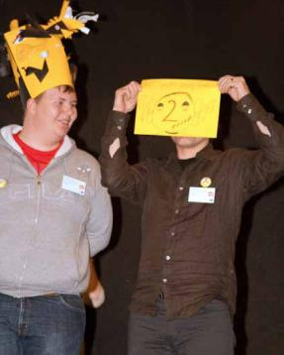
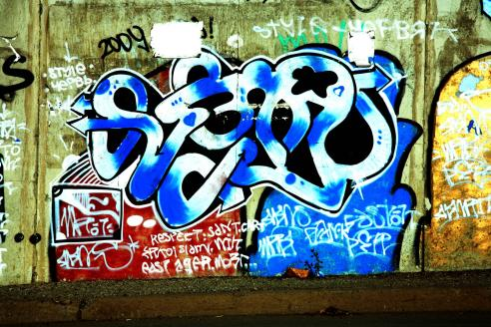
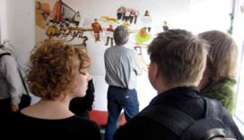

Slide 32
NEGOTIATIONS
TRUST
RESILIENCE
PUBLIC SECTOR
RENEWAL
DIALOGUE
SOCIAL INNOVATION
SPIRAL
UNUSUAL SUSPECTS
CO-PRODUCTION
VALUES

Slide 33
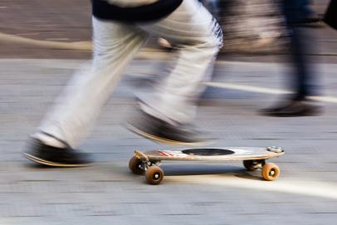
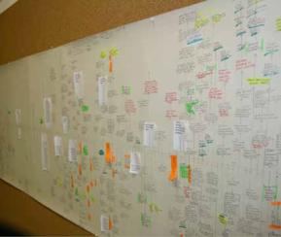
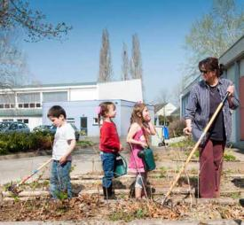
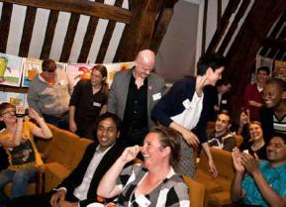
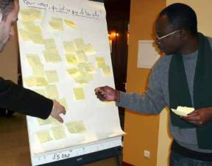

Slide 34
EXPERIMENTATION
TRUST
NEGOTIATIONS
HYBRID
RESILIENCE
PUBLIC SECTOR
RENEWAL
RAPPORT
LEADERSHIP
DIALOGUE
SOCIAL INNOVATION
SPIRAL
MICROCOSM
UNUSUAL SUSPECTS
CO-PRODUCTION
VALUES

Slide 35
EDDY ADAMS
Workstream Leader

Slide 36
SUPPORTING URBAN YOUTH
THROUGH SOCIAL INNOVATION:
STRONGER TOGETHER

Slide 38
AGAINST DIVIDED CITIES IN EUROPE

Slide 39
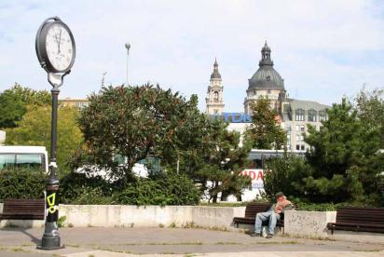
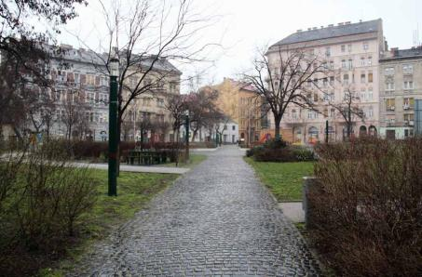
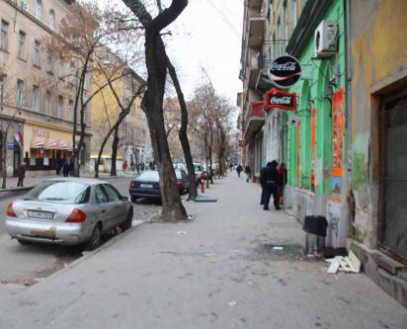

Slide 40
SOCIO-SPATIAL SEGREGATION
DEPRIVED NEIGHBOURHOODS
NO-GO AREAS
GATED COMMUNITIES

Slide 41
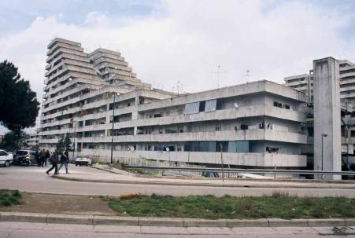
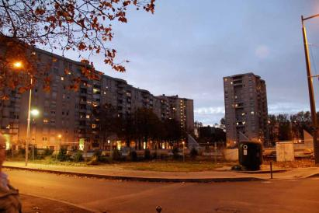
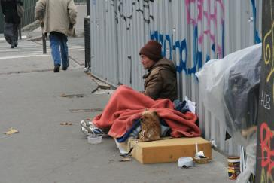
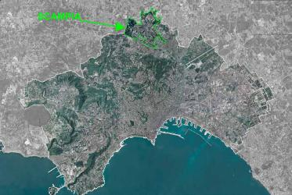

Slide 42
HORIZONTAL POLICIES
SOCIO-SPATIAL SEGREGATION
EQUAL QUALITY
EDUCATION
DEPRIVED NEIGHBOURHOODS
SOCIAL MIX
AREA BASED
INTERVENTIONS
NO-GO AREAS
DEMOLITION
GATED COMMUNITIES

Slide 43
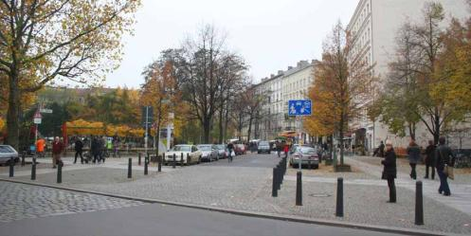
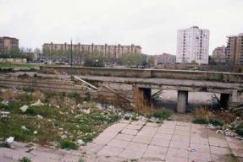

Slide 44
INCREASING
OPPORTUNITIES
HORIZONTAL POLICIES
SOCIO-SPATIAL SEGREGATION
SOCIAL COHESION
DEPRIVED NEIGHBOURHOODS
LOBBYING NATIONAL
POLICIES
EQUAL QUALITY
EDUCATION
AREA BASED
INTERVENTIONS
NO-GO AREAS
DEMOLITION
LONG-TERM VISION
SOCIAL MIX
GATED COMMUNITIES

Slide 45
IVAN TOSICS
Workstream Leader

Slide 46
AGAINST DIVIDED CITIES IN EUROPE

Slide 48
HOW CITIES CAN MOTIVATE
MOBILITY MINDSETS

Slide 50
MOTIVATION
ACCESSIBLE
TRIED & TESTED
LIVING LAB

Slide 52
MOTIVATION
ON DEMAND
ACCESSIBLE
SHARED SPACE
TRIED & TESTED
INTER MODALITY
MINDWARE
LIVING LAB

Slide 54
MOTIVATION
ON DEMAND
NEXT-GENERATION
ACCESSIBLE
ACTIVE
SHARED SPACE
COST EFFICIENCY
TRIED & TESTED
LIVING LAB
INTER MODALITY
LIVEABLE
SEAMLESS
TRAVEL
MINDWARE

Slide 55
SALLY KNEESHAW
Workstream Leader

Slide 56
HOW CITIES CAN MOTIVATE
MOBILITY MINDSETS

Slide 58
BUILDING ENERGY EFFICIENCY
IN EUROPEAN CITIES

Slide 60
ENERGY EFFICIENCY
FUEL POVERTY
DISTRICT
HEATING
URBAN
REGENERATION

Slide 62
ENERGY EFFICIENCY
LIFE CYCLE ASSESSMENT
FUEL POVERTY
DISTRICT HEATING
RETROFITTING
ENERGY
RATING
HERITAGE
URBAN
REGENERATION

Slide 64
LIFE CYCLE ASSESSMENT
ENERGY EFFICIENCY
LOCAL
SUPPLY CHAIN
FUEL POVERTY
RETROFITTING
DISTRICT HEATING
ECO-RESTORATION
CARBON
FOOTPRINT
URBAN
REGENERATION
ENERGY
RATING
RENEWABLE
ENERGIES
HERITAGE

Slide 65
ANTONIO BORGHI
Workstream Leader

Slide 66
BUILDING ENERGY EFFICIENCY
IN EUROPEAN CITIES

Slide 68
FROM CRISIS TO CHOICE:
RE-IMAGINING THE FUTURE
IN SHRINKING CITIES

Slide 70
SHRINKING
EVOLUTIONARY
CHANGE
SOCIO-ECONOMIC
DECLINE

Slide 72
MANAGE DECLINE
EVOLUTIONARY
CHANGE
STRATEGY
SOCIO-ECONOMIC
DECLINE
LEADERSHIP
ADAPTABILITY
SHRINKING

Slide 74
MANAGE DECLINE
LAND-CYCLE
MANAGEMENT
EVOLUTIONARY
CHANGE
ADAPTABILITY
LEADERSHIP
CO-PRODUCTION
INVESTMENT & PLANNING POLICIES
STRATEGY
SHRINKING
CITIES FOR
ALL AGES
SOCIO-ECONOMIC
DECLINE

Slide 75
HANS SCHLAPPA
Workstream Leader

Slide 76
FROM CRISIS TO CHOICE:
RE-IMAGINING THE FUTURE
IN SHRINKING CITIES

Slide 79
MESSAGES FOR CITIES… INNOVATE!

Slide 80
Question time
Czas na zapytania
Klausimų valanda
Jautājumu laiks
Kérdések órája
Tην ώρα των ερωτήσεων
Frågestund
Turno de preguntas
L'heure des questions
Doba vyhrazená pro otázky
Vprašanje časa
Kyselytunti
Spørgetid
vragenuurtje
Hodina otázok
Questão de tempo
Infotund
Ora interpelărilor

Slide 81
THE FUTURE FOR CITIES

Slide 82
TRANSNATIONAL EXCHANGE AND LEARNING NETWORKS
TRANSPORT HUBS
EARLY SCHOOL LEAVING
WOOD INDUSTRIES
PUBLIC SPACE
SUSTAINABLE FOOD
CITY BRANDING
YOUTH EMPLOYMENT
FINANCIAL
ENGINEERING
REGENERATION
OF TOWER BLOCKS
CITY-UNIVERSITY COLLABORATION
INNOVATION IN HEALTH
CREATIVE INDUSTRY
SPIN-OFFS
URBAN MARKETS

Slide 83
CAPACITY BUILDING
SUMMER UNIVERSITIES
NATIONAL TRAINING SCHEME
PILOT TRAINING FOR
ELECTED REPRESENTATIVES

Slide 85
DISSEMINATION OF RESULTS

Slide 86
GET READY FOR URBACT III

Slide 87
URBACT II has succeeded in building a method for exchange, learning and action planning
URBACT III will also:
Extend the networks from action planning to implementation
Continue and enhance capacity building
Develop stronger multi-level focus
Retain emphasis on the Europe 2020 objectives from an urban perspective

