Slide 1
URBACT CITIES IN POLAND – POTENTIAL AND PROPOSITIONS FOR APNs’

Slide 2
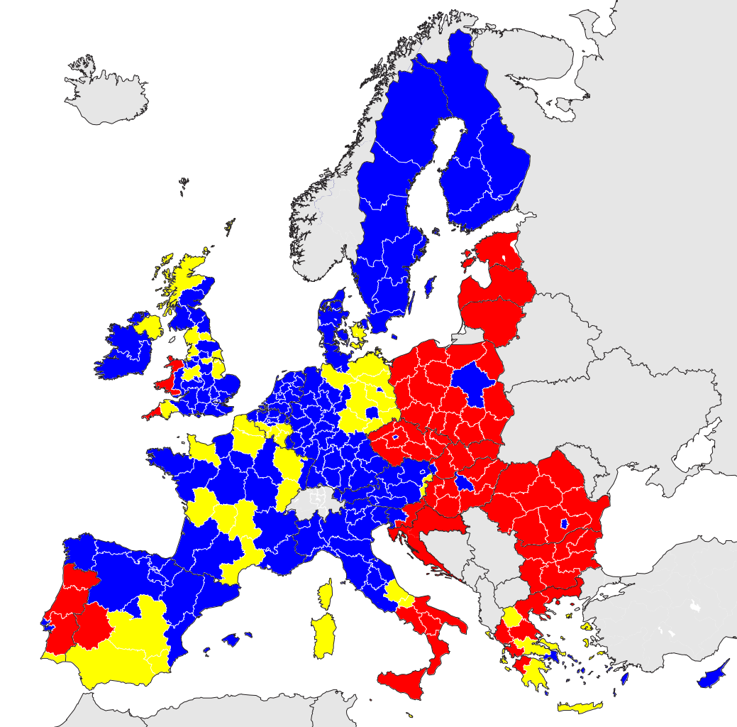
Classification of regions from 2014 to 2020:
Less developed regions
Transition regions
More developed regions
Madrid 2019

Slide 3
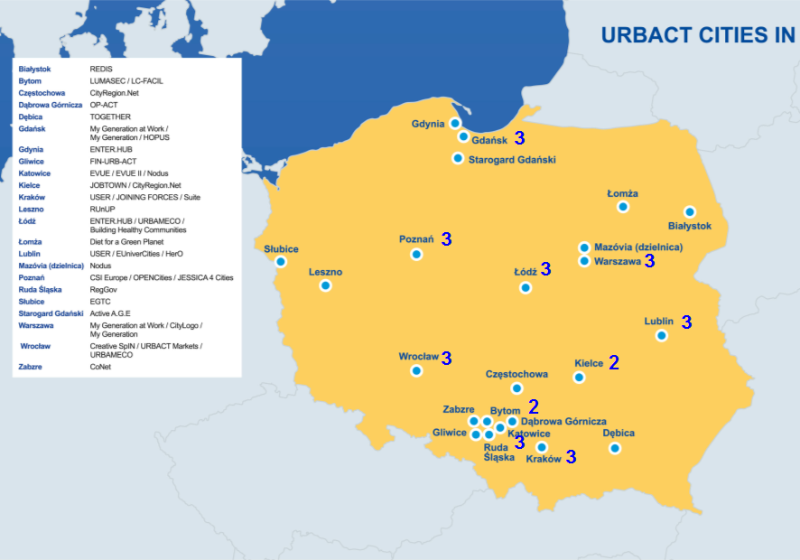
POLAND 2007- 2013

Slide 4
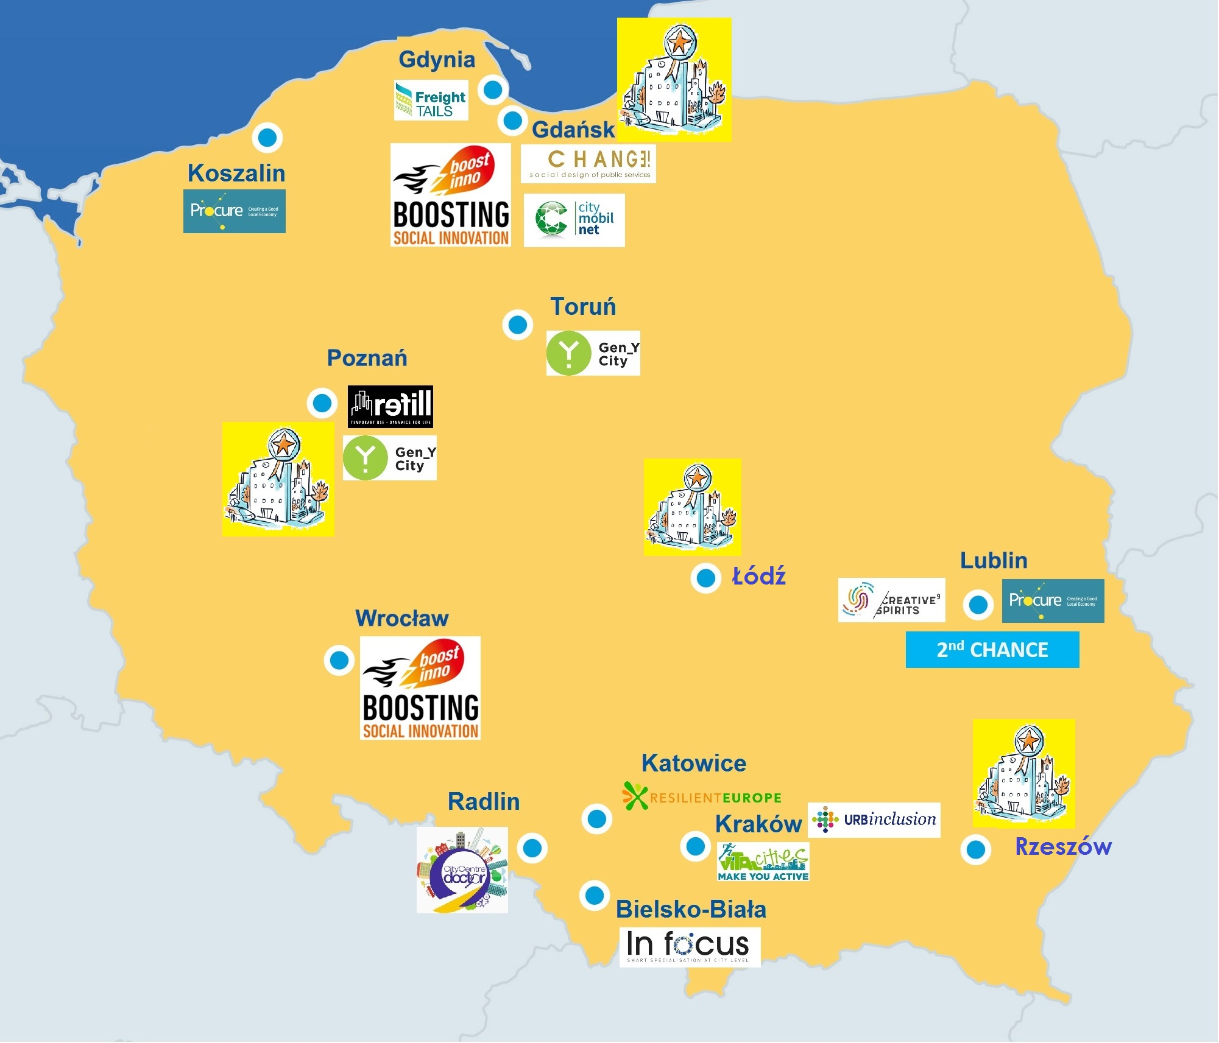
ACTION PLANNING NETWORKS (1st ROUND):
- 14 NETWORKS
- 12 CITIES
IMPLEMENTATION NETWORKS:
- 2 NET. / 2 CITIES
URBACT GOOD PRACTICES:
- 4 CITIES
Madrid 2019

Slide 5
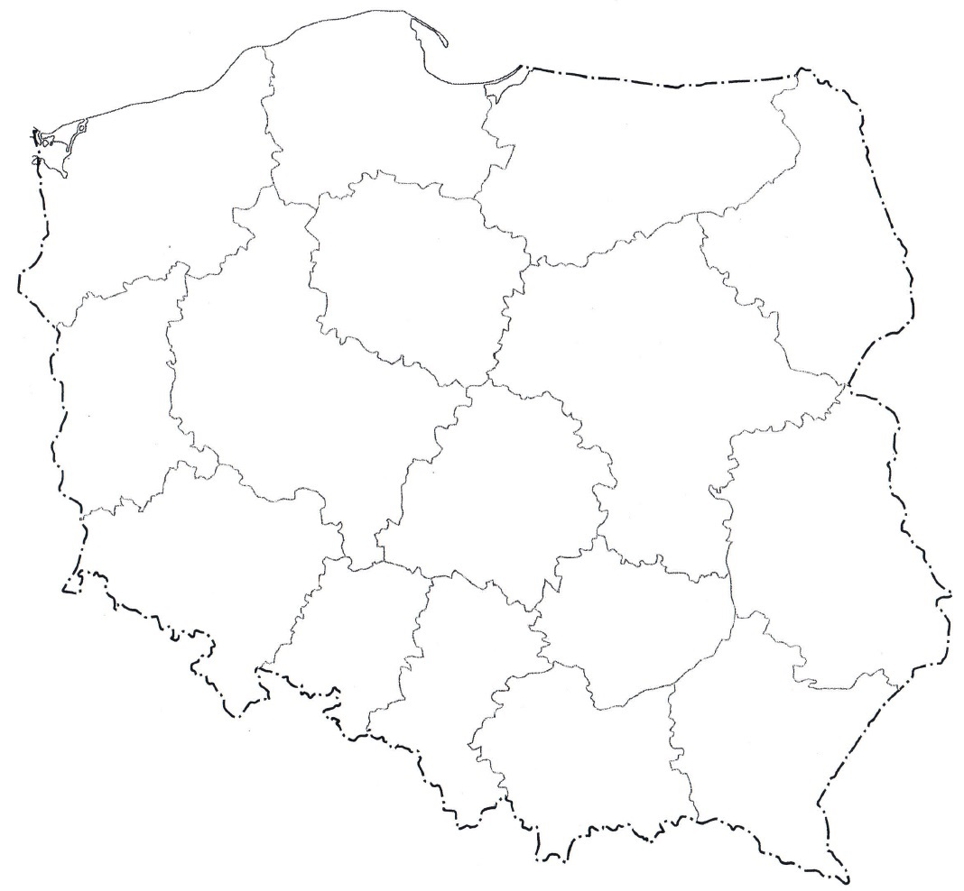
Uczestnicy pierwszych sieci Partnerskiej Inicjatywy Miast
Gdynia
Malbork
Olsztyn
Stowarzyszenie Białostockiego Obszaru Funkcjonalnego
CITIES IN THE PARTNER INITIATIVE FOR CITIES NATIONAL PROGRAMME
The „Polish URBACT”
Szczeciński Obszar Metropolitalny
Gryfino
Ostróda
Toruń
Opalenica
Łosice
Lider
Bojanowo
City:
Nowa Sól
Rawicz
Big
Legnica
Żmigród
Pabianice
Wałbrzych
Hrubieszów
Medium
Świebodzice
Nowa Ruda
Katowice
Stalowa Wola
Tomaszów Lubelski
Small
Functional Urban Area
Czechowice-Dziedzice
Urban Mobility
Urban Regeneration
Air Quality
Kudowa-Zdrój
Skawina
Tarnobrzeg
Jastrzębie-Zdrój
Pszczyna
Cieszyn
Wadowice
Przemyśl
Związek Międzygminny ds. Ekologii w Żywcu
Nowy Sącz

Slide 6
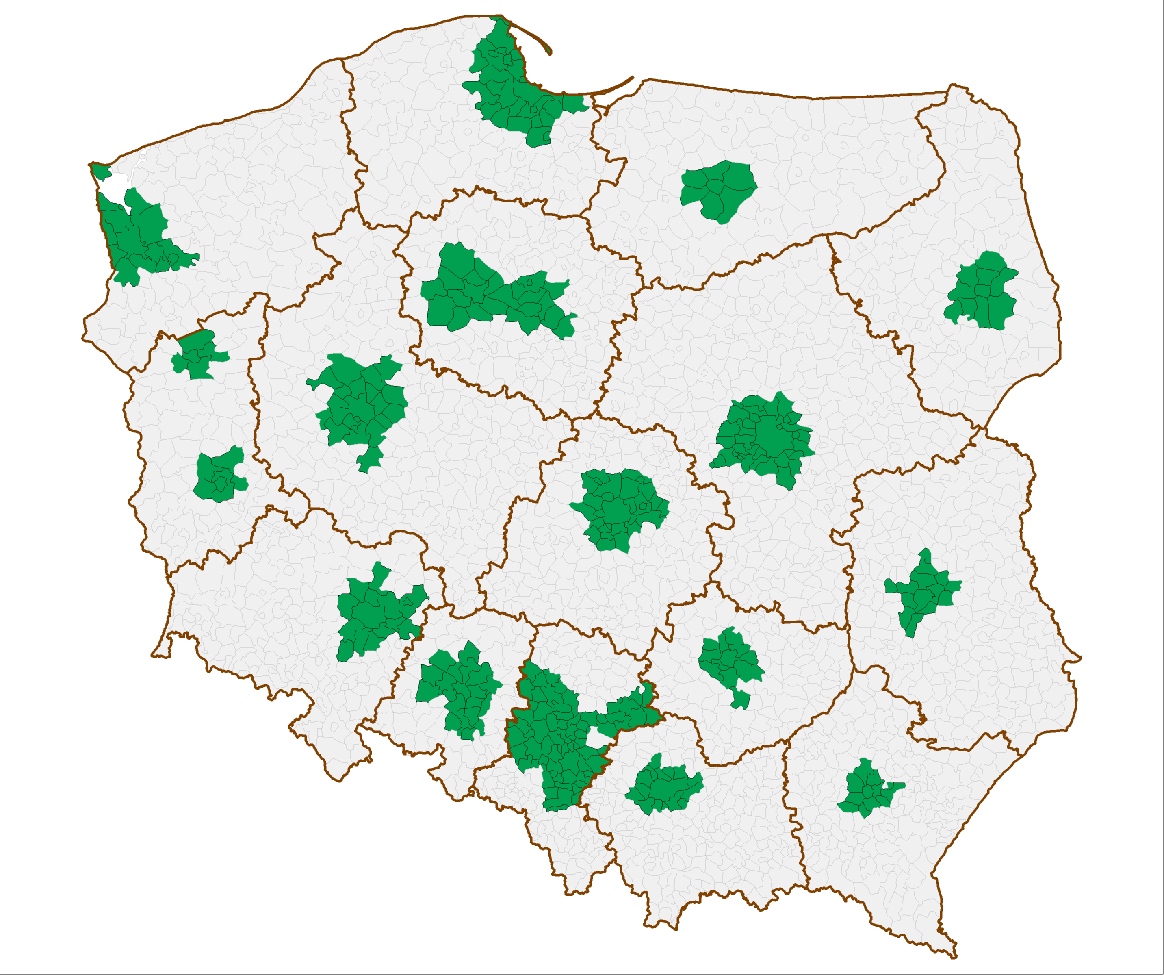
INTEGRATED TERRITORIAL INVESTMENT (Art. 7) - CITY ASSOCIATIONS IN POLAND

Slide 7
KALISZ-OSTRÓW AGGLOMERATION (southern Poland)
Senior policy - intergenerational bonds in the education process.
The idea of the project implemented in the Agglomeration Kalisz-Ostrow as the urban area of operation is to combine generations in the implementation of activities and creation of local communities, activation of the local community and intergenerational integration aimed at using the potential and experience of older people. These activities are to enable older people to develop talents, share their skills and actively spend free time, are also to promote the development of volunteering of older people and strengthen the advocacy of seniors' interests.

Slide 8
Project to improve of the functioning of the system of counteracting and limiting the effects of extreme phenomena in the Opole Agglomeration
– „Solidarity in the face of threats”
The main objective of this project are:
an analysis identifying the risk/threats in the area of the Opole Agglomeration and neighboring area,
assessing the potential of the Opole Agglomeration to remove the effects of extreme events,
proposals for the development of the Opole Agglomeration in the scope of preparation for activities during extreme events

Slide 9
SKAWINA CITY (near Krakow)
The Last Safe Kilometre” project addresses the topic of safe and sustainable mobility for, especially for school travel. These issues are closely related to city planning in terms of population spread and school accessibility as well as public space safety and quality. Our aim is also to tie mobility topics with urban/rural renewal. The project will be realised in alignment with the SDGs. “The Last Safe Kilometre” aims to exchange knowledge and experiences in the field of sustainable and safe mobility for children. The main aim of the project is to develop strategies and action plans that will allow us to create child friendly zones within a 1km radius from the school in urban and rural areas. The big aim is to develop a universal European strategy for the safety of children on the streets on the streets in order to achieve vision zero starting from the school surroundings . It will cover topics such as: streets as public spaces, traffic calming measures, universal design, 8-80 design approach, Placemaking - Lighter Quicker Cheaper methods, as well as, soft measures to tackle behavioral change within local societies.

Slide 10
NATIONAL URBACT POINT
Association of polish Cities
and Silesian Association of Municipalities and Districts
Website www.urbact.pl and urbact.eu/urbact-polska
facebook Krajowy Punkt Kontaktowy , Twitter - @URBACTpl
Contact: aldo.vargas@zmp.poznan.pl info@urbact.pl
Coordinator: Aldo Vargas-Tetmajer, ZMP

